Slide 1
Module 4. Validation and assessment
Author(s):
Evie Kouroumichaki
Institution:
Stimmuli for Social Change

Slide 2
Substantive content
Objectives
Glossary – Theoretical background
Teaching materials
Additional materials and resources
Case study
List of references

Slide 3
objectives

Slide 4
The training module
Objectives
The objectives of the present module are:
To enhance teachers’ knowledge on validating and assessment methodologies.
To boost teachers’ confidence to use innovative evaluation techniques, rather than exams or quizzes.
To prepare teachers with specific examples, who are going to apply the EduNUT curriculum within their classes.

Slide 5
The training module
Teaching methods: self paced reading, case study
Duration: 1,5 hours

Slide 6
Glossary

Slide 7
Main elements of Assessment & Evaluation
Learning assessment: Assessing learning is an essential part of measuring educational achievement, evaluating national educational systems, and monitoring learning progress.
Formative evaluation: The process of evaluation that happens during the program development, aiming to give information that will help the teacher improve their teaching strategy.
Summative evaluation: The type of evaluation that happens at the end of the implementation of the programme where the teacher evaluates the result.

Slide 8
Main elements of Assessment & Evaluation in eduNUT
Self-assessment evaluation: Student self-assessment involves students describing and evaluating the processes and products of their learning. Students evaluate the work they have produced and reflect on processes, actions and activities.
Rubrics: A rubric is a type of scoring guide tool used to assess specific components and expectations of learning, either that would be a single assignment or a module.
Competence assessment: A competency-based assessment, often referred to as CBA, is an approach used to measure individuals' skills, knowledge, and abilities related to a specific role or learning objective. This type of assessment focuses on the actual performance of an individual rather than mere theoretical knowledge.

Slide 9
Teaching materials

Slide 10
Validation & Educational assessment
Assessment of the learning process and outcomes

Slide 11
Validation
WHY
The validation method(s) used by the teacher, give information to themselves and students firstly, and administrators, colleagues and parents secondly, about the ways that learning is understood and measured.
HOW
There are several options for teachers to chose to understand the students’ learning progress.
The 2 most relevant methods are the formative and summative assessment.

Slide 12
Assessment Importance
The most valuable objective of assessment in education, is the advancement of teaching.
The advancement of teaching requires assessment of both students and teachers.
Student’s assessment aspires the identification of their current learning level, the factors that affect their progress, and finally the potential and skills in order to be specifically advanced.

Slide 13
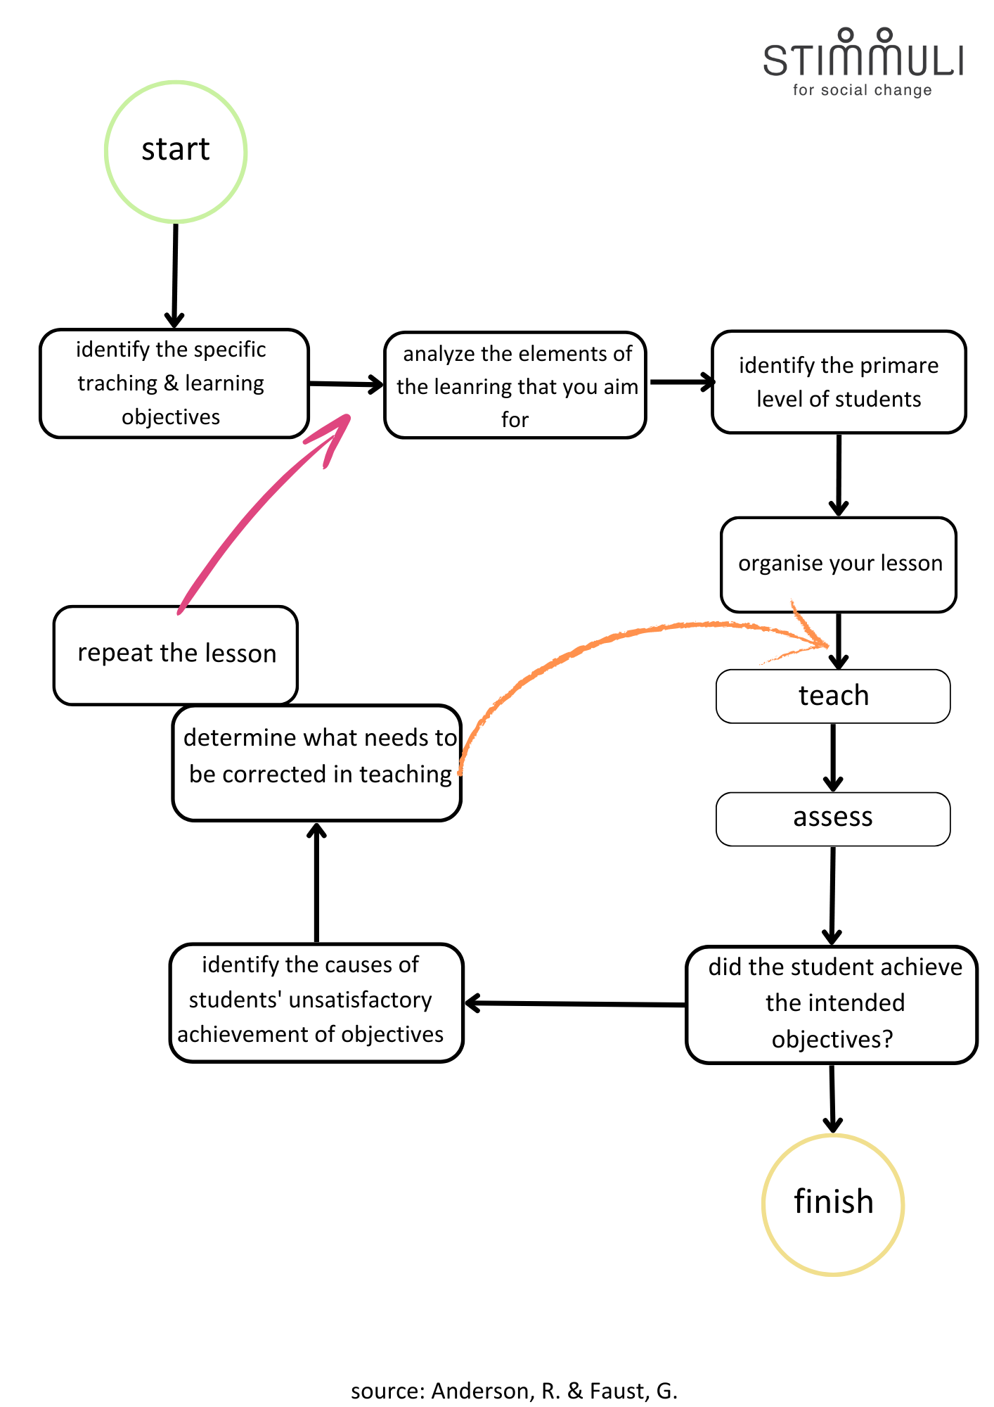
Assessment Process
A schematic representation of the assessment process.

Slide 14
Categorization of educational assessment
There are many types of educational assessment, the most common based on the learning process of which are:
Pre-assessment
Formative assessment
Diagnostic assessment
Summative assessment
There are many types of educational assessment, the most common based on the evaluating group of which are:
Teachers’ assessment
Students’ assessment
There are many types of educational assessment, the most common based on the learning outcome of which are:
Levels of knowledge acquired
Competencies gained

Slide 15
1/Categorization based on the process
Formative evaluation
Summative evaluation
Is an assessment for learning.
Helps the teacher & student to understand what they already know and how they learn.
Assesses the students’ progress in the classroom.
Could have the following format: quizzes, games, projects, presentations, discussions.
Is an assessment of learning.
Helps the teacher & the student to understand what they have learnt.
Assesses the student’s learning outcome at the end of the programme.
Could have the following format: final exams, reports, papers, end-of-class projects, open discussions.

Slide 16
2/Categorization based on the evaluating group
Teachers’ assessment
Students’ assessment
When the evaluating group of the learning process is teachers.
This type of assessment is mainly linked with more traditional learning styles.
When the evaluating group of the learning process is students themselves.
This type of assessment is mainly linked with student-based learning and transformative learning methodology.
Indicative
Self assessment // Co-assessment // Group assessment

Slide 17
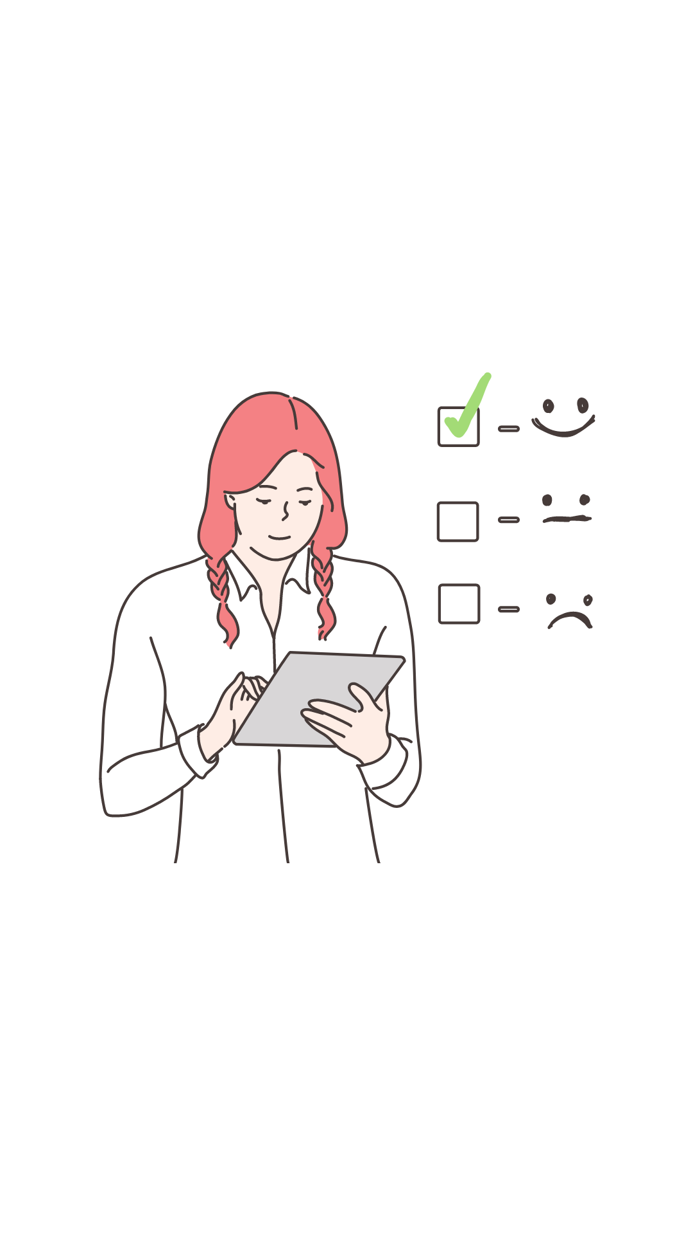
Student Self-assessment
Self-assessment mainly refers to the method of evaluation & pedagogical process where the learner 1)participates in the learning process actively, 2)tries to make sense and 3)judges the outcomes of their learning process.

Slide 18
Peer Assessment & Co-assessment
Peer Assessment refers to the method of evaluation in which a group of individuals (at least 2) rate each other. Peer assessment helps the students to be responsible, and to get insight in the criteria that determine the learning progress.
Co-assessment or collaborative assessment, is a method of evaluation in which both learners and educators participate in the assessment. It is not necessary for the student to rate themselves, but mainly to participate in the process, making a common sense with the educator.

Slide 19
3/Categorization based on the evaluating outcome
Knowledge assessment
Competence assessment
Evaluates the knowledge which is measured against a standard knowledge base.
Evaluates how competent the individual is in applying that knowledge, and skills.

Slide 20
Competence assessment
Competencies are “context-specific cognitive dispositions” that differ from constructs such as “intelligence” or “mental growth”.
Competencies refer to the ability of a person to advance a set of specific challenges in specific situations in specific domains, where intelligence relates to a set of skills or/and mental abilities, and attitudes that can be used to resolve and master challenges.
According to OECD, the definition of competencies is in line with the way which the term “competence” is used in international large-scale assessment studies such as PISA or PIRLS.

Slide 21
Competence assessment
Skills are “context-specific cognitive dispositions” that differ from constructs such as “intelligence” or “intellectual development”.
Skills refer to an individual’s ability to advance a set of specific challenges in specific situations in specific domains, where intelligence refers to a set of skills and/or mental abilities and attitudes that can be used to solve and address the challenges.
Σύμφωνα με τον ΟΟΣΑ, ο ορισμός των ικανοτήτων συνάδει με τον τρόπο με τον οποίο χρησιμοποιείται ο όρος «ικανότητα» σε διεθνείς μελέτες αξιολόγησης μεγάλης κλίμακας, όπως η PISA ή η PIRLS.

Slide 22
Assessment tools
Tools and methods used in the competence assessment method

Slide 23
Assessment tools
Traditional assessment tools
Alternative assessment tools

Slide 24
Assessment tools – Traditional tools
Open-ended test
True-False test
Multiple choice test
Matching test
Oral exam

Slide 25
Assessment tools – Alternative tools
Performance assignment
Project work (project-based learning)
Structured grid - Rubric
Portfolio
Peer Evaluation & Co-evaluation form
Self-evaluation form
Concept maps
Interview
Attitude scale

Slide 26
Structured Grids - Rubrics
Rubrics can serve both educational and evaluative purposes. When integrated into a formative, student-focused assessment strategy, rubrics can aid students in building understanding and skills/competencies, while also enabling them to accurately assess the quality of their own work.

Slide 27
Rubrics for Competence assessment
Competencies are general statements that describe either a set of desired knowledge, skills and attitudes of a students, or one specific skill, when students finish their learning process.
*The ideas presented here are applicable for anyone who wants or uses rubrics in the classroom, regardless of the discipline or grade level.

Slide 28
Rubrics – Designing effective rubrics
Identification of the qualities and attributes that you want to observe in the students’ outputs.
Set the learning objectives descriptively.
Decide the scale of the grid, there are more complex grids, with 5 scale metrics, but also minimal designs with 4 or even 3 scales of grading.

Slide 29
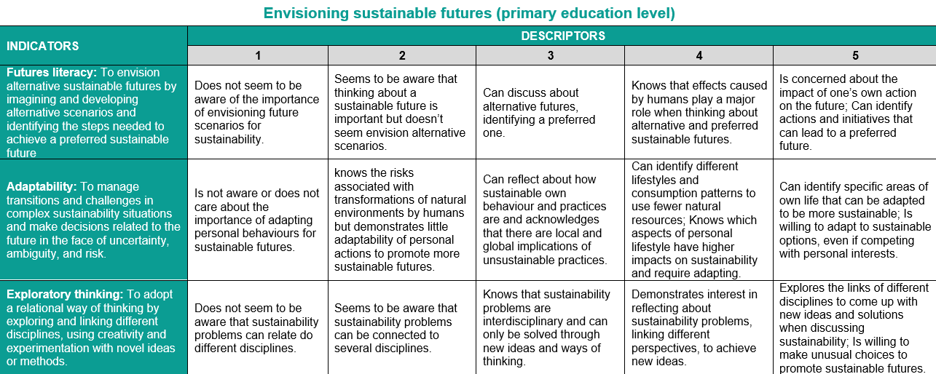
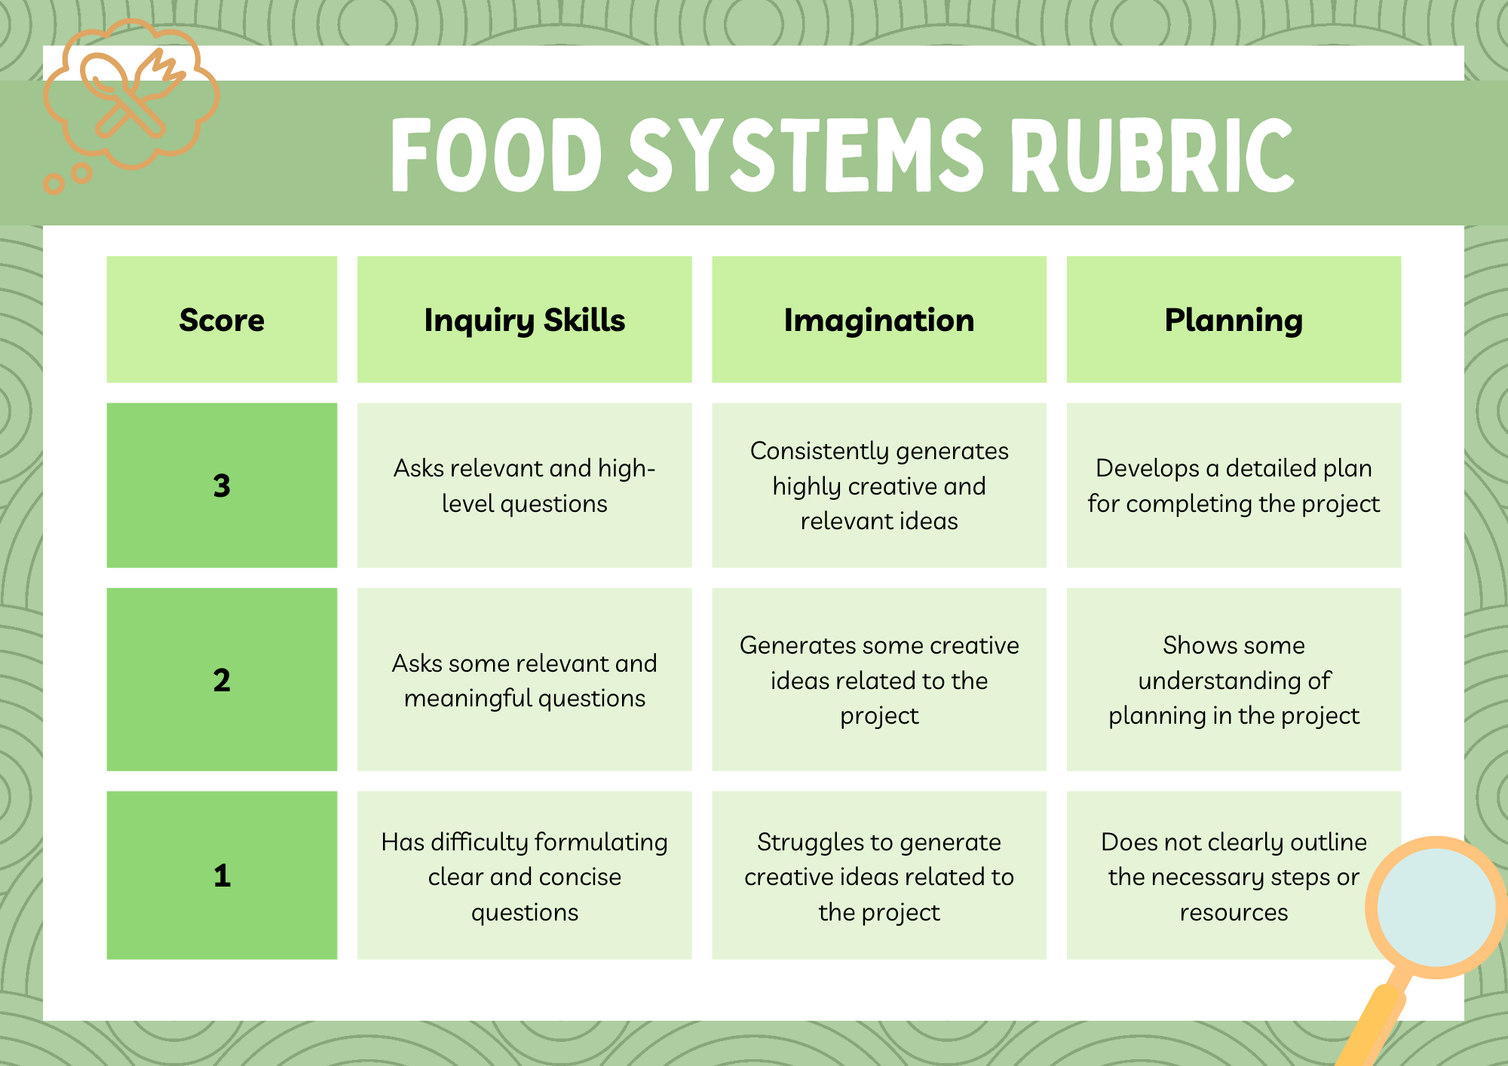
Rubrics – Designing effective rubrics

Slide 30
Rubrics – Designing effective rubrics
3 categories are commonly examined to support the validity and should be considered in the development of scoring rubrics:
Fairness
Construct-related Evidences
Criterion-related Evidences
*Those categories are being utilized for validation of assessment tools in general, not only for rubrics.
** Those categories are being updated in time.

Slide 31
Rubrics – Designing effective rubrics
Make sure that the rubric is not biased against specific socioeconomic, cultural, ethnic, gendered subgroups.
Fairness
Construct-related Evidences
Make sure that the score validates a specific construct. For example, if you are checking a written paper for “problem solving” you want mark any score because of spelling mistakes.
Criterion-related Evidences
Make sure that you assess a construct that predicts either current (concurrent validity) or future (predictive validity) real-life performance or other external outcomes of interest.

Slide 32
Rubrics – Ranking the outcome
In order to calculate and rank the students’ learning growth, we look at each one of the criteria for the outcomes and give a comment/rank as insufficient,, sufficient, good or excellent.
To calculate the final grade in a scale of 10, add all the grades together and double the grade for the presentation, then divide the outcome by 10. round up or down to full or half.
If you teaches in classes where you can use different grading systems, that uses for example notions, such as ‘insufficient’, ‘sufficient’, ‘good’, and ‘excellent’, you can use the following standards:
Between 5 and 6: insufficient
Between 6 and 7: sufficient
Between 7 and 9: good
Between 9 and 10: excellent.

Slide 33
Competence assessment in the EduNUT project
The eduNUT project aims to boost students to become confident, and gain skills, attitudes and knowledge about sustainable food systems and nutrition, in order to progressively change their personal consumption patterns, and inspire other to do the same.
A competence-based education helps students to develop such green skills based on knowledge and attitudes that can help promote responsible action and stimulate willingness to take or demand action at local, national and global level.
To succeed that, the eduNUT curriculum would be designed based on the European framework for green competence assessment “GreenComp”. The European Commission has developed it on sustainability competences at EU level, to provide a common ground to learners and guidance to educators, providing an agreed definition of what sustainability as a competence entails.
GreenComp can support education and training systems in shaping systemic and critical thinkers who care about our planet’s present and its future. All 12 competences of the framework are applicable to all learners. Among those 12, we have concluded to work with the following three: 1. Embracing complexity in sustainability, 2. Envisioning sustainable futures and 3. Acting for sustainability.

Slide 34
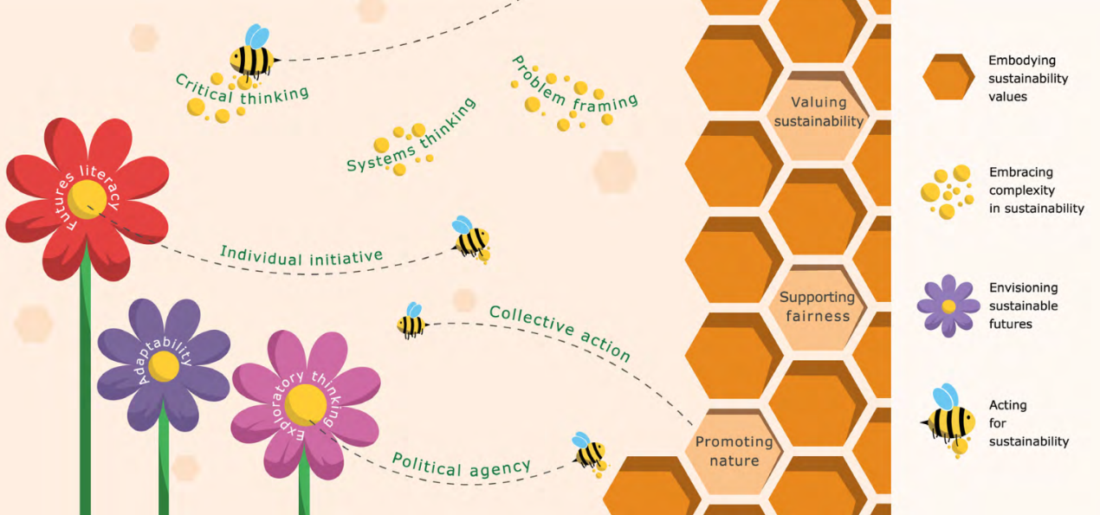
Competence assessment in the EduNUT project
Image: visual presentation of the sustainability competence/source: JRC, 2022

Slide 35
Additional materials and sources of information

Slide 36
EU Competence Frameworks
GreenComp: The European sustainability competence framework
LifeComp: The European framework for the personal, social and learning to learn key competence
DigComp 2.2: The Digital Competence Framework for Citizens - With new examples of knowledge, skills and attitudes

Slide 37
Assessment Grid Tools & Resources
AI tools: Enter in the chat the names of the competencies, module, ages of students, scale and metric system.
Excel / Google Sheets: For spreadsheet enthusiasts, these tools give you great flexibility in designing your grids.
ChallengeMe: A platform offers you an intuitive interface for creating, managing and evaluating peer-based activities.
iRubric: A platform that can help your organization develop a culture of outcomes-based assessments and manage data.

Slide 38
Case study

Slide 39
Case study – design an assessment rubric
You are a teacher of 13 years old students, and you have the overview of implementing a project with the title “farm to table”, that lasts for 4 weeks in total. The educational programme is designed in a way that promotes student-based learning about sustainable farming and nutrition. It promises to cultivate 4 skills to students (knowledge of ecological farming, collaboration, active citizenship, and futures literacy). Now, give your best and try to design a rubric that can assess at least 1 out of those competencies.

Slide 40
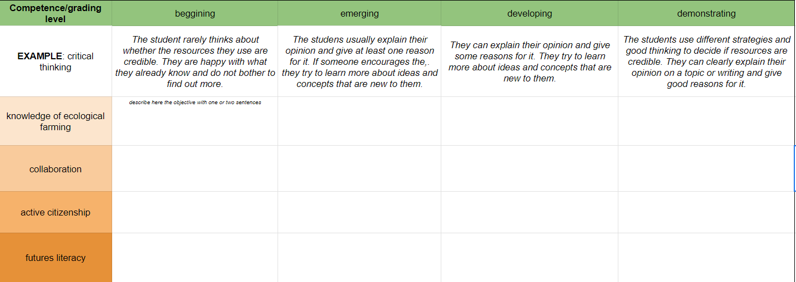
Case study – design an assessment rubric
√ Download the excel sheet and work locally.
↓Click: EduNUT_WP3_module 4_rubric template

Slide 41
List of references

Slide 42
Bianchi, G., Pisiotis, U. and Cabrera Giraldez, M. (2022). GreenComp The European sustainability competence framework, Punie, Y. and Bacigalupo, M. editor(s), EUR 30955 EN, Publications Office of the European Union, Luxembourg, 2022, ISBN 978-92-76-46485-3, doi:10.2760/13286, JRC128040.
Cox, J., B. Foster and D. Bamat (2019). A review of instruments for measuring social and emotional learning skills among secondary school students, U.S. Department of Education, Institute of Education Sciences, National Center for Education Evaluation and Regional Assistance, Regional Educational Laboratory Northeast & islands.
Çalışkan, H., & Kaşıkçı, Y. (2010). The application of traditional and alternative assessment and evaluation tools by teachers in social studies. Procedia-Social and Behavioral Sciences, 2(2), 4152-4156.
Bianchi, G., Pisiotis, U., Cabre- ra Giraldez, M. (2022). GreenComp – The European sustainability competence framework. Bacigalupo, M., Punie, Y. (editors), EUR 30955 EN, Publications Office of the European Union, Luxembourg; ISBN 978-92-76-46485-3, doi:10.2760/13286, JRC128040.
Linzarini, A. and D. Catarino da Silva (2024). Innovative tools for the direct assessment of social and emotional skills, OECD Education Working Papers, No. 316, OECD Publishing, Paris, https://doi.org/10.1787/eed9bb04-en
Van den Bergh, V., et. al. (2006). NEW ASSESSMENT MODES WITHIN PROJECT-BASED EDUCATION – THE STAKEHOLDERS. Studies in Educational Evaluation 32 (2006) 345–368

