Slide 1
Module 2. Low emission strategies
Responsible authors:
Katarzyna Halicka, Zofia Kołoszko-Chomentowska, Anna Kononiuk, Ewa Rollnik-Sadowska, Julia Siderska, Danuta Szpilko

Slide 2
Substantive content:
Reasons to move towards sustainable development.
Clean energy and sustainable transport – pillars of the UE Green Deal strategy.
Theoretical issues of renewable energy sources and sustainable transportation.
Good practices of reducing greenhouse gas emissions.
Presentation of the 6 hats technique for creative problem solving.
Presentation of the scenario analysis for creative problem solving.

Slide 3
General Information

Slide 4
Objectives of the training module:
Understanding the importance of shifting towards low-carbon emission technologies.
Understanding the potential of renewable energy sources and sustainable transportation.
Showing examples of good practices referring to reducing greenhouse gas emissions.
Developing creative thinking competencies.
Teaching methods: lectures, case studies, practical exercises, self-study of additional literature
Duration: 5 hours

Slide 5
Glossary

Slide 6
biomass (solid biofuels) organic, non-fossil material of biological origin, which may be used for heat production or electricity generation. It includes: charcoal; wood and wood waste; black liquor, bagasse, animal waste and other vegetal materials and residuals
https://ec.europa.eu/eurostat/web/interactive-publications/energy-2023#
carbon footprint - the total greenhouse gas (GHG) emissions caused directly and indirectly by an individual, organization, event or product.”1 It is calculated by summing the emissions resulting from every stage of a product or service’s lifetime (material production, manufacturing, use, and end-of-life).
Center for Sustainable Systems, University of Michigan. 2023. "Carbon Footprint Factsheet." Pub. No. CSS09-05.
climate change can be defined as the shift in climate patterns mainly caused by greenhouse
gas emissions
Fawzy, S., Osman, A.I., Doran, J. et al. Strategies for mitigation of climate change: a review. Environ Chem Lett 18, 2069–2094 (2020). https://doi.org/10.1007/s10311-020-01059-w
geothermal energy the energy available as heat from within the earth’s crust, usually in the form of hot water or steam.
https://ec.europa.eu/eurostat/web/interactive-publications/energy-2023#

Slide 7
greenhouse gases consist of carbon dioxide, methane, ozone, nitrous oxide, chlorofluorocarbons, and water vapor
https://climate.nasa.gov/faq/19/what-is-the-greenhouse-effect/#:~:text=Greenhouse%20gases%20consist%20of%20carbon,that%20initially%20caused%20the%20warming.
hydropower/hydroelectric the electricity generated from the potential and kinetic energy of water in hydroelectric plants (the electricity generated in pumped storage plants is not included). https://ec.europa.eu/eurostat/web/interactive-publications/energy-2023#
hydrogen is the most abundant element available on our planet, two-thirds of which is water. This element can be used as a zero-carbon fuel if we separate it.
https://www.greenmatch.co.uk/blog/2021/09/advantages-and-disadvantages-of-renewable-energy#types-of-renewable-energy
low-emission strategies cover a range of approaches aimed at reducing greenhouse gas emissions and pollutants released into the atmosphere. They are implemented across different sectors, focusing on minimizing emissions from human activities. They are commonly deployed in areas such as improving public transport systems and enhancing energy efficiency practices.
Honegger, M.; Michaelowa, A.; Poralla, M. Net-zero emissions: The role of Carbon Dioxide Removal in the Paris Agreement. Policy Briefing Report. Perspectives Climate Research, Freiburg 2019.

Slide 8
photovoltaic (PV) technology is the most efficient technique to convert radiant energy into electrical energy. Solar cells are photoelectric energy conversion devices that employ the photoelectric effect to convert sunlight to electricity. Solar cells and associated components make up a photovoltaic system.
Saleh W.H., Jadallah A.A., Shyraiji A.L. (2022): A Review for the Cooling techniques of PV/T Solar Air Collectors. Engineering and Technology Journal, 40(01): 129-136. DOI:10.30684/etj.v40i1.2139
renewable energy sources, energy sources whose use is not associated with long-term deficit, because their resources are renewed in a relatively short time (renewable raw materials). Such sources are: sun, wind, biomass, biogas and biofuels. Renewable energy also includes heat obtained from the ground (geothermal energy), air (aerothermal energy), and water (hydrothermal energy). Renewable energy plays a vital role for saving environment
Hamed, T. A., and A. J. J. O. S. D. O. E. Alshare. 2022. Water, and E. Systems, environmental impact of solar and wind energy-a review. Journal of Sustainable Development of Energy, Water and Environment Systems 10 (2):1–23. doi:10.13044/j.sdewes.d9.0387.

Slide 9
solar energy reaches the Earth in the form of solar radiation. The sun is currently considered to have the greatest fuel and energy potential. It can be processed in the photovoltaic, photothermal or photochemical conversion process. The advantages of solar energy include: the unlimited nature of its resources and its universality, thanks to which it is used almost everywhere on Earth. Solar energy is already the least expensive source of electricity accessible in several nations throughout the world.
Shiradkar, N., R. Arya, A. Chaubal, K. Deshmukh, P. Ghosh, A. Kottantharayil, S. Kumar, and J. Vasi. 2022. Recent developments in solar manufacturing in India. Solar Compass 1:100009. doi:10.1016/j.solcom.2022.100009.
sustainable transportation refers to low- and zero-emission, energy-efficient, and affordable modes of transport, including electric and alternative-fuel vehicles, as well as domestic fuels.
https://www.energy.gov/eere/sustainable-transportation-and-fuels
tidal energy or ocean energy is the hydropower energy we can get from tides. This energy is sometimes sorted under the category of hydropower, not in a separate one.
https://www.greenmatch.co.uk/blog/2021/09/advantages-and-disadvantages-of-renewable-energy#types-of-renewable-energy
wind energy: the kinetic energy of wind converted into electricity in wind turbines.
https://ec.europa.eu/eurostat/web/interactive-publications/energy-2023#

Slide 10
Teaching materials

Slide 11
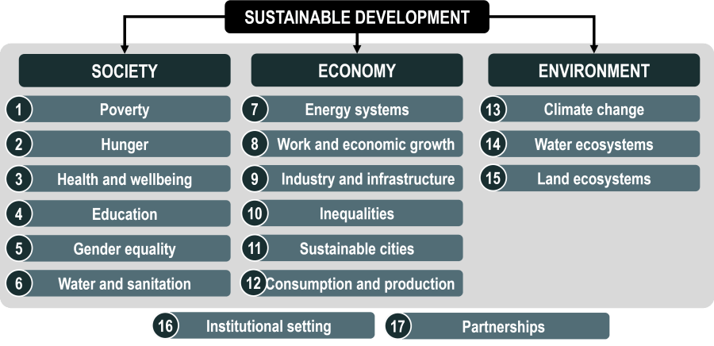
Sustainable development meets the needs of the present without compromising the ability of future generations to meet their needs. It creates an optimal balance between economic, environmental, and social dimensions of sustainability and shows the need to integrate those aspects of development and politics. Environmental sustainability preserves natural resources, minimizes pollutants, and reduces impacts on ecosystems as climate change. Social sustainability considers health and safety considerations, access, and distribution of benefits and costs among community groups, and economic sustainability focuses on economic growth, cost-effectiveness, and financial sustainability.
Heidari I., Eshlaghy A.T., Hoseini S.M.S., Sustainable transportation: Definitions, dimensions, and indicators – Case study of importance-performance analysis for the city of Tehran, Heliyon, 9(2023), https://doi.org/10.1016/j.heliyon.2023.e20457
1) UN, Transforming Our World: The 2030 Agenda for Sustainable Development (UN, New York, 2015); http://bit.ly/TransformAgendaSDG-pdf 2) https://transportgeography.org/contents/chapter4/transportation-sustainability-decarbonization/three-e-development/

Slide 12
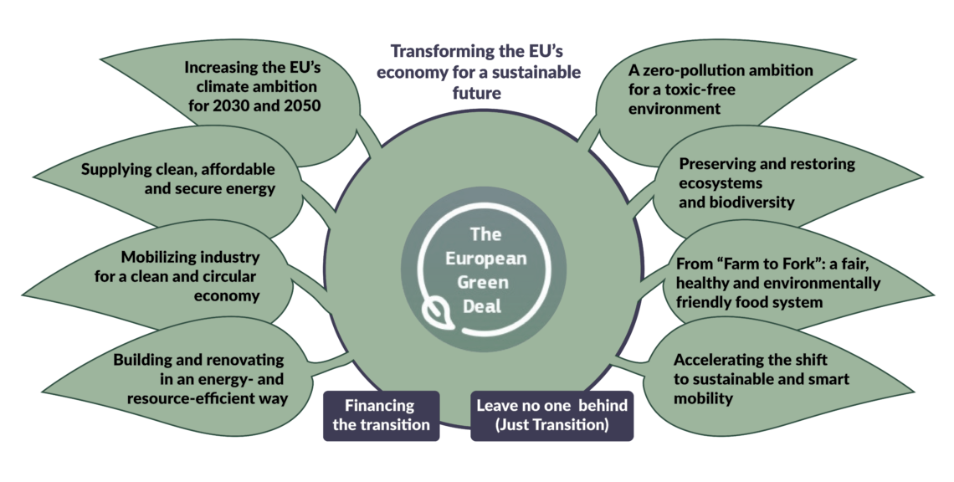
1) Communication from The Commission to The European Parliament, The European Council, The Council, The European Economic and Social Committee and The Committee of the regions. The European Green Deal. COM (2019) 640 Final, 11.12.2019.
2) Website of the Geopolitical Intelligence Services AG, https://www.gisreportsonline.com/r/european-green-deal/

Slide 13
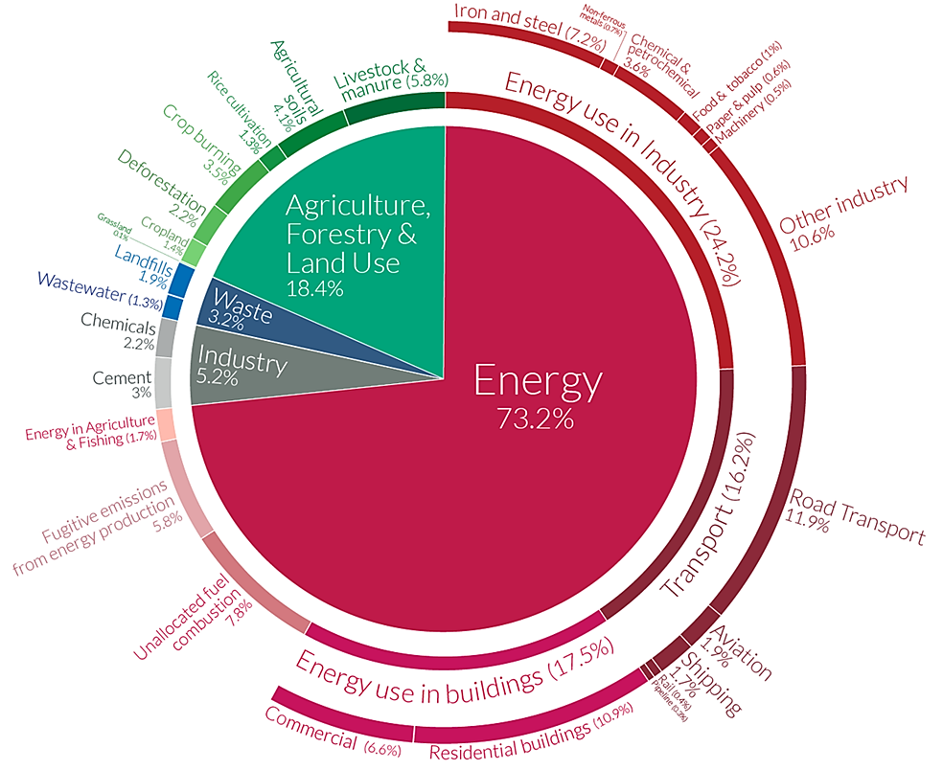
Global greenhouse gas emissions by sector
Sector | Global GHG Emissions Share
Energy Use | 73.2%
Agriculture, Forestry & Land Use | 18.4%
Industrial processes | 5.2%
Waste | 3.2%
Sub-sector (Energy Use) | GHG Emissions Share | Further breakdown
Transport | 16.2% | • Road 11.9% • Aviation 1.9% • Rail 0.4% • Pipeline 0.3% • Ship 1.7%
https://www.visualcapitalist.com/a-global-breakdown-of-greenhouse-gas-emissions-by-sector/

Slide 14
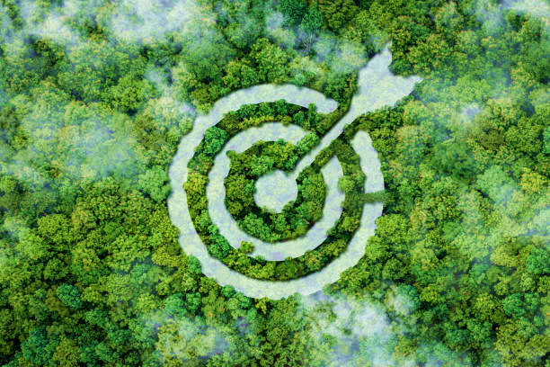
Strategic objectives
To achieve climate neutrality by 2050 (a 90% reduction in transport emissions is needed by 2050 since transport accounts for a quarter of the EU’s greenhouse gas emissions).
Decarbonizing the energy system is critical to reach climate objectives in 2030 and 2050
The production and use of energy across economic sectors account for more than 75% of the EU’s greenhouse gas emissions.
A power sector must be developed and based on renewable sources, complemented by the rapid phasing out of coal and decarbonizing gas.
New technologies, sustainable solutions, and disruptive innovation are critical to achieve the objectives of the European Green Deal.
www.unsplash.com
Source: 1) Communication from The Commission to The European Parliament, The European Council, The Council, The European Economic and Social Committee and The Committee of the regions. The European Green Deal. COM (2019) 640 Final, 11.12.2019.
2) Communication from The Commission to The European Parliament, The Council, The European Economic and Social Committee and The Committee of the regions. Sustainable and Smart Mobility Strategy – Putting European transport on truck fot the future. COM (2020) 789 Final, 9.12.2020.

Slide 15
Low-emission strategies encompass a diverse array of approaches and initiatives specifically crafted to mitigate the release of greenhouse gases and other pollutants into the atmosphere. These strategic measures are commonly deployed across various sectors, emphasizing the reduction of emissions linked to human activities. Notably, two key domains where low-emission strategies are extensively employed are in enhancing public transport systems and optimizing energy efficiency practices.
Honegger, M.; Michaelowa, A.; Poralla, M. Net-zero emissions: The role of Carbon Dioxide Removal in the Paris Agreement. Policy Briefing Report. Perspectives Climate Research, Freiburg 2019.
Focus in on:
>> Low Carbon Growth
Avoid ecologically sensitive impacts of transportation by ensuring lower emissions from direct and indirect processes.
Reduce average emission factor per ton km
>> Climate Resilient Growth
Build transport system immune to effects of climate change – climate proofing transport infrastructure
>> Access and mobility
www.pixabay.com
https://www.slideshare.net/aishwarykgupta/sustainable-transportation-71408026

Slide 16
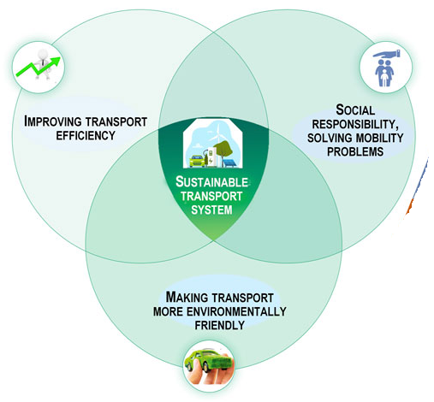
What can be done?
A key objective is to boost considerably the uptake of clean vehicles and alternative fuels
The deployment of recharging and refuelling points where persistent gaps exist
The low-emission energy transformation ensures the implementation of the so-called European triad of goals (energy security, energy competitiveness and climate protection)
Jałowiec T, Wojtaszek H, Miciuła I. Analysis of the Potential Management of the Low-Carbon Energy Transformation by 2050. Energies. 2022; 15(7):2351. https://doi.org/10.3390/en15072351
Fossil fuels as an energy source are replaced by non-fossil/ renewable energy sources (e.g. geothermal, solar, hydro, wind, nuclear), which do not release CO2 emissions to generate energy
Cadez S., Czerny A., Climate change mitigation strategies in carbon-intensive firms, Journal of Cleaner Production, 112, Part 5, 2016, 4132-4143, https://doi.org/10.1016/j.jclepro.2015.07.099.
Makarova I, Buyvol P, Shubenkova K, Fatikhova L and Parsin G (2023) Editorial: Sustainable transport systems. Front. Built Environ. 9:1161361. doi: 10.3389/fbuil.2023.1161361

Slide 17
Sustainable transportation
The Canadian Department of Transportation believes that all transportation activities must be sustainable from three aspects: economic, environmental, and social.
The main focus of (ST) has been on reducing resource consumption and controlling the environmental degradation and pollution caused by the consumption of petroleum derivatives in cars, and it is the result of people's widespread concern about global warming, which is part of sustainable development. Zhou J., Sustainable transportation in the US: a review of proposals, policies, and programs since 2000, Front. Archit. Res. 1 (2012) 150–165
Considers economic and social well-being, equity, human health, and environmental integrity.
Pålsson, H., Kovács, G. (2014), Reducing transportation emissions : A reaction to stakeholder pressure or a strategy to increase competitive advantage, International Journal of Physical Distribution & Logistics Management, Vol. 44 No. 4, pp. 283-304. https://doi.org/10.1108/IJPDLM-09-2012-0293
www.pixabay.com
www.pixabay.com

Slide 18
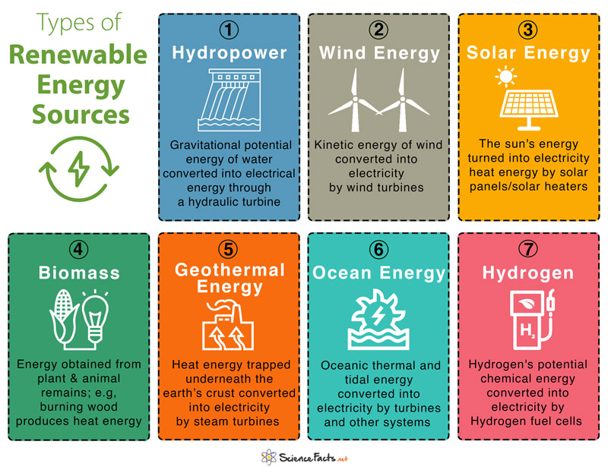
Renewable energy sources
Energy sources are those whose use is not associated with long-term deficit, because their resources are renewed in a relatively short time (renewable raw materials). Such sources are: sun, wind, biomass, biogas, and biofuels. Renewable energy also includes heat obtained from the ground (geothermal energy), air (aerothermal energy), and water (hydrothermal energy). Renewable energy plays a vital role for saving the environment.
Hamed, T. A., and A. J. J. O. S. D. O. E. Alshare. 2022. Water, and E. Systems, environmental impact of solar and wind energy-a review. Journal of Sustainable Development of Energy, Water and Environment Systems 10 (2):1–23. doi:10.13044/j.sdewes.d9.0387.
https://www.sciencefacts.net/types-of-renewable-energy.html

Slide 19
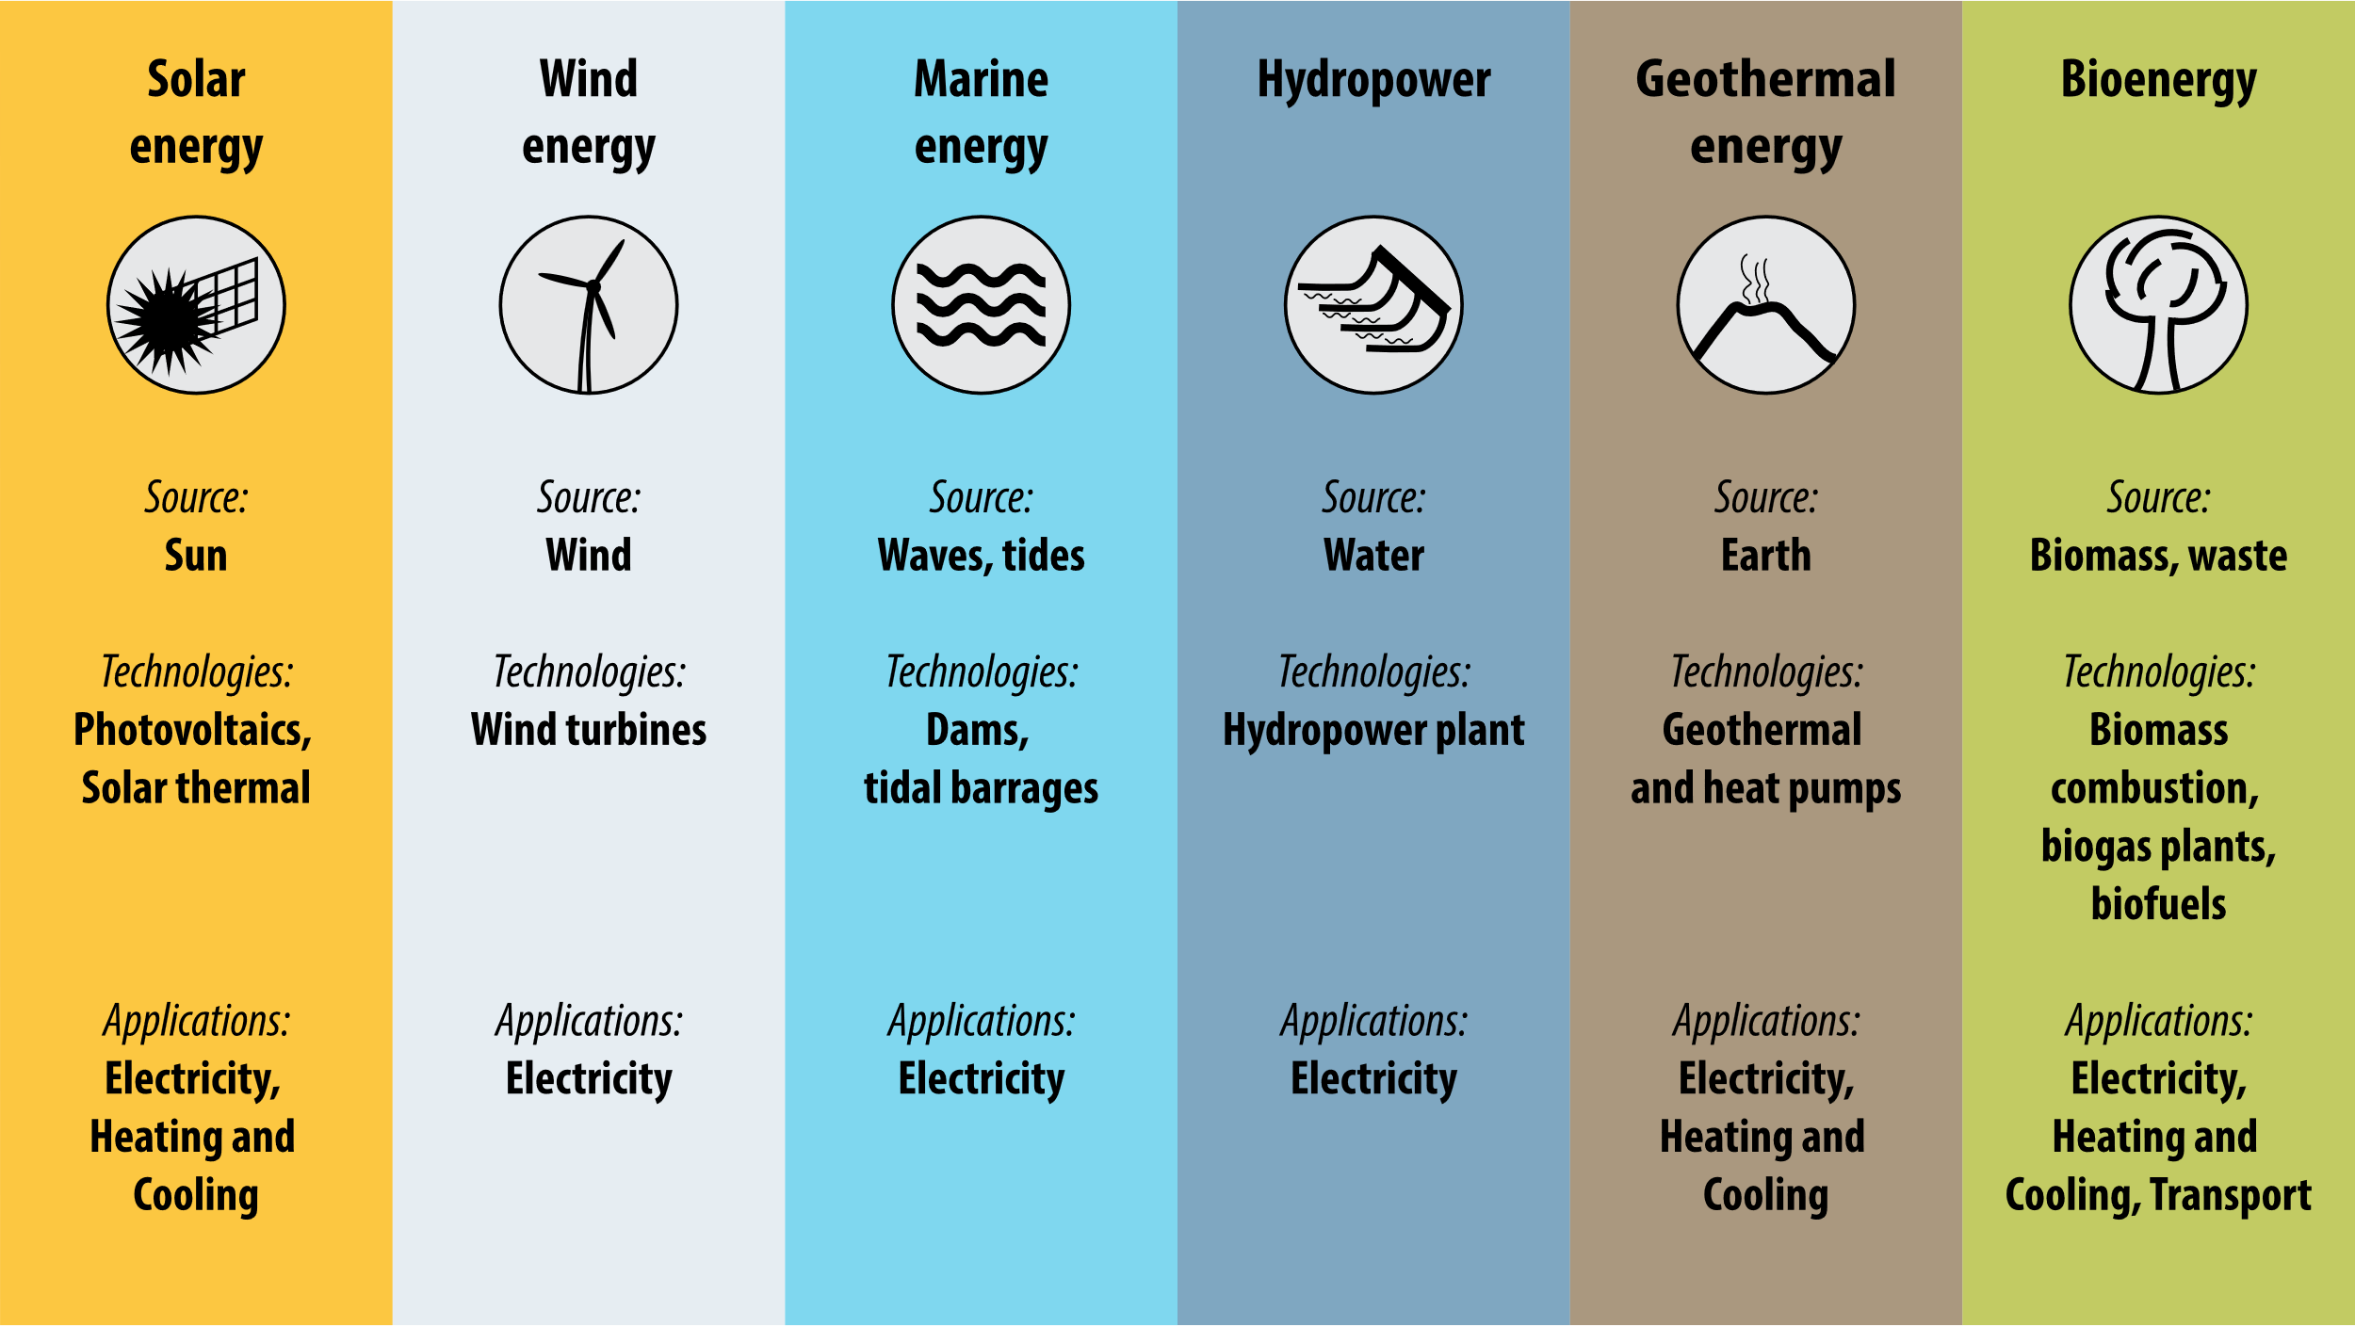
Applications
Hydroelectric Energy
Electric power generation through hydro-electric power plant
Wind energy
Electric power generation
Pumping underground water using windmills
Milling grain employing gristmills
Solar energy
Producing electricity by converting solar energy using photovoltaic cells
Cooking using solar cookers and heaters
Running solar pumps
https://op.europa.eu/webpub/eca/special-reports/renevable-energy-5-2018/en/
https://www.sciencefacts.net/types-of-renewable-energy.html

Slide 20
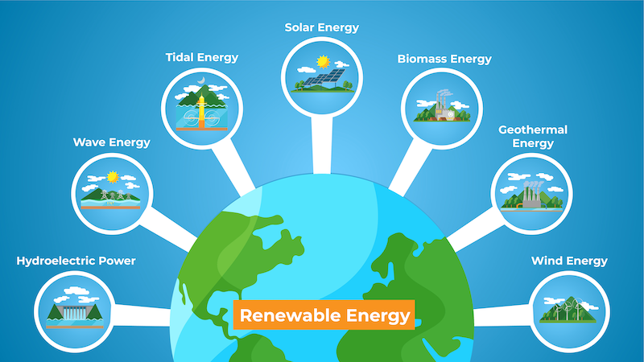
Applications
Biomass
Production of biodiesel and alcohol to be used as a replacement for traditional automobile fuels
Producing methane gas that can be used to generate heat, electricity, and organic chemicals
Geothermal Energy and ocean energy
Electricity generation
Hydrogen Fuel Cells
Hydrogen fuel cells can be used to drive automobiles instead of petrol or diesel engines
https://www.sciencefacts.net/types-of-renewable-energy.html

Slide 21
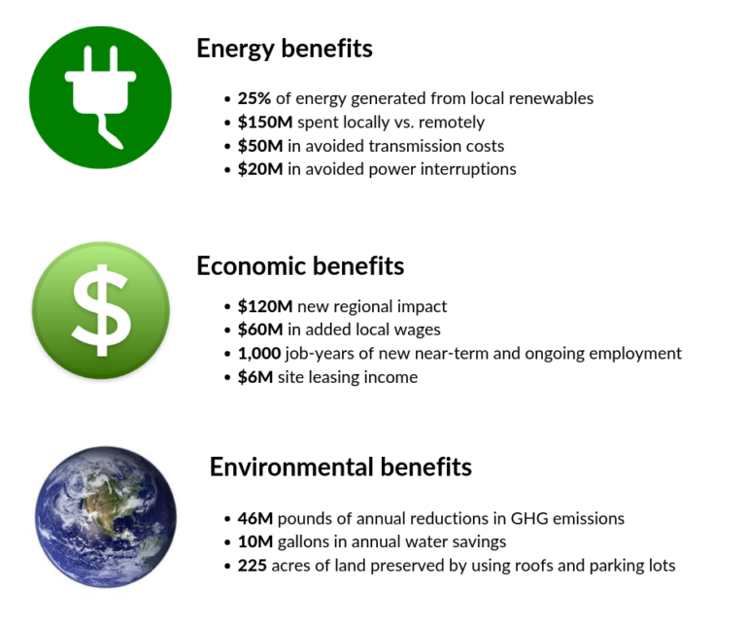
Advantages of renewable energy
Renewable energy sources will not run out
Renewable energy is reliable
Renewable energy is environmentally friendly
Renewable energy can increase public health
Renewable technologies create lots of jobs
Renewable technologies require less maintenance cost
Renewable energy can reduce turmoil in energy prices
Renewable energy can increase countries’ economic independence
Leftovers can be Used in renewable technologies
https://www.greenmatch.co.uk/blog/2021/09/advantages-and-disadvantages-of-renewable-energy#types-of-renewable-energy
https://clean-coalition.org/value-of-clean-local-energy/benefits/

Slide 22
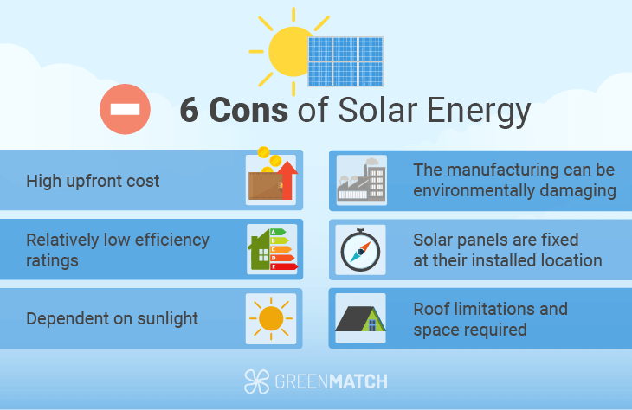
Disadvantages of renewable energy
Intermittent availability - renewable energy can be inconsistent due to weather, requiring fallbacks to traditional power.
Lower efficiency - renewable technologies have lower efficiency rates compared to fossil fuel-based methods.
High initial costs - the upfront cost of renewable technologies and their installation is often steep.
Space requirements - renewable energy farms demand large land areas, more so than traditional power stations.
Recycling challenges - while cleaner, renewable devices can be pollutive at disposal and require effective recycling methods.
https://www.greenmatch.co.uk/blog/2014/08/5-advantages-and-5-disadvantages-of-solar-energy
https://www.greenmatch.co.uk/blog/2021/09/advantages-and-disadvantages-of-renewable-energy

Slide 23
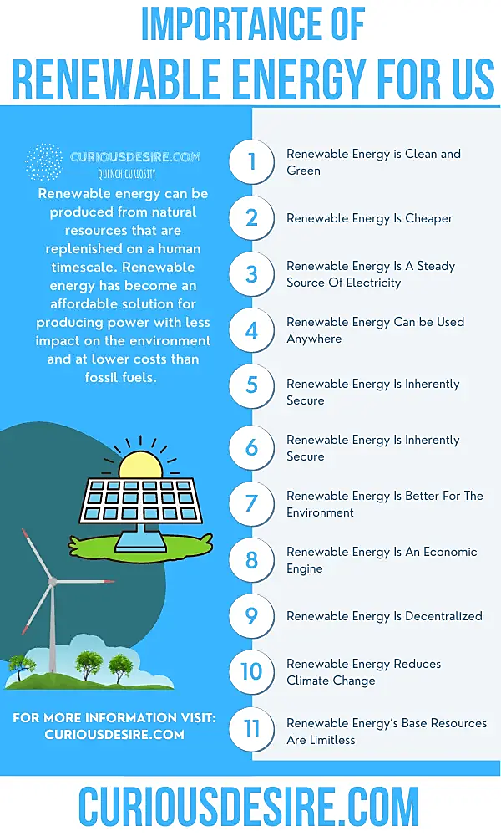
The significance of renewable energy
Halting global warming: Burning fossil fuels releases significant amounts of carbon dioxide, exacerbating global warming. Renewable energies offer an affordable, plentiful, and never-ending supply that doesn't emit greenhouse gases, making them key to curbing global warming and ensuing climate alterations.
Strengthening fuel supply stability: With fluctuating energy markets and geopolitical instabilities, ensuring a stable fuel supply is a global priority. Utilizing indigenous renewable resources can help nations meet their energy needs more reliably.
Economic and employment advancements: Investing in renewable energy infrastructure can spur economic growth and generate new employment prospects, particularly for the younger generation.
Maradin, Dario (2021). Advantages and disadvantages of renewable energy sources utilization. In: International Journal of Energy Economics and Policy 11 (3), S. 176 - 183. doi:10.32479/ijeep.11027.
https://curiousdesire.com/reasons-why-renewable-energy-is-important/

Slide 24
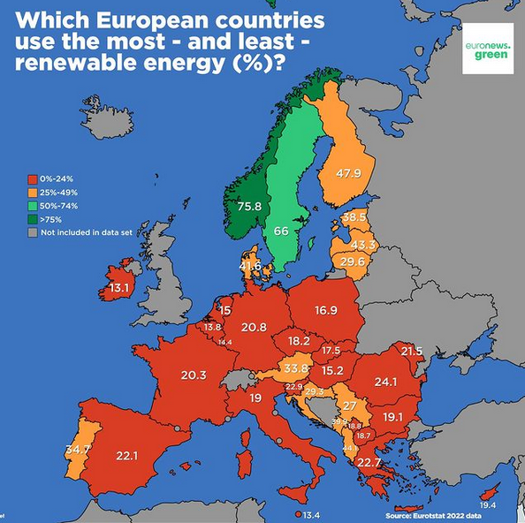
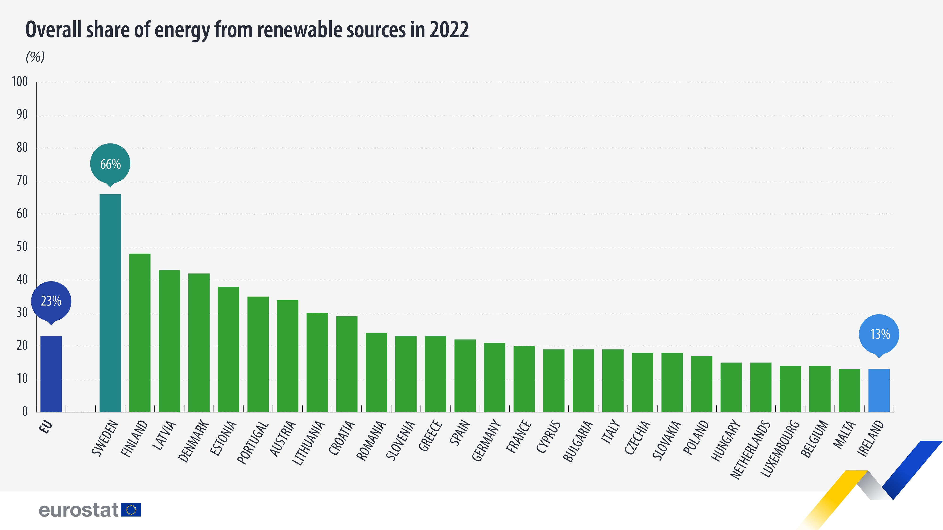
https://ec.europa.eu/eurostat/statistics-explained/index.php?title=File:Renewable_energy_2022_infographic.jpg

Slide 25
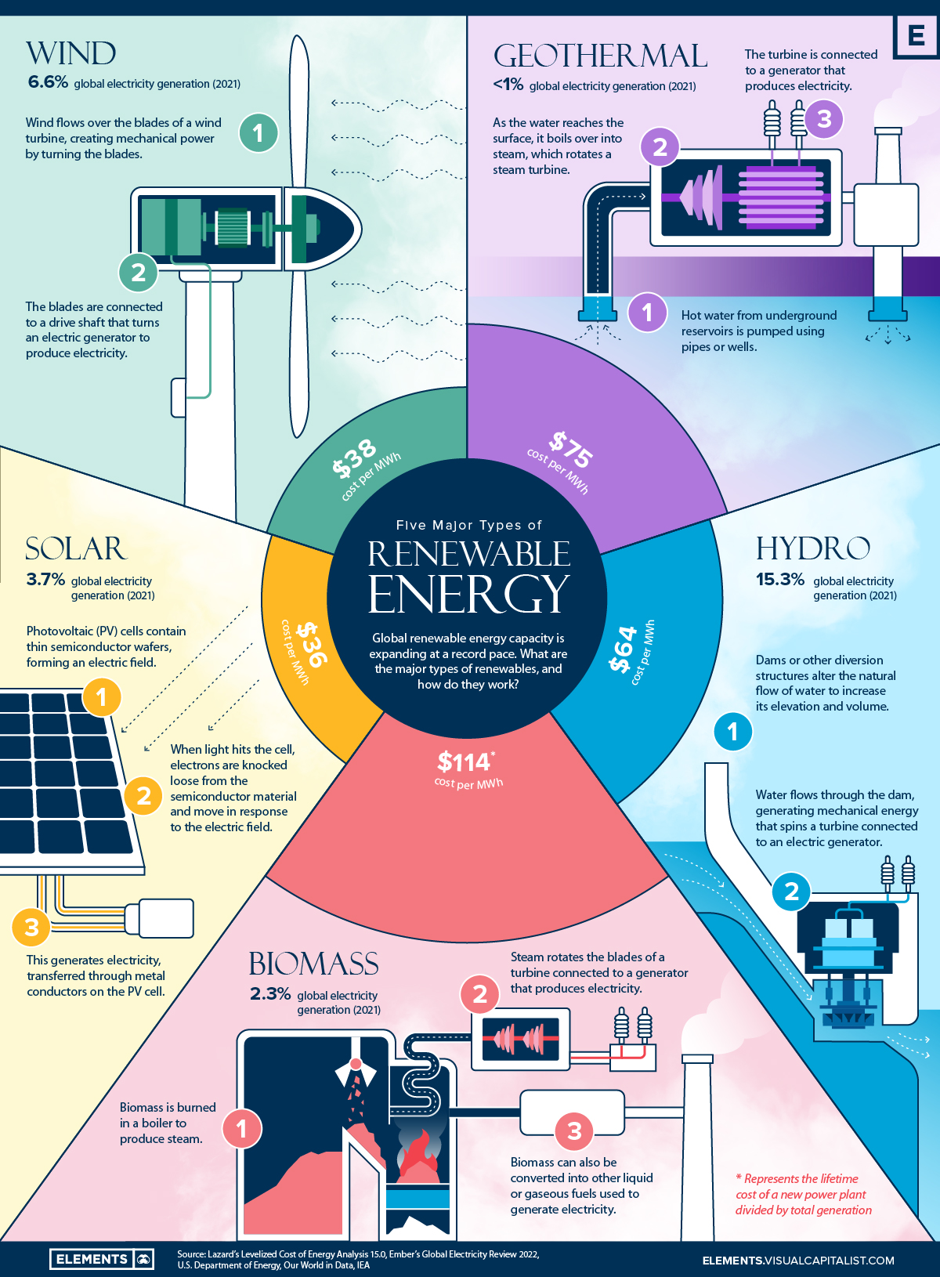
Major Types of Renewable Energy in the world
https://elements.visualcapitalist.com/what-are-the-five-major-types-of-renewable-energy/

Slide 26
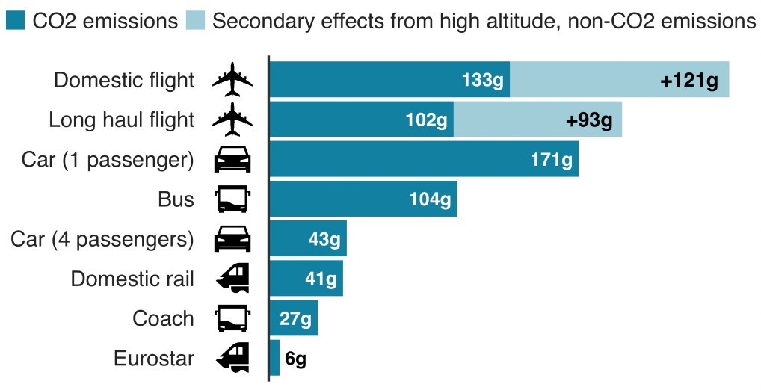
Emissions from different types of transport
Emission per passanger per km travelled
https://www.sherbetlondon.com/news-blog/how-our-travel-footprint-affects-the-environment-in-2020/

Slide 27
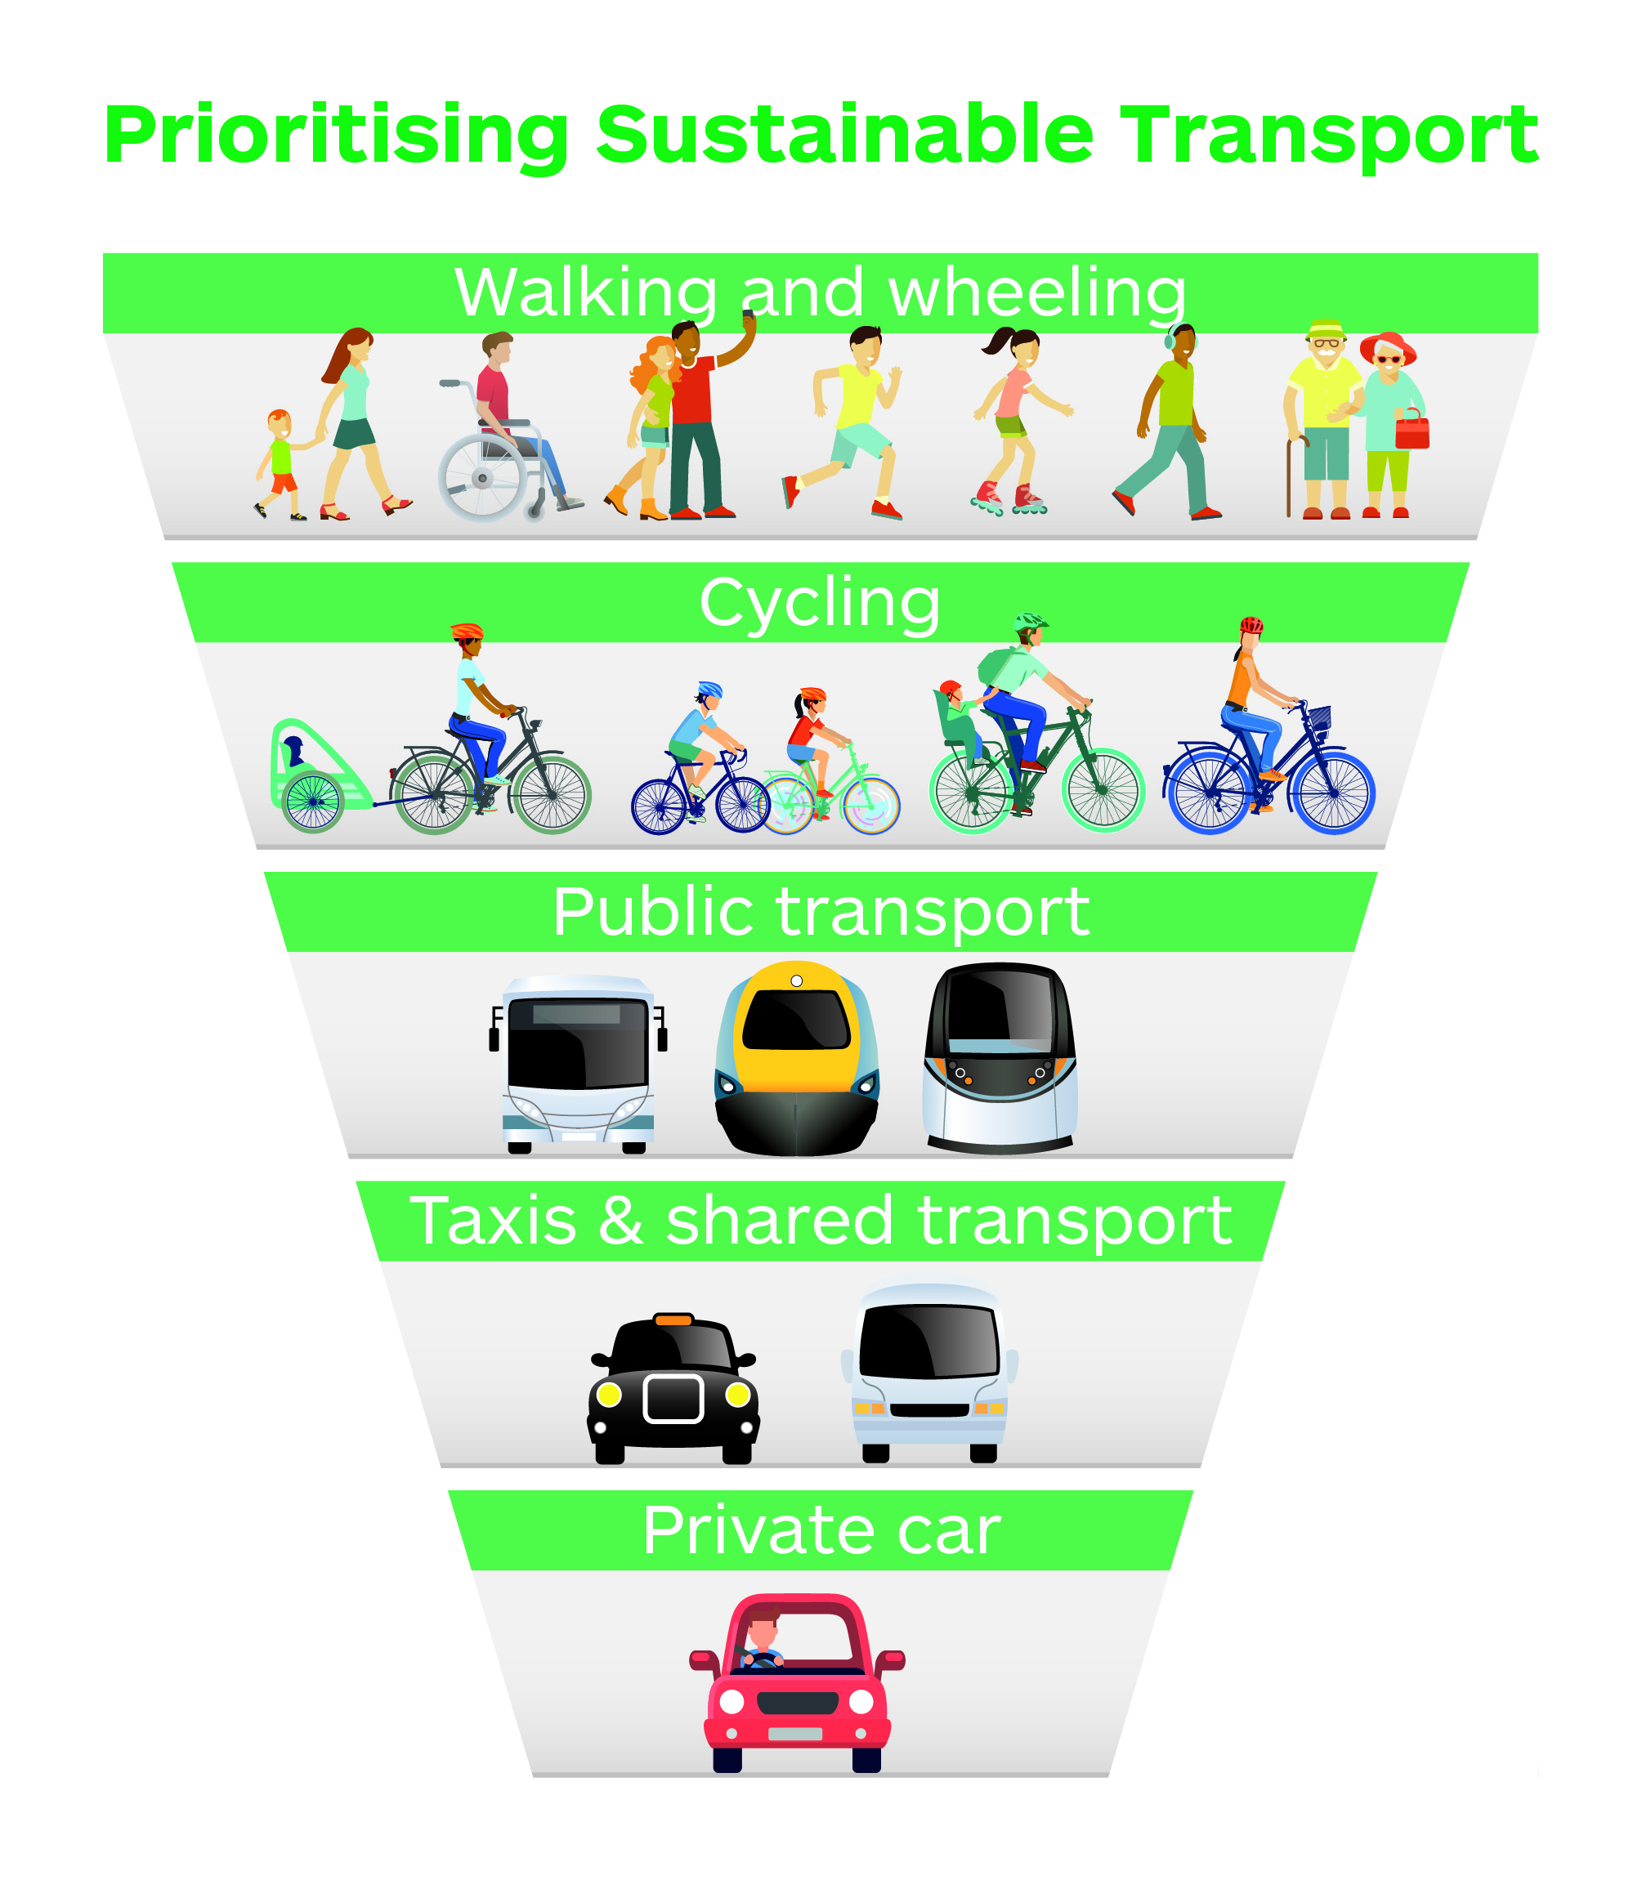
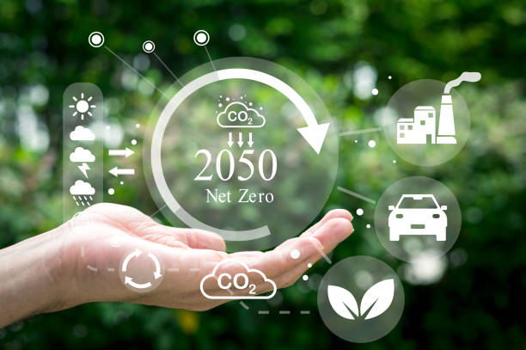
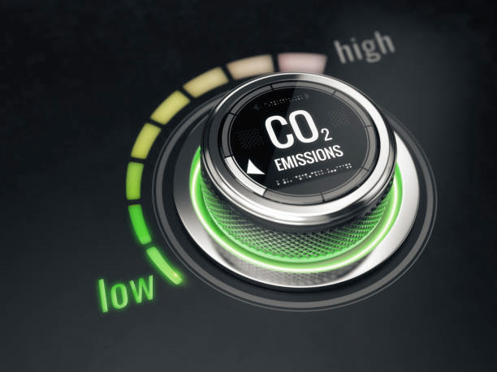
Types of Sustainable Transport
www.unsplash.com
Electric Vehicles (EVs)
Hydrogen Fuel Cell Vehicles
Biofuel Vehicles
Compressed Natural Gas (CNG) Vehicles
Solar-Powered Vehicles
Human-Powered Vehicles
Electric-Assist Vehicles
www.unsplash.com
www.unsplash.com
Source: https://www.transport.gov.scot/active-travel/developing-an-active-nation/sustainable-travel-and-the-national-transport-strategy/

Slide 28
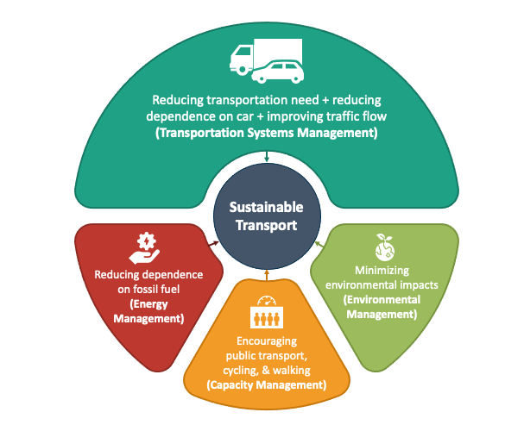
Sustainable transportation
The benefits of sustainable transportation include:
Cost savings on fuel and vehicles
Reduced carbon emissions from burning fossil fuels, resulting in less air pollution
Job creation with increased vehicle and battery manufacturing and fuel production
Improved accessibility to reliable, affordable transportation options
Enhanced energy security and independence with less reliance on foreign sources of materials and fuels.
Source: https://www.sketchbubble.com/en/presentation-sustainable-transport.html
Source: https://www.energy.gov/eere/sustainable-transportation-and-fuels

Slide 29
Low emission strategies for agricultural practices
The term ''sustainable agriculture'' (U.S. Code Title 7, Section 3103) means an integrated system of plant and animal production practices having a site-specific application that will over the long-term:
Satisfy human food and fiber needs.
Enhance environmental quality and the natural resource base upon which the agriculture economy depends.
Make the most efficient use of nonrenewable resources and on-farm resources and integrate, where appropriate, natural biological cycles and controls.
Sustain the economic viability of farm operations.
Enhance the quality of life for farmers and society as a whole.
The European Commission defines carbon farming as “a green business model that rewards land managers for taking up improved land management practices, resulting in the increase of carbon sequestration in living biomass, dead organic matter and soils by enhancing carbon capture and/or reducing the release of carbon into the atmosphere, in respect of ecological principles favourable to biodiversity and the natural capital overall.”
https://climate.ec.europa.eu/system/files/2021-12/com_2021_800_en_0.pdf

Slide 30
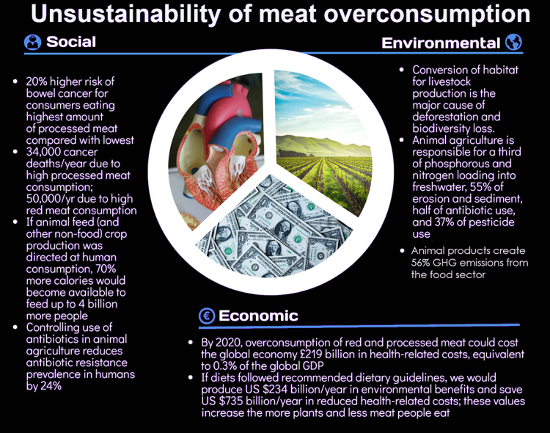
Reduction of meat production
Reduction of monocultures
Monoculture farming means cultivating a single species of plant on a large area of land to increase the production
limiting the variety of plant and animal species
increase the vulnerability of crops to diseases and pests
large population of a single host species makes it easier for the latter to spread rapidly
requires a massive use of chemicals such as fertilizers, pesticides
contaminate groundwater and soil, damaging the health of animals (and even people) living nearby
negative impact on the environment and biodiversity
Source: https://www.savingbees.org/en/2023/03/21/why-monocultures-are-not-good-for-the-environnement/
Source: N. A. Rust, L. Ridding, C. Ward, B. Clark, L. Kehoe, M. Dora, M.J. Whittingham, P. McGowan,
A. Chaudhary, C. J. Reynolds, C. Trivedy, N. West, How to transition to reduced-meat diets that benefit people and the planet,
Science of The Total Environment, 718

Slide 31
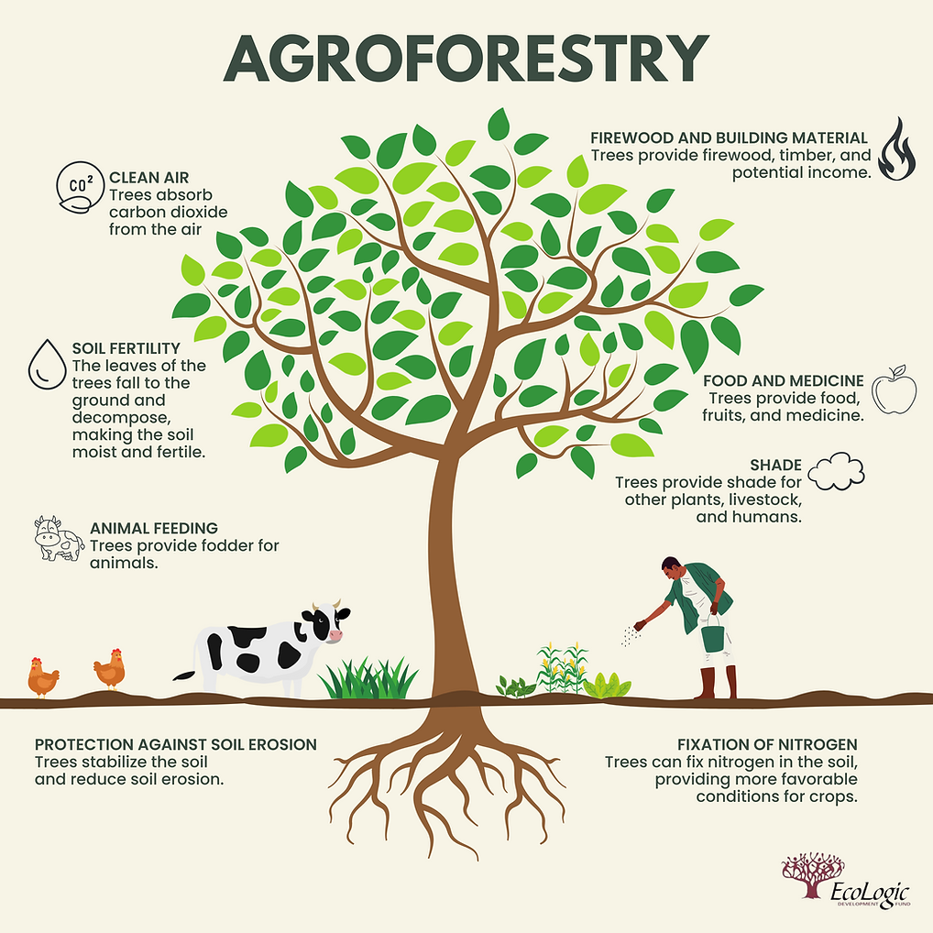
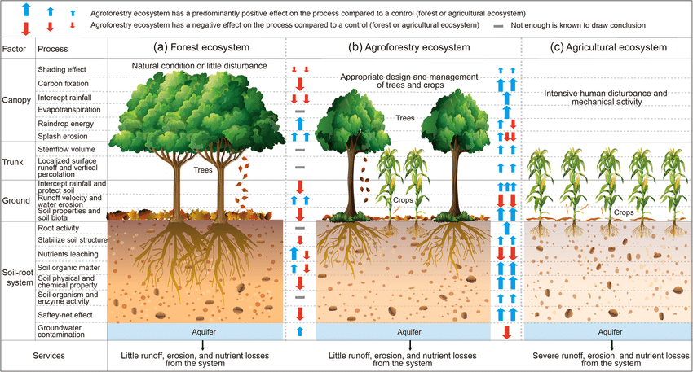
https://www.ecologic.org/post/agroforestry-what-it-is-and-why-it-is-essential-for-sustainable- and-climate-smart-use-of-land
Agroforestry is a land use management system that intentionally integrates trees and shrubs with crops or pasture to create environmental, economic, and social benefits. It combines agricultural and forestry technologies.
Source: Zhu et al., 2021; Reductions in water, soil and nutrient losses and pesticide pollution in agroforestry practices: a review of evidence and processes, Plant Soil (2020) 453:45–86.

Slide 32
Additional materials and sources of information

Slide 33
Application to increase audience engagement: https://www.mentimeter.com/
beFORE E-Learning Course, http://futureoriented.eu/ foresight-course/, where you can benefit from lessons dedicated to scenario analysis: http://futureoriented.eu/courses/advanced-course-students/lessons/module-5-lesson-2-future-oriented-methodologies/topic/topic-7-intuitive-logics-school-ofscenario-construction-case-studies/or take the entire Futures Literacy course (http:// futureoriented.eu/foresight-course/)
The European Environment Agency (EEA) website, https://www.eea.europa.eu/en/topics/in-depth/climate-change-mitigation-reducing-emissions
https://www.oecd.org/agriculture/topics/climate-change-and-food-systems/
Dr Edward de Bono introduces Lateral Thinking; https://www.youtube.com/watch?v=hdm3m85M5e8
The Indigo Archive - Edward de Bono Tools in Practice; https://www.youtube.com/watch?v=wclCeGutYUo
Global Footprint Network: https://www.footprintcalculator.org/
Miro board, where you can create a STEEP analysis template as the first step in the scenario method using ready-made output visualisations and work together online: https://miro.com/
The coursebook developed within Futures project: Replay your futures – labs for exploring undiscovered pathways course (pdf) https://futuresproject.pb.edu.pl/app/uploads/2023/08/Handbook-Futures-2022.pdf

Slide 34
Case study

Slide 35
DANONE
Danone is a manufacturer and producer of dairy and nutrition products. The company offers fresh dairy products, bottled water, baby nutrition and medical nutrition products.
The company sells its products under the Danone, Activia, Evian, Volvic, Aqua, Gallia, Actimel, Nutricia and Bledina brands. It distributes its products through retail chains, traditional outlets and specialised distribution channels, including hospitals, clinics and pharmacies.
The company's operations span the Americas, the Middle East, Africa, Europe and the Asia-Pacific region. Danone is headquartered in Paris, Ile-de-France, France.
Source: Danone, About Danone, https://www.danone.com/about-danone/we-are-danone.html#MISSION
Source: Global Data, Danone SA: Overview, https://www.globaldata.com/company-profile/danone-sa/

Slide 36
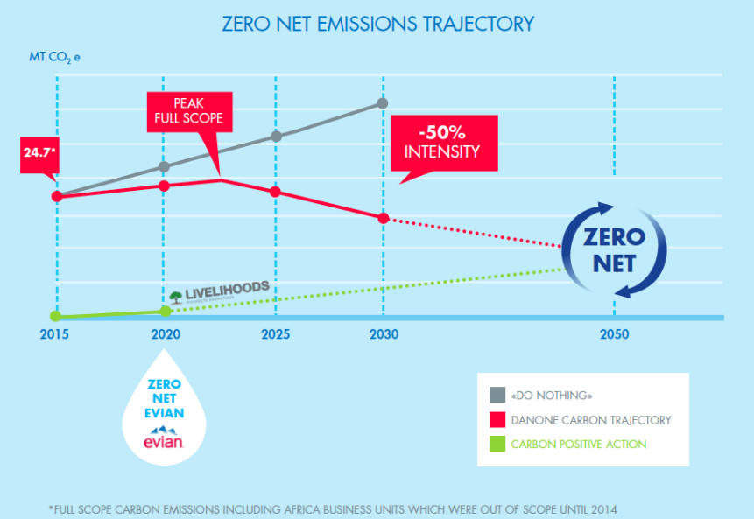
TARGET ZERO NET CARBON EMISSIONS
Healthy food and the water cycle are significantly linked to the climate, which in turn depends on carbon levels in the atmosphere and oceans.
Danone's ambition is to set a trajectory for reducing greenhouse gas emissions in line with scientific guidelines, aiming to keep temperature increases below 2°C and to support the decarbonisation of the economy. According to the latest UN report on the 'emissions gap', Danone's main goal is to achieve net zero emissions in all emissions areas.
Source: Danone, Climate Policy, https://www.danone.com/content/dam/corp/global/danonecom/about-us-impact/policies-and-commitments/en/2016/2016_05_18_ClimatePolicyFullVersion.pdf

Slide 37
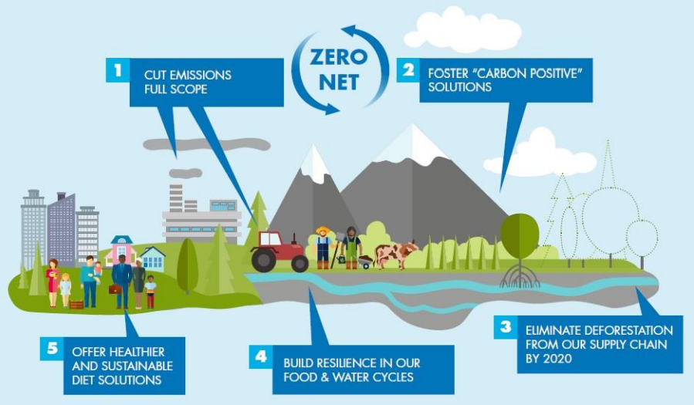
Danone’s ambition is to:
Take action on mitigation and contribute to sequestering carbon in soils, forests and ecosystems for “net positive” impacts to combat climate change,
Take action on adaptation, building resilient food and water cycles,
Be at the forefront of business solutions with healthier diet options for more people with less carbon.
Source: Danone, Climate Policy, https://www.danone.com/content/dam/corp/global/danonecom/about-us-impact/policies-and-commitments/en/2016/2016_05_18_ClimatePolicyFullVersion.pdf

Slide 38
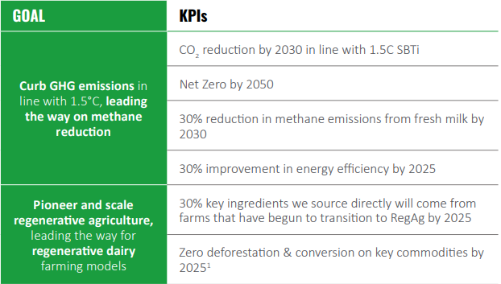
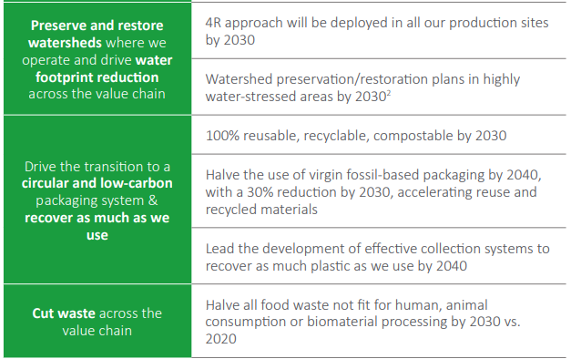
AMBITIONS
Danone has developed the following goals and KPIs:
Source: Danone, Danone integrated annual report 2022, https://www.danone.com/content/dam/corp/global/danonecom/rai/2022/danone-integrated-annual-report-2022.pdf

Slide 39
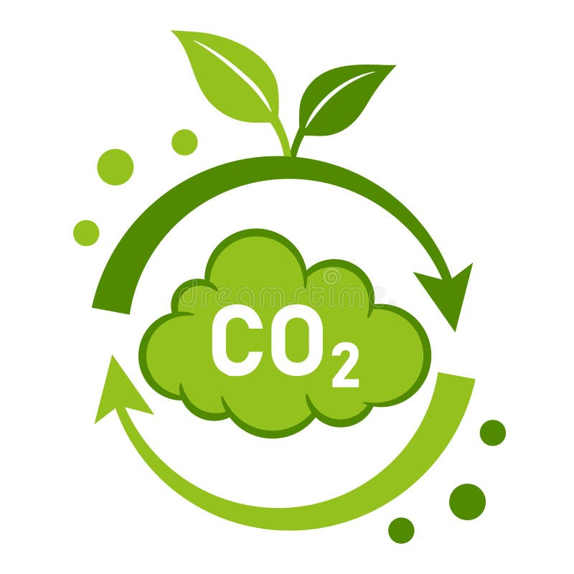
ACHIEVEMENTS
Danone was among the first companies to have its 1.5°C Forest, Land and Agriculture (FLAG) target approved by the Science Based Targets initiative.
In Balclutha (New Zealand), biomass boiler is powered by locally-sourced wood residues from sustainably-managed forests (waste debris, bark and organic matter), supplying the plant with indigenous, renewable energy. Combined with the use of 100% renewable electricity at the plant, CO2 emissions will be reduced by 95%.
Danone is one of only 13 ‘Triple A’ companies worldwide, out of almost 15,000 companies scored by CDP.
Action plans to convert manure into organic fertilizers through compost and biodigesters, the traceability of animal feeds in areas with no deforestation risks and improved cow productivity in Brazil.
-8.3% absolute total FLAG emissions reduction since 2020 (2030 science based target: -30.3%).
Update of the Danone Regenerative Agriculture Handbook and Scorecard and launch of associated digital tool.
Danone launched a Global Energy Excellence Program, Re-Fuel Danone, to transform the energy footprint of its production sites worldwide.
Switch to renewable electricity sources in Indonesia, Mexico, and in the Steenvoorde Supply Point in France.
Renewed Forest Policy, with the ambition to continue and amplify efforts in protecting and restoring forests.
70.5% of renewable electricity.
Source: Danone, Danone integrated annual report 2022, https://www.danone.com/content/dam/corp/global/danonecom/rai/2022/danone-integrated-annual-report-2022.pdf

Slide 40
Danone is collaborating with several partners to enhance global comprehension of how agricultural practices can contribute to nurturing and safeguarding soil health.
Link to video: https://www.youtube.com/watch?v=08TI1RKj54g
Source: Danone, Regenerative agriculture, https://www.danone.com/impact/planet/regenerative-agriculture.html

Slide 41
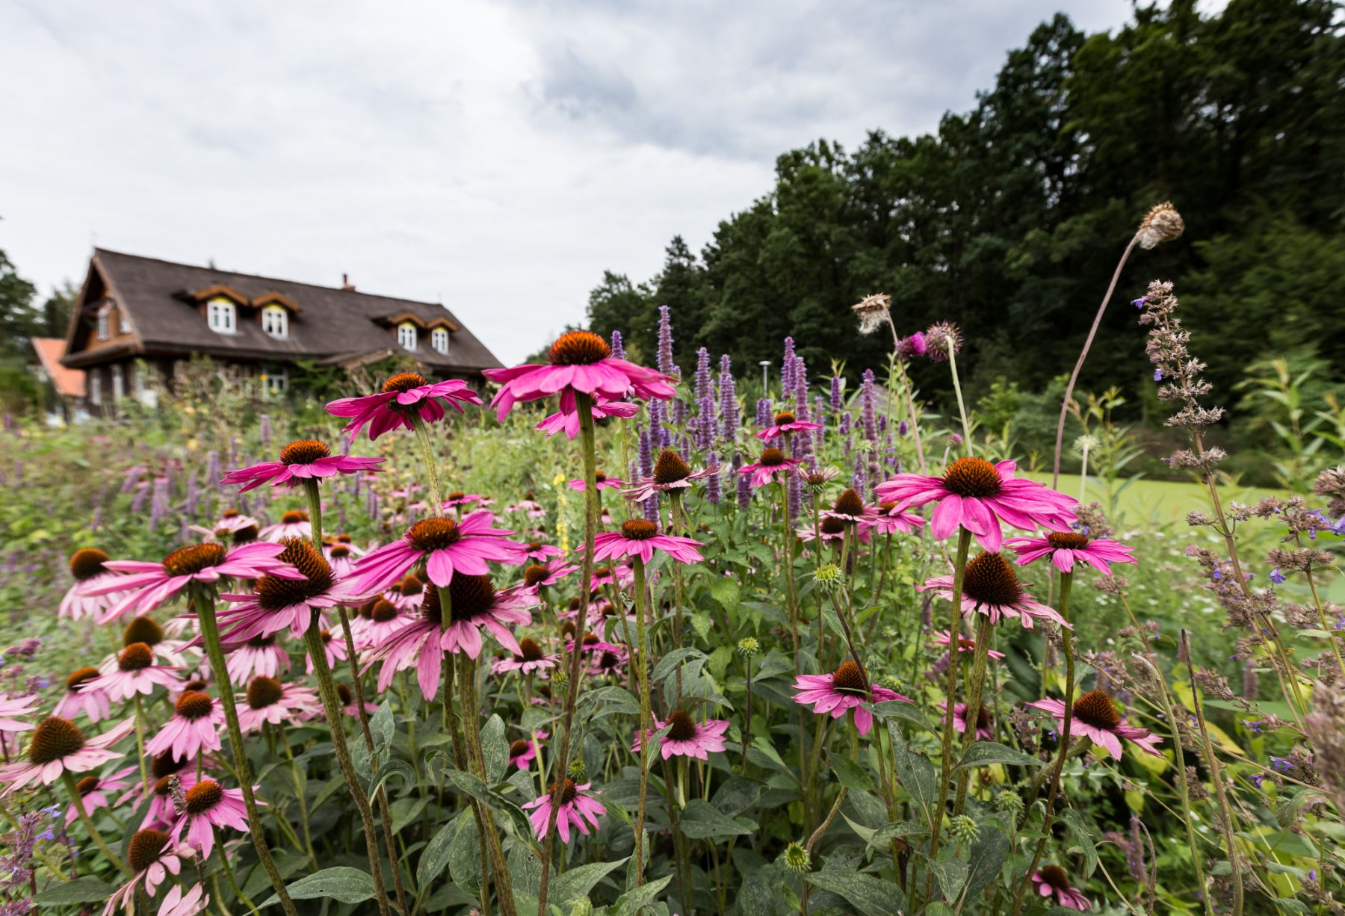
„Ziołowy zakątek” agritourism farm
The agritourism farm is located in the heart of the cleanest region of Poland - Podlasie.
On an area of ​​almost 20 hectares, it brings together the rich culture and tradition of this area. You can find here buildings typical of the region, handicrafts and, above all, herbs.
An integral element of the herbal and botanical activities carried out is the Dary Natury company, which was established almost 30 years ago.
There is a Nature Education Center at the farm. The purpose of the center is to provide knowledge about the organic food, herbal traditions and sustainable development.
The farm uses traditional, low-emission agricultural practices.
Source: provided by Ziołowy zakątek

Slide 42
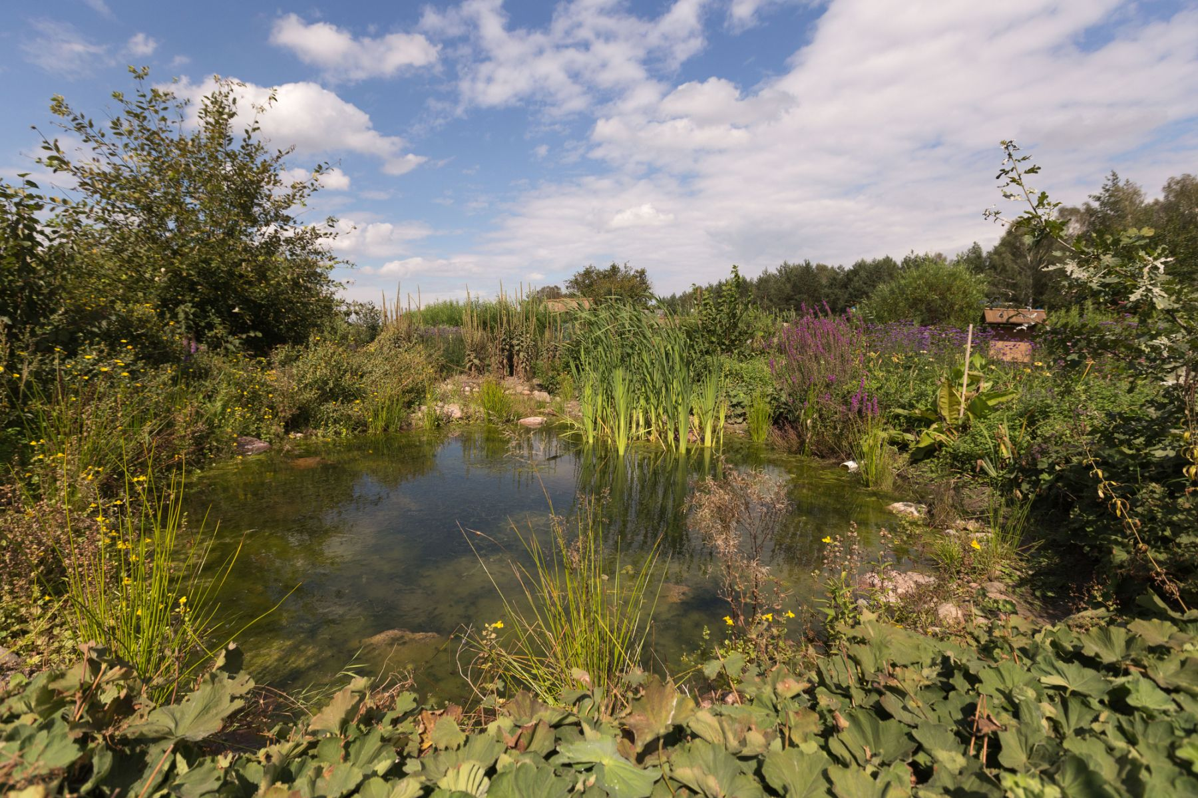
low-emission practices in crop production
vegetables are grown organically in a traditional way
herbs are collected from nearby forests and fields
cultivation of melliferous plants as part of maintaining biodiversity
use of organic fertilizers
exclusion from cultivation of areas that are constantly wet,
covering the soil with vegetation throughout the year - catch crops in crop rotation
The results: high food quality, maintaining biodiversity, reducing greenhouse gas emissions
Source: provided by Ziołowy zakątek

Slide 43
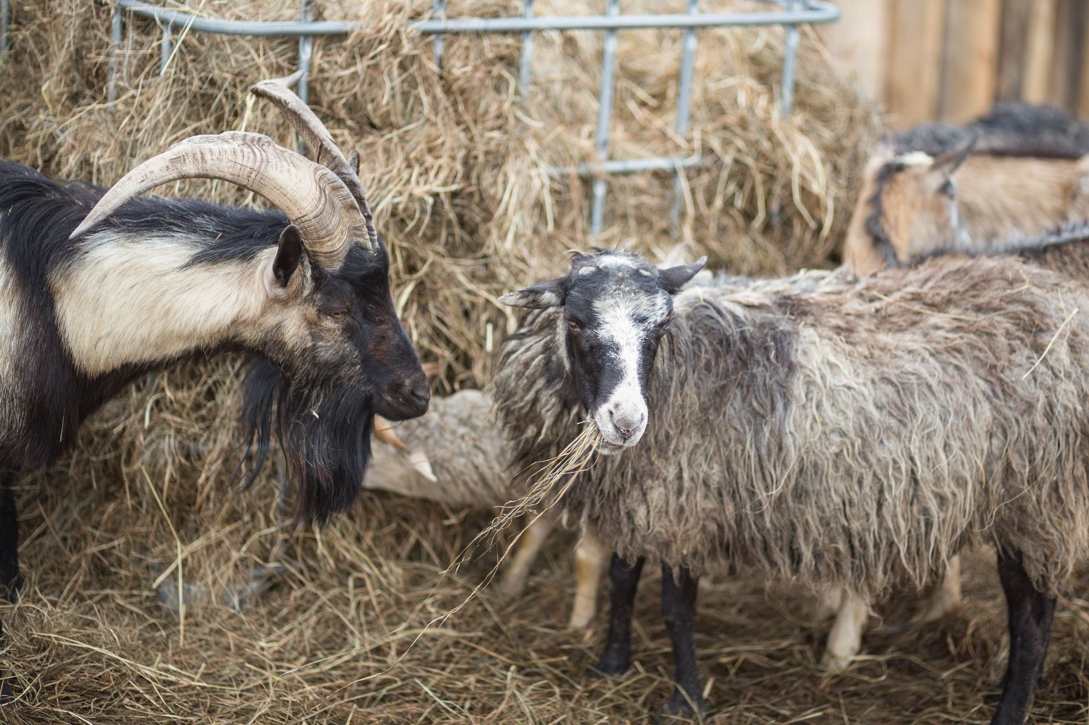
Low-emission animal housing systems - care for animal welfare
cows grazing on the pasture (from spring to autumn) - ammonia reduction
hay feeding in winter
animal feed with the addition of herbal mixtures (health-promoting activities)
precise balancing of the food dose
free-stall animal housing system
poultry is free-range
Source: provided by Ziołowy zakątek

Slide 44
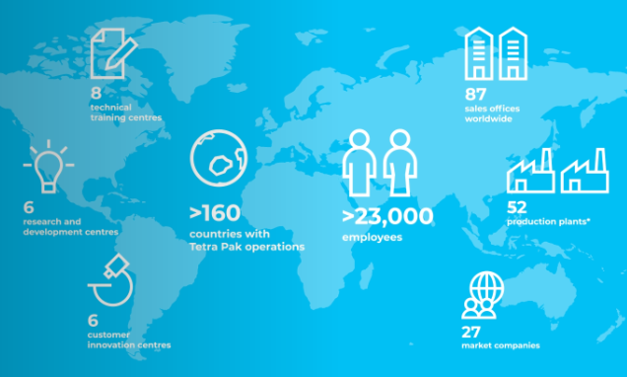
Tetra Pak
The company is the world's leading provider of food processing and packaging solutions. Working closely with customers and suppliers, the company innovates to provide access to safe, nutritious food to hundreds of millions of people in more than 160 countries, while striving to reduce its environmental impact.
Founder: Ruben Rausing
Headquarters: Pully, Switzerland
Number of employees: >23 000
Founding: 1951, Lund, Sweden
Source: Tetra Pak, Who we are, https://www.tetrapak.com/en-pl/about-tetra-pak/who-we-are/company

Slide 45
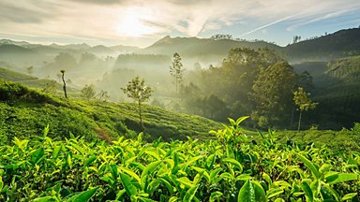
Tetra Pak commits to net zero emissions
Tetra Pak was founded on the idea that a package should save more than it costs, with sustainability always at the core of how the company operates as a business. Since 1999, the company has been collecting data on energy use and greenhouse gas emissions from across the organisation on an annual basis, with its GHG accounts audited by an independent third party since 2013.
Tetra Pak is reaffirming its strategic commitment to promoting sustainability transformation by setting an ambition to achieve net zero emissions across its value chain by 2050. In support of this goal, the company has set an interim target for 2030 to achieve zero net carbon emissions from its own operations. In addition, the company has set emission reduction targets in line with 1.5°C, in line with the principles of the Science Based Targets (SBT) initiative.
Source: Tetra Pak, Tetra Pak commits to net zero emissions, https://www.tetrapak.com/en-pl/about-tetra-pak/news-and-events/newsarchive/tetra-pak-commits-to-net-zero-emissions

Slide 46
Tetra Pak aims to achieve net zero greenhouse gas emissions by 2030 and meet its 2050 targets by focusing on four key areas:
Lowering energy-related emissions through energy conservation, improvements in energy efficiency, installing on site solar photovoltaics (solar PV) and purchasing renewable Energy. The company has invested more than €16 million in energy efficiency since 2011, preventing a 23% increase in energy consumption. To date, around 2.7 MW of solar PV has been installed, enabling the delivery of low-carbon electricity and reducing operating costs. Tetra Pak has also increased its use of renewable electricity from 20% in 2014 to 69% in 2019.
Partnering with suppliers and other stakeholders along the value chain to significantly reduce carbon footprint. Tetra Pak is committed to working with suppliers to reduce greenhouse gas emissions at various stages of the supply chain. Together, they are setting ambitious renewable energy targets and increasing the use of renewable and recycled materials.
Accelerating the development of its low carbon circular packaging and equipment portfolio. The company is increasing its investment in sustainable innovation to meet targets for recyclable packaging and minimising its carbon footprint.
Developing sustainable recycling value chains. Tetra Pak works with customers, waste management companies and others to ensure that all beverage cartons can be recycled and that the zero ones are properly disposed of or recycled.
Source: Tetra Pak, Tetra Pak commits to net zero emissions, https://www.tetrapak.com/en-pl/about-tetra-pak/news-and-events/newsarchive/tetra-pak-commits-to-net-zero-emissions

Slide 47
FOOD SYSTEMS
CIRCULARITY
AMIBITION
AMIBITION
Contribute to secure, resilient, and sustainable food systems that provide access to safe, affordable, and nutritious food, and minimise food loss and food waste across our value chain.
Drive circular solutions by designing recyclable food and beverage packaging, using recycled and renewable materials, and expanding collection and recycling to keep materials in use and out of landfills.
PROGRESS
PROGRESS
Collaboration with Fresh Start looking at technical solutions to food systems challenges.
New processing method for soya drinks and technology to transform Brewer’s Spent Grain into a plant-based beverage.
43,939 farmers (96.2% smallholders) delivered milk to dairies in 22 Dairy Hub projects.
66 million children in 44 countries participated in school feeding programmes.
1.2 milion tonnes of carton packages collected and sent for recycling.
8.8 billion plant-based packages and 11.9 billion plant-based caps sold.
Testing of fibre-based barrier to substitute the thin aluminium foil layer in aseptic carton packages
~ €30 million invested in the collection and recycling of carton packages.
Source: Tetra Pak, Sustainability Report FY22 Highlights, https://www.tetrapak.com/content/dam/tetrapak/media-box/global/en/documents/sustainability-report-highlights-infographics.pdf

Slide 48
CLIMATE
NATURE
AMIBITION
AMIBITION
Take action on mitigating climate change by decarbonising our operations, products, and our value chain.
Act for nature through responsible sourcing practices and strategic partnerships to conserve and restore biodiversity, mitigate and adapt to climate change, and contribute to global water resilience.
PROGRESS
PROGRESS
Achieved an ‘A’ for climate change by the global environmental non-profit CDP.
131 kilo tonnes of CO2 saved by buying more plant-based plastic.
84% renewable energy consumption in our operations.
39% GHG emission reduction in our operations compared to 2019.
87 hectares of land, the equivalent of 136 football fields, restored through the Araucaria Conservation Programme in the Brazilian Atlantic Forest.
Achieved an 'A' for Forests by CDP.
Completed a water value-chain analysis to better understand our water footprint and water related risks.
First Procedure for Responsible Sourcing of Renewable Polymers published.
Source: Tetra Pak, Sustainability Report FY22 Highlights, https://www.tetrapak.com/content/dam/tetrapak/media-box/global/en/documents/sustainability-report-highlights-infographics.pdf

Slide 49
Imagining and designing
Scenario analysis

Slide 50
Objective of the training session
In this topic we will guide you through the intuitive logic school of scenario construction.
You will learn how to identify strategic decision (concerning the use of sustainable transport), identify the factors influencing sustainable transport, select driving forces, elaborate and create scenarios.
You will identify hopes and fears for the use of sustainable transport in 2040.
Source: www.pexels.com

Slide 51
Do you know the difference between forecasts and scenarios?

Slide 52
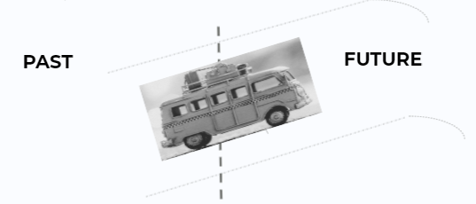
Forecasting vs. scenario building
Forecasting is frequently based on trend extrapolation.
It could be associated with driving from the past to the future but looking at the rear mirrors. Either way, we are following the same path. This is what we call trend extrapolation.
TREND EXTRAPOLATION
In scenarios, we assume that there is more than one path into the future!

Slide 53
FORECAST
PATH
PRESENT
FUTURE
1 future based on assumptions
Linear/ non-linear projection
SCENARIOS
FUTURES
Source: Forum, W. E. (2008). The future of pensions and healthcare in a rapidly ageing world. Scenarios to 2030.
Multiple futures that challenge assumptions
Multiple development

Slide 54
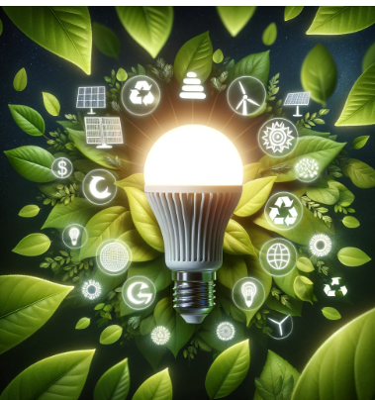
How can I use scenarios for sustainable transport?
To assess trends affecting sustainable transport in my city/region/country.
To assess the strength of the impact of trends on the sustainable transport over a time horizon of several years.
To assess the degree of uncertainty of trends affecting sustainable transport.
To develop alternative visions of sustainable transport according to changing trends.

Slide 55
In intuitive logic school of scenario construction, we assume that scenarios could be created in a structured way!

Slide 56
How to do it? In iterative way as follows….
1. THINK ABOUT
SUSTAINABLE TRANSPORT
2. IDENTIFY
FACTORS INFLUENCING SUSTAINABLE TRANSPORT
3. SELECT
DRIVING FORCES
4. TRANSFORM
DRIVING FORCES INTO SCENRIOS
5. CREATE
SCENARIOS

Slide 57
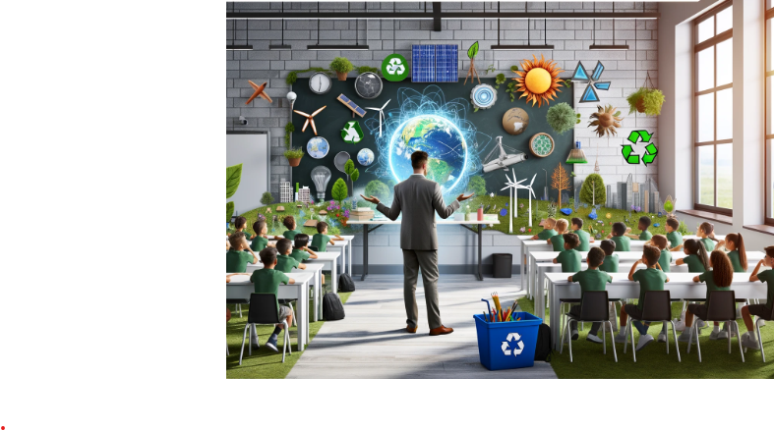
Stage 1
Think about the future of sustainable transport in your city/region/country.
Choose a "time horizon for your analysis (let's assume 10-15 years).

Slide 58
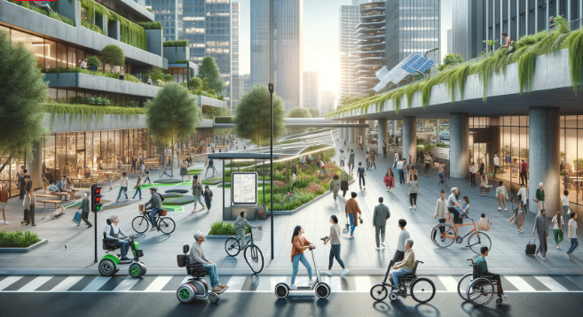
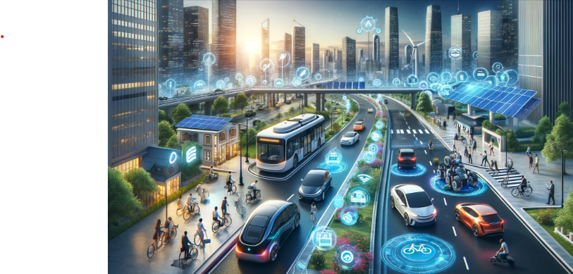
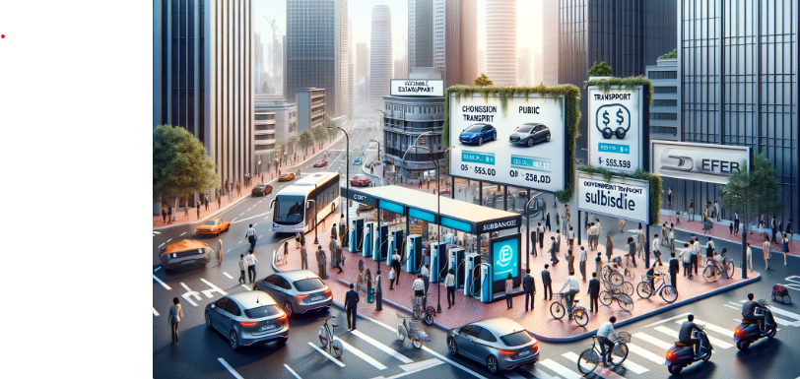
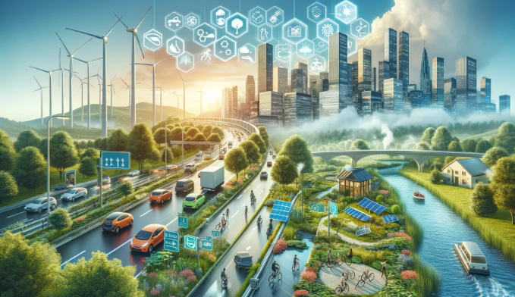
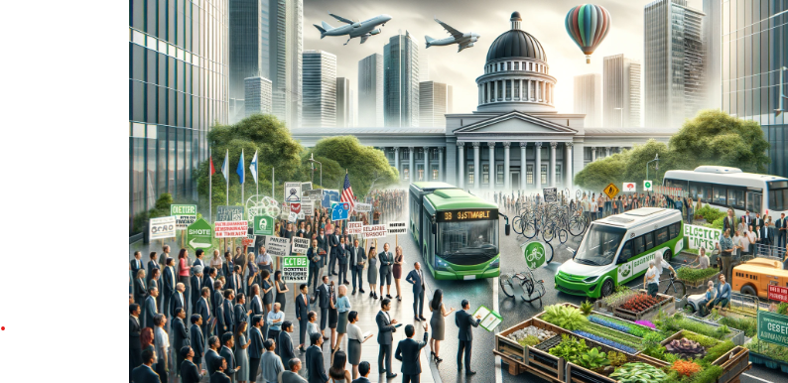
Stage 2
Identify the external factors affecting the sustainable transport
This you can do with the use of STEEP analysis, which is a checklist of social, technological, economic, ecological and political factors.
Create a list of your own factors, or use a ready-made list presented in the following slides!
LEGAL
SOCIAL
TECHNOLOGICAL
ECONOMIC
ECOLOGICAL
POLITICAL
VALUES

Slide 59
Examples of STEEP factors (social)
Cultural Attitudes and Values: Societal norms and values play a significant role. For example, in some cultures, cars are seen as a status symbol, which can make reducing car usage challenging. Conversely, in places where cycling or public transport is culturally accepted and promoted, there might be a higher inclination towards these sustainable options.
Social Norms and Peer Influence: The behavior and choices of individuals within a social network can significantly influence others. If sustainable transport options like cycling, walking, or using public transport are seen as the norm within a peer group or community, individuals are more likely to adopt these practices.
Accessibility and Inclusivity: The availability of sustainable transport options that cater to people with disabilities, elderly individuals, and those with other special needs is crucial. Designing inclusive transport systems can encourage a broader section of the society to participate in sustainable transport practices.

Slide 60
Examples of STEEP factors (technological)
Advancements in Vehicle Technology: Innovations in electric and hybrid vehicles, including improvements in battery technology, charging infrastructure, and energy efficiency, are pivotal. These advancements make sustainable vehicles more accessible, affordable, and practical for everyday use.
Public Transport Technology: The development of more efficient and reliable public transportation systems, such as electric buses, light rail systems, and the use of renewable energy sources, enhances the appeal and usability of public transport. Real-time data integration into public transport systems can also improve user experience by providing accurate schedules, routes, and availability information.
Smart Infrastructure: Intelligent transportation systems (ITS) that utilize data, sensors, and communication technologies can optimize traffic flow, reduce congestion, and enhance safety. Smart traffic lights, adaptive traffic management systems, and smart parking solutions contribute to a more efficient and sustainable urban transport system.

Slide 61
Examples of STEEP factors (economic)
Fuel Prices: High fuel prices can make driving personal combustion-engine vehicles more expensive, encouraging people to seek out more fuel-efficient or alternative fuel vehicles, as well as public transportation, cycling, or walking.
Cost of Vehicles: The upfront cost of electric vehicles (EVs) and other sustainable transport options can be a significant barrier to their adoption. However, as technology advances and production scales, these costs are decreasing, making sustainable options more accessible.
Public Transport Fares: The pricing of public transport can influence its attractiveness compared to private vehicle use. Affordable and competitive pricing can encourage higher usage of public transport systems.

Slide 62
Examples of STEEP factors (ecological)
Air Quality: High levels of air pollution, especially in large cities, lead to a search for transport solutions that minimize exhaust emissions, such as electric vehicles, bicycles, or walking.
Land Use: Intensive use of land for transport infrastructure leads to soil degradation and loss of green areas, which in turn motivates the search for solutions that minimize the need for new spaces.
Threat to Biodiversity: The construction of new roads and the development of transport infrastructure can lead to habitat fragmentation and pose a threat to biodiversity. Sustainable transport solutions seek to minimize such impacts.
Natural Resource Consumption: The depletion of natural resources, such as fossil fuels, drives the search for and use of more sustainable and renewable energy sources to power vehicles.

Slide 63
Examples of STEEP factors (political)
Government Subsidies and Incentives: Political decisions regarding subsidies for electric vehicles, tax incentives for using renewable energy sources, and financial support for public transport can encourage the adoption of sustainable transport methods.
International Agreements: Participation in international environmental agreements, such as the Paris Agreement, can commit countries to reducing their carbon footprint, thereby promoting policies that favor sustainable transport solutions.
Urban Planning Policies: Political decisions related to urban development and planning can have a significant impact on sustainable transport. For instance, investing in pedestrian-friendly cities and bike can encourage more sustainable mobility patterns.
Political Stability and Will: The political will to implement and maintain sustainable transport initiatives, as well as the stability of political institutions, can influence the consistency and effectiveness of policies and measures aimed at promoting sustainable transport.

Slide 64
Stage 3Select driving forces
Try to rank all the identified STEEP factors by importance and uncertainty. Those factors that are important and predictable could be the subject to forecasting.
Two factors that are at the same time the most important and the most uncertain are the subject to scenario analysis!

Slide 65
Factors’ ranking
scenario analysis
forecasting
importance
uncertainty

Slide 66
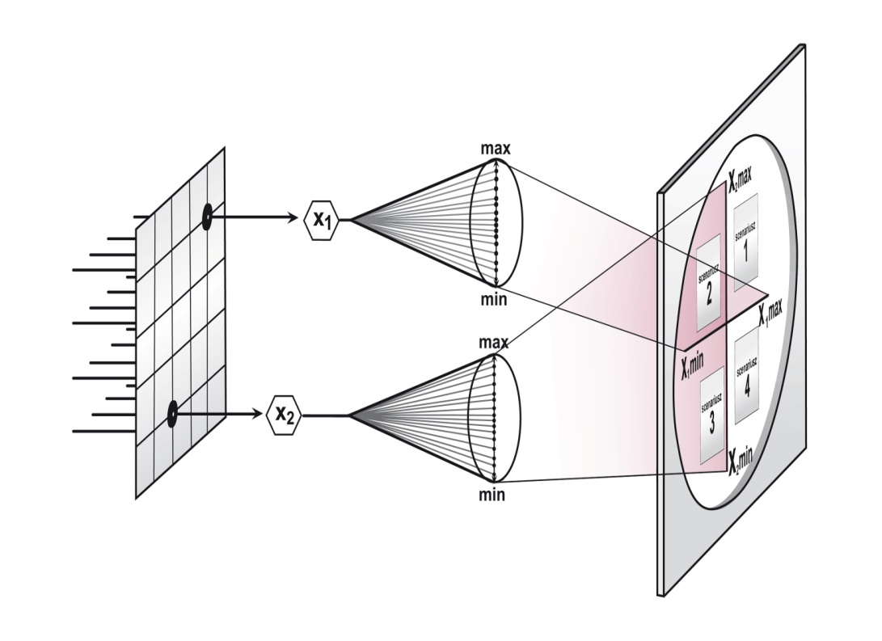
Stage 4: Transform two driving forces into scenarios
Two factors that are at the same time the most important and uncertain come out into extreme states.
Think about high availability of smaty infrastructure versus low availability of smart infrrastructure, high fuel prices versus low fuel prices. Two extreme states of two factors are transformed into four scenarios!
Experiment with other factors!

Slide 67
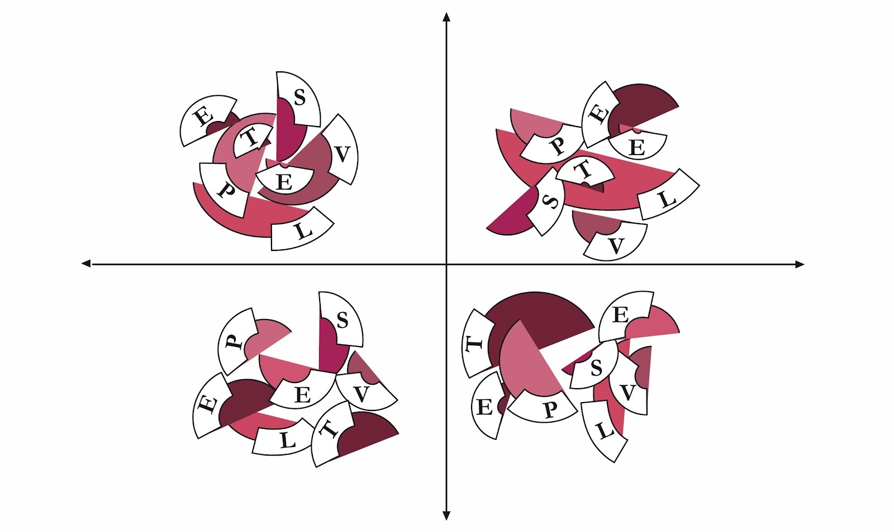
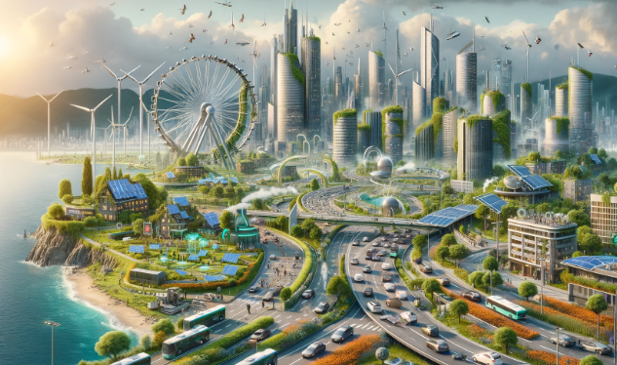
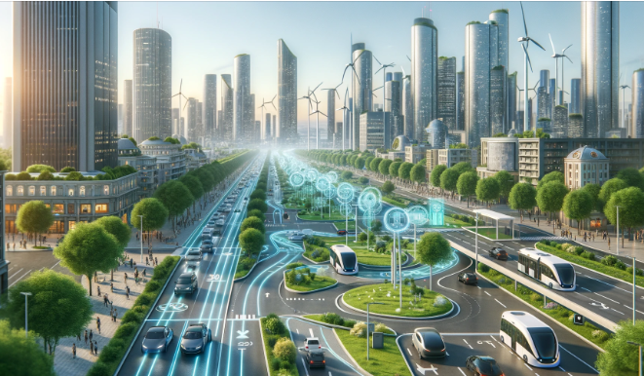
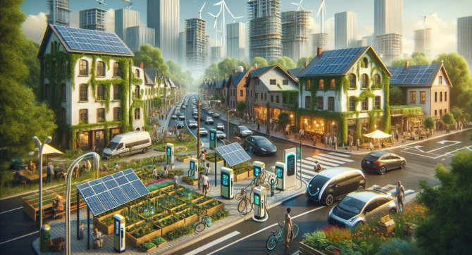
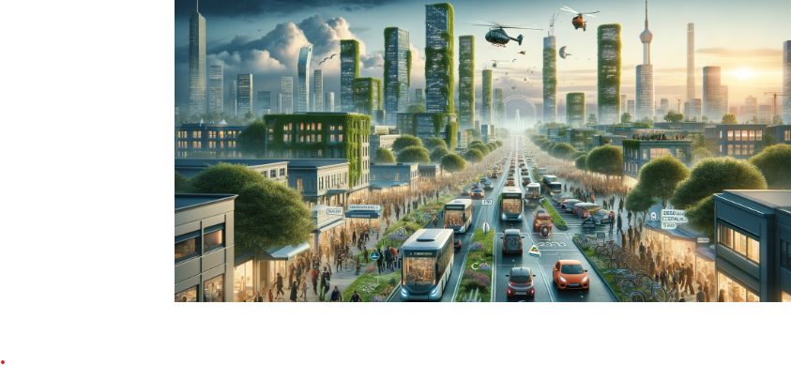
Stage 5: Develop four possible scenarios How does this look in practice?
Plot the identified factors x1 and x2 on two orthogonal axes
Assign extreme values to x1 and x2 factors
X1: high availability of smart infrastructure
Scenario 2: Smart Green 2040: Navigating Sustainability Amidst Affluence
Scenario1: „Green Horizons: The 2040 Urban Utopia”
X2: low fuel prices
X2: high fuel prices
Scenario 3: Grassroots Green: The 2040 Community-Driven Eco-Revolution
Scenario 4:"Resilient Mobility 2040: Navigating Through Constraints
X1: low availability of smart infrastructure

Slide 68
Develop your own scenario narratives or refer to the scenario descriptions below!
Scenario 1: "Green Horizons: The 2040 Urban Utopia"
In 2040, the high availability of smart infrastructure has revolutionized sustainable transport, making it more efficient and accessible than ever. With fuel prices soaring, cities have rapidly transitioned to electric and autonomous vehicles, integrated seamlessly with smart traffic management systems to reduce congestion and emissions. Public transportation has become highly reliable and convenient, supported by real-time data and predictive analytics, encouraging a significant shift from private car ownership. As a result, urban environments are cleaner, quieter, and more livable, with citizens embracing a more sustainable and eco-friendly lifestyle.

Slide 69
Scenario 2: „Smart Green 2040: Navigating Sustainability Amidst Affluence"
In 2040, even with low fuel prices, cities thrive on sustainable transport thanks to widespread smart infrastructure. Electric vehicles and renewable energy are the norms, minimizing the allure of cheap fossil fuels. Smart systems enhance efficiency, making green transport the preferred choice. Urban spaces are cleaner and greener, underscoring a global commitment to sustainability.

Slide 70
Scenario 3: "Grassroots Green: The 2040 Community-Driven Eco-Revolution"
By 2040, despite low fuel prices and sparse smart infrastructure, sustainable transport evolves through community-led solar projects and bike-sharing programs. Government and non-profit support helps retrofit infrastructure, enhancing efficiency. A cultural shift towards environmental responsibility fosters a resilient approach to sustainability, focusing on local solutions and renewable energy.

Slide 71
Scenario 4: "Resilient Mobility 2040: Navigating Through Constraints"
By 2040, high fuel prices and limited smart infrastructure prompt a shift towards sustainable transport. Renewed interest in bicycles and enhanced pedestrian paths becomes prevalent, while public transport, powered by renewables, forms urban mobility's core. Carpooling and ride-sharing flourish through local initiatives, fostering a resilient, eco-conscious community amidst technological constraints.

Slide 72
Extension of the exercise
What are your hopes in relation to the occurrence of scenarios?
What fears do these scenarios generate?

Slide 73
While working in group
1. Familiarise yoursef with possible future scenarios
2. Identify your fears and hopes in each scenario
3. Assess which of your hopes and fears seem to be the most important, and which are less important?
Have fun! Every answer is correct!

Slide 74
Imagining and designing
De Bono Six Thinking Hats Technique

Slide 75
Lateral thinking
The concept of lateral thinking introduced by Edward de Bono assumes the assessment of a given phenomenon from various points of view.
This approach, according to the author, allows for a conscious search for new, alternative solutions by means of creative thinking.
Source: www.pexels.com

Slide 76
The need for lateral thinking
Alternatives
learning the ‘how to’ and value of extracting concepts using concepts to breed new ideas
Challenge
challenging traditional ways constructively learning to break free of our thinking patterns
Focus
shifting from the single focus on problems
learning the importance of redefining the focus
developing your own creative solutions of the problem
Source: www.pexels.com

Slide 77
De Bono Six Thinking Hats Technique
In order to make it easier to remember and use that technique, de Bono assigned each thinking style a hat of the appropriate color: white, red, yellow, black, green and blue.
These hats are not labels for thinking - they are rather directions in which thinking goes.
Source: https://akademickaedukacja.wordpress.com/2016/04/02/73/

Slide 78
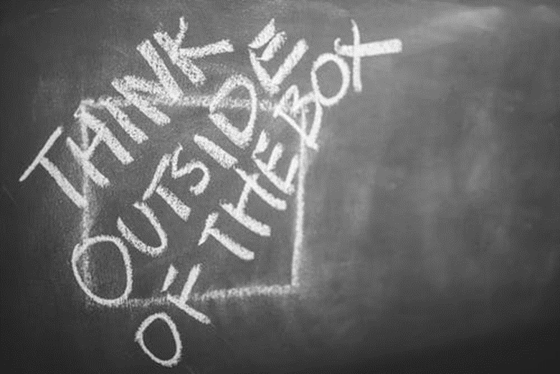
De Bono Six Thinking Hats Technique
When we put on a hat, we assume a certain type of thinking.
Hats cannot be used to assign people to a given category.
During group work, everyone wears the same hat at the same time.
Source: www.pexels.com

Slide 79
White - the facts
Facts, Figures, Data, Information
What do we know?
What data do we need to get?
What are the specifics?

Slide 80
Green - creativity
Investigating possibilities, inquiry, searching, suggestions, propositions, ideas, innovations, alternative solutions
What can you do?
Can it be done in a different way?

Slide 81
Yellow - optimism
Benefits, advantages, profits, savings
Why is it worth doing this?
What will be the benefits?
Why will it pay off?

Slide 82
Black - pessimism
Caution, assessing the truthfulness, judging, checking, verifying the facts
Will it work?
Will it be safe?
Is it possible?

Slide 83
Red - emotions
Emotions, feelings, premonitions, intuition
What do we feel about this matter when we think about it?

Slide 84
Blue - summary
Control of the thinking process, summary
Where have we come?
What action should be taken?
What is the procedure to solve the problem?

Slide 85
Hat sequence suggestions

Slide 86
Case study – EduNUT Isle
EduNUT Isle is a small island nation with a population of 500,000 people, heavily reliant on imported fossil fuels for its energy needs, which makes its electricity costs high and contributes to significant carbon emissions. The government has set an ambitious goal to transition to 100% renewable energy by 2030 to reduce its carbon footprint, enhance energy security, and stabilize energy costs. The primary renewable options available are solar, wind, and tidal energy.
As EduNUT Isle embarks on its renewable energy journey, it faces a multifaceted dilemma involving environmental, social, and economic considerations:
1. The best locations for wind farms are also key habitats for several endangered bird species. Installing wind turbines could disrupt these habitats, leading to potential ecological imbalance. | 2. The initial investment in renewable energy infrastructure, such as solar panels and tidal energy converters, is substantial. The government struggles to secure funding without imposing heavy taxes on its population, which could lead to public discontent.
3. As the nation transitions to renewable energy, there's a risk that remote communities might be left behind due to the high costs of extending | 4. The intermittent nature of solar and wind energy requires robust energy storage solutions to ensure a stable power supply. The current technology

Slide 87
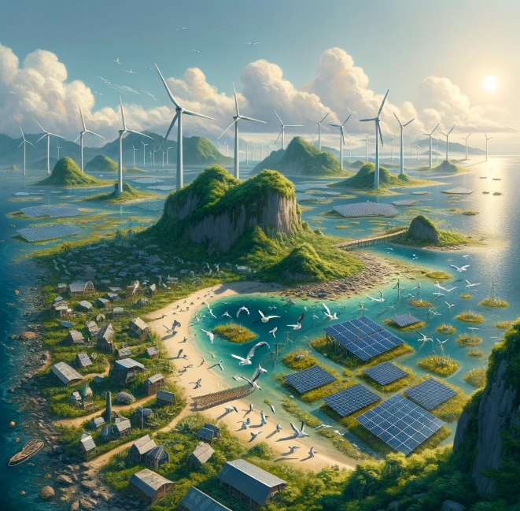
Case study - Renewable energy transition dilemma
TASK: Support EduNUT Isle government to decide whether to implement transition to 100% renewable energy by 2030 taking into account the above dilemmas. Use De Bono Six Thinking Hats technique to make a decision.

Slide 88
Literature

Slide 89
Cadez S., Czerny A., Climate change mitigation strategies in carbon-intensive firms, Journal of Cleaner Production, 112, Part 5, 2016, 4132-4143, https://doi.org/10.1016/j.jclepro.2015.07.099.
Cairns G., Wright G., Bradfield R., van der Heijden K., Burt G., Exploring e-government futures through the application of scenario planning, “Technological Forecasting and Social Change” 2004, No. 71.
Communication from The Commission to The European Parliament, The European Council, The Council, The European Economic and Social Committee and The Committee of the regions. The European Green Deal. COM (2019) 640 Final, 11.12.2019.
Communication from The Commission to The European Parliament, The Council, The European Economic and Social Committee and The Committee of the regions. Sustainable and Smart Mobility Strategy – Putting European transport on truck fot the future. COM (2020) 789 Final, 9.12.2020.
de Bono E., Six Thinking Hats, Penguin Life, 2016; http://dspace.vnbrims.org:13000/jspui/bitstream/123456789/4746/1/Six%20thinking%20hats.pdf.
Ejdys J., Gudanowska A., Halicka K., Kononiuk A., Magruk A., Nazarko J., Nazarko Ł., Szpilko D., Widelska U., Foresight in Higher Education Institutions: Evidence from Poland, „Foresight and STI Governance” 2019, Vol. 13, No.1 3.
Fahey L., Randall M. (1998), Learning from the Future. Competitive Foresight Scenarios, John Wiley&Sons, New York.
Fawzy, S., Osman, A.I., Doran, J. et al. Strategies for mitigation of climate change: a review. Environ Chem Lett 18, 2069–2094 (2020). https://doi.org/10.1007/s10311-020-01059-w.
Gudanowska A. (ed.), Kononiuk A. (ed.) (2020), Uwarunkowania rozwoju procesów produkcji i wzrostu kompetencji cyfrowych społeczeństwa, Politechnika Białostocka, Białystok.
Hamed, T. A., and A. J. J. O. S. D. O. E. Alshare. 2022. Water, and E. Systems, environmental impact of solar and wind energy-a review. Journal of Sustainable Development of Energy, Water and Environment Systems 10 (2):1–23. doi:10.13044/j.sdewes.d9.0387.
Heidari I., Eshlaghy A.T., Hoseini S.M.S., Sustainable transportation: Definitions, dimensions, and indicators – Case study of importance-performance analysis for the city of Tehran, Heliyon, 9(2023), https://doi.org/10.1016/j.heliyon.2023.e20457.
Honegger, M.; Michaelowa, A.; Poralla, M. Net-zero emissions: The role of Carbon Dioxide Removal in the Paris Agreement. Policy Briefing Report. Perspectives Climate Research, Freiburg 2019.
Jałowiec T, Wojtaszek H, Miciuła I. Analysis of the Potential Management of the Low-Carbon Energy Transformation by 2050. Energies. 2022; 15(7):2351. https://doi.org/10.3390/en15072351.

Slide 90
Makarova I, Buyvol P, Shubenkova K, Fatikhova L and Parsin G (2023) Editorial: Sustainable transport systems. Front. Built Environ. 9:1161361. doi: 10.3389/fbuil.2023.1161361.
Pålsson, H., Kovács, G. (2014), Reducing transportation emissions : A reaction to stakeholder pressure or a strategy to increase competitive advantage, International Journal of Physical Distribution & Logistics Management, Vol. 44 No. 4, pp. 283-304. https://doi.org/10.1108/IJPDLM-09-2012-0293.
Ringland G., (2007), UNIDO Technology Foresight for Practitioners. A specialised Course on Scenario Building. Prague, 5-8 November.
Saleh W.H., Jadallah A.A., Shyraiji A.L. (2022): A Review for the Cooling techniques of PV/T Solar Air Collectors. Engineering and Technology Journal, 40(01): 129-136. DOI:10.30684/etj.v40i1.2139
Shiradkar, N., R. Arya, A. Chaubal, K. Deshmukh, P. Ghosh, A. Kottantharayil, S. Kumar, and J. Vasi. 2022. Recent developments in solar manufacturing in India. Solar Compass 1:100009. doi:10.1016/j.solcom.2022.100009.
Watson R., (2012), Trends and technology timeline 2010+ a roadmap for the exploration of current and future trends, in Future Files. A brief history of the next 50 years, Nicholas Brealey Publishing, London.
Zhou J. , Sustainable transportation in the US: a review of proposals, policies, and programs since 2000, Front. Archit. Res. 1 (2012) 150–165.

Slide 91
Internet sources/Websites
https://climate.nasa.gov/faq/19/what-is-the-greenhouse-effect
https://ec.europa.eu/eurostat/web/interactive-publications/energy-2023#
https://www.energy.gov/eere/sustainable-transportation-and-fuels
UN, Transforming Our World: The 2030 Agenda for Sustainable Development (UN, New York, 2015); http://bit.ly/TransformAgendaSDG-pdf
https://www.gisreportsonline.com/r/european-green-deal/
Danone, About Danone, https://www.danone.com/about-danone/we-are-danone.html#MISSION
Danone, Climate Policy, https://www.danone.com/content/dam/corp/global/danonecom/about-us-impact/policies-and-commitments/en/2016/2016_05_18_ClimatePolicyFullVersion.pdf
Global Data, Danone SA: Overview, https://www.globaldata.com/company-profile/danone-sa/
Danone, Danone integrated annual report 2022, https://www.danone.com/content/dam/corp/global/danonecom/rai/2022/danone-integrated-annual-report-2022.pdf
Danone, Regenerative agriculture, https://www.danone.com/impact/planet/regenerative-agriculture.html
Tetra Pak, Sustainability Report FY22 Highlights, https://www.tetrapak.com/content/dam/tetrapak/media-box/global/en/documents/sustainability-report-highlights-infographics.pdf
Tetra Pak, Tetra Pak commits to net zero emissions, https://www.tetrapak.com/en-pl/about-tetra-pak/news-and-events/newsarchive/tetra-pak-commits-to-net-zero-emissions
Tetra Pak, Who we are, https://www.tetrapak.com/en-pl/about-tetra-pak/who-we-are/company
https://www.sciencefacts.net/types-of-renewable-energy.html
https://www.greenmatch.co.uk/blog/2021/09/advantages-and-disadvantages-of-renewable-energy#types-of-renewable-energy
https://op.europa.eu/webpub/eca/special-reports/renevable-energy-5-2018/en/
https://clean-coalition.org/value-of-clean-local-energy/benefits/

