Slide 1
Food Systems
Promoting Sustainable Food Habits and Futures Literacy
Presented by:
Joe Short
Institution:
Kora
Notes:
Welcome participants to the module.
Introduce yourself and provide a brief overview of your background and expertise.
Briefly outline what the session will cover and its importance in the context of food systems education.
Additional Information:
Background: Food systems encompass all the processes involved in feeding a population: growing, harvesting, processing, packaging, transporting, marketing, consumption, and disposal of food and food-related items.
Importance: Understanding food systems is crucial for promoting sustainable practices, improving public health, and addressing environmental challenges.

Slide 2
Learning Objectives
Understand the importance of sustainable food habits and the complexity of food systems.
Develop futures literacy capabilities by imagining and designing sustainable food systems.
Act for climate and sustainable food systems, encouraging a shift in thinking.
Duration: 1.5 hours
Notes:
Welcome the participants warmly.
Explain the significance of food systems education in the current global context.
Provide an overview of what will be covered in the module.
Highlight the main objectives of the session.
Clearly state the learning objectives.
Explain how these objectives will guide the session and what participants can expect to learn.
Emphasise the importance of these objectives in shaping effective teaching practices.
Additional Information:
Significance: Food systems are integral to human survival and well-being. They affect and are affected by several global issues, including climate change, health, and economic stability.
Session Objectives: By the end of this session, participants should understand the complex nature of food systems, recognise the importance of sustainable practices and personal behaviours, and feel equipped to inspire and educate students on these topics.
Sustainable Food Habits: These include practices such as reducing food waste, choosing locally-sourced foods, and understanding the impact of food choices on the environment.
Futures Literacy: This refers to the ability to imagine and design future scenarios that are sustainable and equitable, helping students to think critically about long-term impacts.
Climate Action: Encouraging behavioural changes that support sustainability, such as reducing carbon footprints and promoting eco-friendly practices.

Slide 3
What is a food system?
A food system includes all the processes and infrastructure involved in feeding a population: the growing, harvesting, processing, packaging, transporting, marketing, consumption, and disposal of food and food-related items.
Notes:
Define what a food system is.
Explain components: production, processing, distribution, consumption, and disposal.
Discuss the components
Explain the importance of each component and how they interconnect and give examples.
Additional Information - Components of a food system:
Production: The initial stage where food is grown or raised.
Processing: Transforming raw ingredients into products suitable for consumption.
Distribution: The logistics of transporting food from producers to consumers.
Consumption: The act of eating or using food products.
Disposal: The end-of-life stage of food, including waste management and recycling.

Slide 4
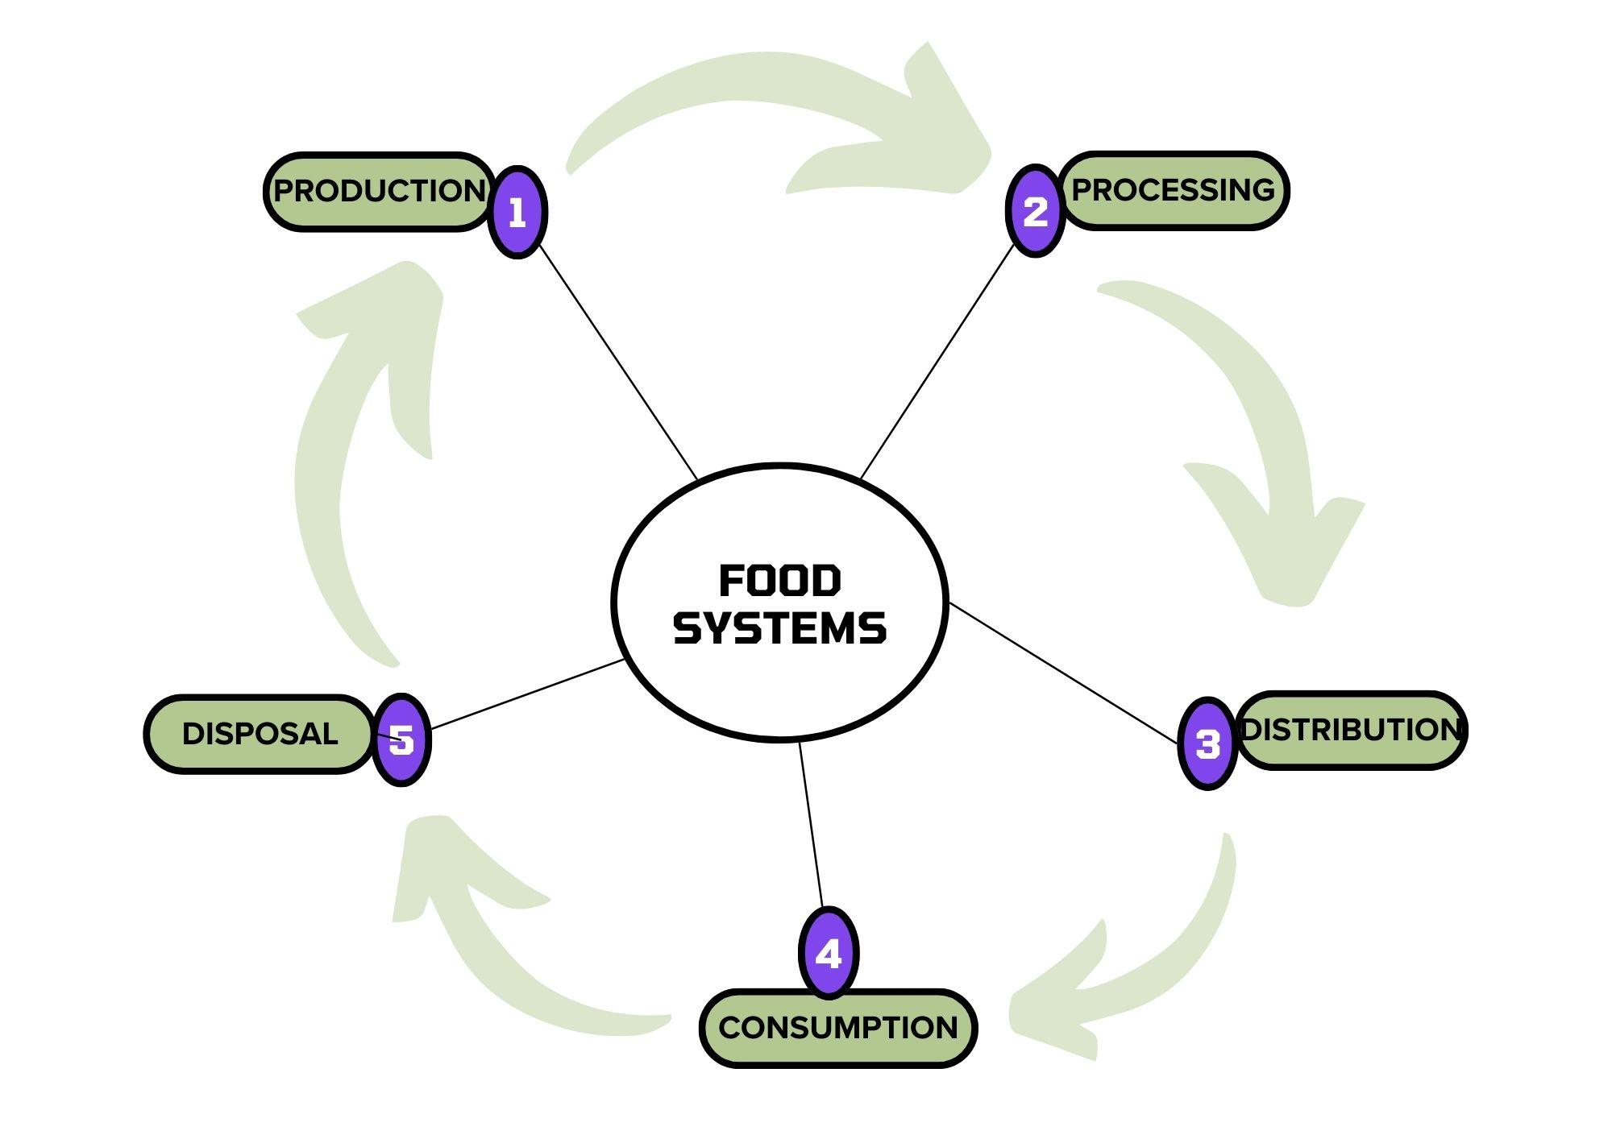

Slide 5
VIDEO: FOOD SYSTEMS
Notes:
Introduce the video and encourage participants to watch it for a comprehensive overview.

Slide 6
Impact of Food Systems
Personal Health and Food Choices
Public Health
Environment
Environmental Impact of Food Choices
Sustainability of Food Habits
Notes:
Health Impact: Poor dietary choices can lead to health issues such as obesity, diabetes, and heart disease. Sustainable diets promote better health and well-being.
Environmental Impact: Food production and consumption are major contributors to greenhouse gas emissions, deforestation, and biodiversity loss. Sustainable practices help mitigate these impacts.
Sustainability: Emphasising the need for habits that support long-term ecological balance, such as reducing meat consumption, avoiding food waste, and choosing organic produce.

Slide 7
Let’s think about the impact of our choices…
1-What is a primary benefit of choosing locally sourced food?
A. It is always cheaper. B. It reduces the carbon footprint associated with food transportation. C. It tastes better than imported food. D. It eliminates the need for food packaging.
Notes:
Multiple choice quiz on file with questions, alternatives and explanation of right answers.
Choice of applying quiz directly on Platform, use PDF file or simply discuss in the presentation.
Q:1 B: Choosing locally sourced food reduces the carbon footprint because it minimises the distance food travels from farm to table, leading to lower transportation emissions. This helps decrease greenhouse gas emissions and supports local economies. Sometimes local food is cheaper and most of the time it tastes better too and if you can avoid the packaging by buying directly from the local market you are also contributing to reduce pollution.

Slide 8
1-What is a primary benefit of choosing locally sourced food?
A. It is always cheaper. B. It reduces the carbon footprint associated with food transportation. C. It tastes better than imported food. D. It eliminates the need for food packaging.
Notes:
Multiple choice quiz on file with questions, alternatives and explanation of right answers.
Choice of applying quiz directly on Platform, use PDF file or simply discuss in the presentation.
Q:1 B: Choosing locally sourced food reduces the carbon footprint because it minimises the distance food travels from farm to table, leading to lower transportation emissions. This helps decrease greenhouse gas emissions and supports local economies. Sometimes local food is cheaper and most of the time it tastes better too and if you can avoid the packaging by buying directly from the local market you are also contributing to reduce pollution.

Slide 9
2-How can reducing meat consumption contribute to environmental sustainability?
A. It increases water use. B. It decreases the need for synthetic fertilisers. C. It reduces greenhouse gas emissions. D. It leads to greater biodiversity loss.
Notes:
Multiple choice quiz on file with questions, alternatives and explanation of right answers.
Choice of applying quiz directly on Platform, use PDF file or simply discuss in the presentation.
Q2: C: Reducing meat consumption helps lower greenhouse gas emissions, as intensive feedlot animal farming is a significant source of methane and other greenhouse gases. This reduction is crucial for mitigating climate change and its impacts on the environment.

Slide 10
2-How can reducing meat consumption contribute to environmental sustainability?
A. It increases water use. B. It decreases the need for synthetic fertilisers. C. It reduces greenhouse gas emissions. D. It leads to greater biodiversity loss.
Notes:
Multiple choice quiz on file with questions, alternatives and explanation of right answers.
Choice of applying quiz directly on Platform, use PDF file or simply discuss in the presentation.
Q2: C: Reducing meat consumption helps lower greenhouse gas emissions, as intensive feedlot animal farming is a significant source of methane and other greenhouse gases. This reduction is crucial for mitigating climate change and its impacts on the environment.

Slide 11
3-What is a health benefit of eating less meat and more vegetables?
A. Increased risk of heart disease. B. Higher levels of cholesterol. C. Lower risk of chronic diseases such as diabetes. D. Reduced intake of dietary fibre.
Notes:
Multiple choice quiz on file with questions, alternatives and explanation of right answers.
Choice of applying quiz directly on Platform, use PDF file or simply discuss in the presentation.
Q3:C: A plant-based diet is associated with a lower risk of chronic diseases such as diabetes, heart disease, and certain cancers due to higher intake of essential nutrients, vitamins, and antioxidants, and lower intake of unhealthy fats.

Slide 12
3-What is a health benefit of eating less meat and more vegetables?
A. Increased risk of heart disease. B. Higher levels of cholesterol. C. Lower risk of chronic diseases such as diabetes. D. Reduced intake of dietary fibre.
Notes:
Multiple choice quiz on file with questions, alternatives and explanation of right answers.
Choice of applying quiz directly on Platform, use PDF file or simply discuss in the presentation.
Q3:C: A plant-based diet is associated with a lower risk of chronic diseases such as diabetes, heart disease, and certain cancers due to higher intake of essential nutrients, vitamins, and antioxidants, and lower intake of unhealthy fats.

Slide 13
Importance of food systems
4-What is a major environmental impact of food waste?
A. Increased biodiversity. B. Enhanced soil fertility. C. Methane emissions from decomposing food in landfills. D. Decreased water pollution.
Notes:
Multiple choice quiz on file with questions, alternatives and explanation of right answers.
Choice of applying quiz directly on Platform, use PDF file or simply discuss in the presentation.
Q4:C: When food waste decomposes in landfills, it produces methane, a potent greenhouse gas that significantly contributes to climate change. Reducing food waste can help lower methane emissions and reduce the overall environmental impact.

Slide 14
4-What is a major environmental impact of food waste?
A. Increased biodiversity. B. Enhanced soil fertility. C. Methane emissions from decomposing food in landfills. D. Decreased water pollution.
Notes:
Multiple choice quiz on file with questions, alternatives and explanation of right answers.
Choice of applying quiz directly on Platform, use PDF file or simply discuss in the presentation.
Q4:C: When food waste decomposes in landfills, it produces methane, a potent greenhouse gas that significantly contributes to climate change. Reducing food waste can help lower methane emissions and reduce the overall environmental impact.

Slide 15
5-Why is food security an important aspect of sustainable food systems?
A. It ensures all communities have access to high-calorie foods. B. It promotes the use of genetically modified organisms (GMOs). C. It ensures all people have access to sufficient, safe, and nutritious food. D. It encourages the global distribution of food.
Notes:
Multiple choice quiz on file with questions, alternatives and explanation of right answers.
Choice of applying quiz directly on Platform, use PDF file or simply discuss in the presentation.
Q5:C: Food security is crucial for sustainable food systems because it ensures that all people have access to enough safe and nutritious food to maintain a healthy and active life. This includes addressing issues such as hunger, malnutrition, and equitable food distribution.

Slide 16
5-Why is food security an important aspect of sustainable food systems?
A. It ensures all communities have access to high-calorie foods. B. It promotes the use of genetically modified organisms (GMOs). C. It ensures all people have access to sufficient, safe, and nutritious food. D. It encourages the global distribution of food.
Notes:
Multiple choice quiz on file with questions, alternatives and explanation of right answers.
Choice of applying quiz directly on Platform, use PDF file or simply discuss in the presentation.
Q5:C: Food security is crucial for sustainable food systems because it ensures that all people have access to enough safe and nutritious food to maintain a healthy and active life. This includes addressing issues such as hunger, malnutrition, and equitable food distribution.

Slide 17
Challenges we face with our Food Systems
Complex Web: Food systems are an intricate web of production, processing, distribution, consumption, and disposal.
Interdependency: Each component relies on the others – changes in one affects all.
Global Impact: Choices made locally can have global environmental, economic, and social impacts.
Notes:
Discuss each challenge and the complexity and interconnectedness of food systems.
Highlight key challenges faced by food systems today.
**Online activity (Forum) Described in Content
Interconnectedness: Food systems are linked to various sectors such as water, energy, and health. Changes in one area can have cascading effects on others.
Challenges:
Resource Use: Efficient use of land, water, and energy is crucial to sustainable food production.
Waste Management: Reducing food waste through better storage, processing, and consumption practices.
Climate Impact: Addressing the significant contribution of food systems to global greenhouse gas emissions.
Social Equity: Ensuring fair access to food and resources, and supporting farmers and workers in the food industry.

Slide 18
Challenges we face with our Food Systems
Resource Intensive: High demand for water, energy, and land resources.
Climate Change: Agriculture is a major contributor to greenhouse gas emissions.
Food Security: Ensuring everyone has access to sufficient, safe, and nutritious food.
Notes:
Discuss each challenge and the complexity and interconnectedness of food systems.
Highlight key challenges faced by food systems today.
** Online activity (Forum) Described in Content
Interconnectedness: Food systems are linked to various sectors such as water, energy, and health. Changes in one area can have cascading effects on others.
Challenges:
Resource Use: Efficient use of land, water, and energy is crucial to sustainable food production.
Waste Management: Reducing food waste through better storage, processing, and consumption practices.
Climate Impact: Addressing the significant contribution of food systems to global greenhouse gas emissions.
Social Equity: Ensuring fair access to food and resources, and supporting farmers and workers in the food industry.

Slide 19
Challenges we face with our Food Systems
Biodiversity Loss: Monoculture farming reduces biodiversity, affecting ecosystem health.
Waste: Significant food waste at all stages – production to consumption.
Social Equity: Disparities in food access and quality across different regions and communities.
Sustainability: Balancing the need to feed the growing population with the need to preserve the planet.
Notes:
Discuss each challenge and the complexity and interconnectedness of food systems.
Highlight key challenges faced by food systems today.
If possible use Online activity (Forum) Described in the Presentation Content
Interconnectedness: Food systems are linked to various sectors such as water, energy, and health. Changes in one area can have cascading effects on others.
Challenges:
Resource Use: Efficient use of land, water, and energy is crucial to sustainable food production.
Waste Management: Reducing food waste through better storage, processing, and consumption practices.
Climate Impact: Addressing the significant contribution of food systems to global greenhouse gas emissions.
Social Equity: Ensuring fair access to food and resources, and supporting farmers and workers in the food industry.

Slide 20
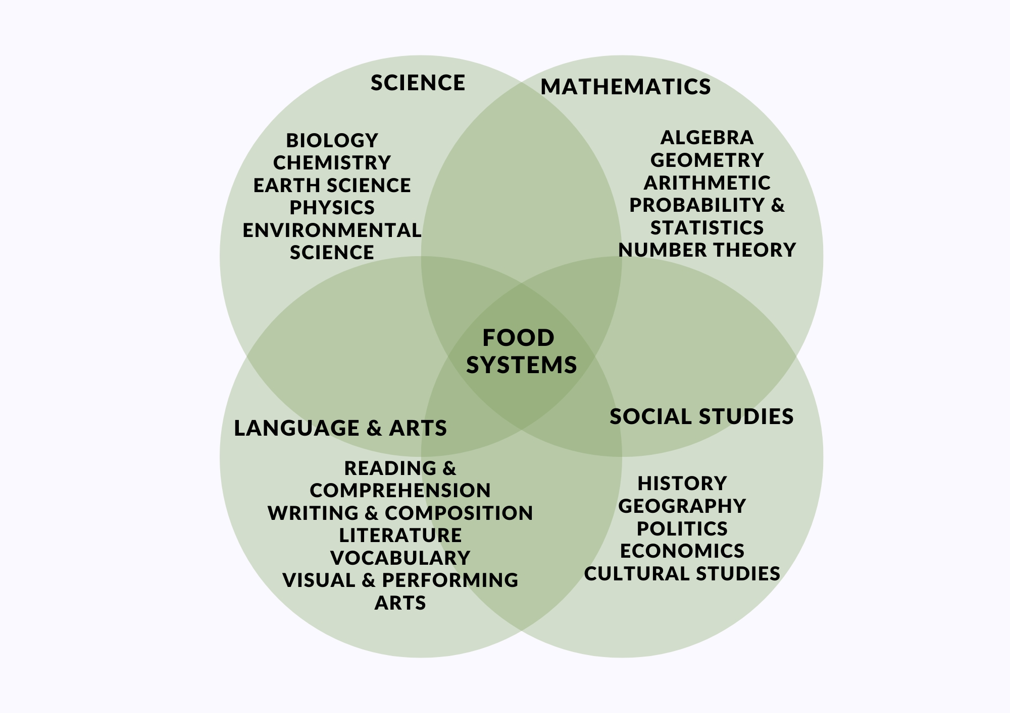
TEACHING ABOUT FOOD SYSTEMS
YOU CAN TEACH ABOUT FOOD SYSTEMS
IN ANY DISCIPLINE.
THERE ARE MANY TOPICS AND OPPORTUNITIES
TO INCLUDE FOOD SYSTEMS IN YOUR CLASS PLANS
Notes:
Multiple choice quiz on file with questions, alternatives and explanation of right answers.
Choice of applying quiz directly on Platform, use PDF file or simply discuss in the presentation.
Q5:C: Food security is crucial for sustainable food systems because it ensures that all people have access to enough safe and nutritious food to maintain a healthy and active life. This includes addressing issues such as hunger, malnutrition, and equitable food distribution.

Slide 21
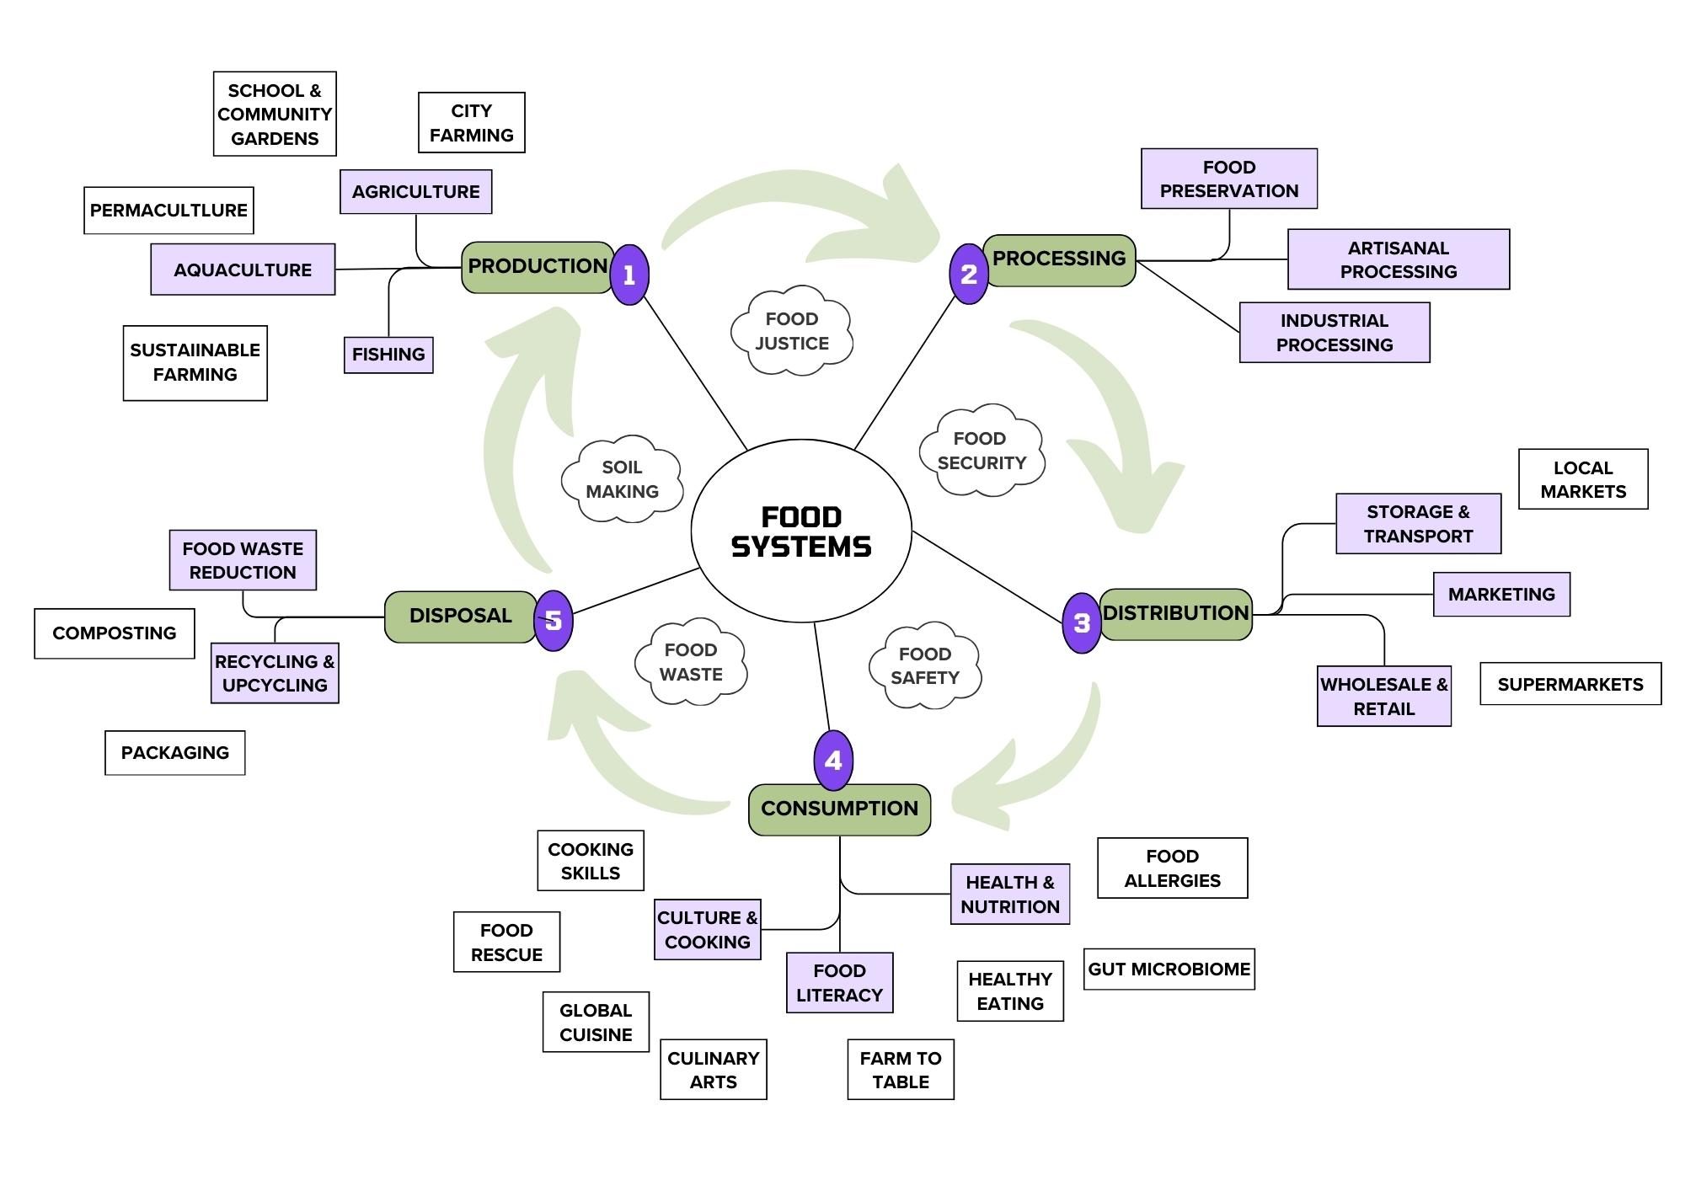
MANY TOPICS TO CHOSE FROM
Notes:
Multiple choice quiz on file with questions, alternatives and explanation of right answers.
Choice of applying quiz directly on Platform, use PDF file or simply discuss in the presentation.
Q5:C: Food security is crucial for sustainable food systems because it ensures that all people have access to enough safe and nutritious food to maintain a healthy and active life. This includes addressing issues such as hunger, malnutrition, and equitable food distribution.

Slide 22
Starting with production. Why do we need sustainable food production?
Farms as cultivated ecosystems
Integrated Design: for energy, water and fertility storages with cultivated biodiversity and accelerated succession on our farming methods.
Notes:
Discuss various methods of sustainable food production.
Highlight the importance of biodiversity and organic farming in sustainable agriculture.
Sustainable Agricultural Practices: Introduce the concept of Permaculture as an integral design method for sustainable food production that include techniques such as organic farming, crop rotation, agroforestry, integrated pest management, soil regeneration and integral water management.
Biodiversity: Emphasise how maintaining a variety of plants and animals in agriculture helps improve ecosystem resilience and productivity.
Organic Farming: Highlight the benefits of organic farming, such as reduced chemical use and improved soil health.

Slide 23
VIDEO: SUSTAINABLE FARMING
Notes:
Introduce the animated video on sustainable farming practices and encourage participants to watch it.

Slide 24
Lets talk about Sustainable Food Habits?
Plant Predominant Diets (meat or no meat?)
Local sourcing of food (market X supermarkets)
Food Waste Reduction (food at home?)
Notes:
Plant-predominant Diets: can reduce the environmental impact of food production and improve health outcomes. Plan your meals to take advantage of seasonal local foods.
Local Sourcing: benefits such as supporting local economies and reducing transportation emissions. Ask your suppliers about the origin of the food and let them know your preference for local.
Food Waste Reduction Habits: such as meal planning, proper food storage, and composting. Make your own broth from clean leftovers. Learn to make full use of all vegetables.
Discuss the benefits of sustainable diets and healthy food habits.
Emphasise the importance of reducing food waste.
**ToolKit Activity ( I LEARN)
Quiz: Sustainable Diets and Food Habits
Quiz: True/False questions on sustainable diets.
Presenter’s Notes:
Introduce the quiz and encourage participants to test their understanding of sustainable diets.

Slide 25
Sustainable Food Habits - True or False?
1- A plant-based diet is considered more sustainable than a diet high in animal products.
Notes:
Quiz: True/False questions on sustainable diets.
Introduce the quiz and encourage participants to test their understanding of sustainable diets.
True
Explanation: A plant-based diet generally has a lower environmental impact, requiring fewer resources such as water and land, and producing fewer greenhouse gases compared to a diet high in animal products.

Slide 26
Sustainable Food Habits - True or False?
2- Choosing locally sourced foods always means lower environmental impact.
Notes:
Quiz: True/False questions on sustainable diets.
Introduce the quiz and encourage participants to test their understanding of sustainable diets.
False
Explanation: While locally sourced foods can reduce transportation emissions, the overall environmental impact also depends on the methods of production. For instance, locally grown foods that rely heavily on fossil fuels or chemical inputs may still have a high environmental footprint.

Slide 27
Sustainable Food Habits - True or False?
3- Reducing food waste is a key component of a sustainable diet.
Notes:
Quiz: True/False questions on sustainable diets.
Introduce the quiz and encourage participants to test their understanding of sustainable diets.
True
Explanation: Reducing food waste helps conserve resources used in food production, decreases methane emissions from landfills, and ensures that more food is available to feed the global population.

Slide 28
Sustainable Food Habits - True or False?
4- Organic farming practices always guarantee better soil health.
Notes:
Quiz: True/False questions on sustainable diets.
Introduce the quiz and encourage participants to test their understanding of sustainable diets.
True
Explanation: Organic farming avoids synthetic chemicals and emphasises natural processes, which generally leads to improved soil health through better soil structure, fertility, and biodiversity.

Slide 29
Sustainable Food Habits - True or False?
5- Eating a variety of foods is not important for sustainability.
Notes:
Quiz: True/False questions on sustainable diets.
Introduce the quiz and encourage participants to test their understanding of sustainable diets.
False
Explanation: Eating a diverse range of foods promotes agricultural biodiversity, which is crucial for ecosystem health and resilience. It also reduces the risk of over-reliance on a single crop, which can be vulnerable to pests and diseases.

Slide 30
Sustainable Food Habits - True or False?
6- Processed foods are always less sustainable than whole foods.
Notes:
Quiz: True/False questions on sustainable diets.
Introduce the quiz and encourage participants to test their understanding of sustainable diets.
False
Explanation: The sustainability of processed foods depends on various factors including the methods of production, packaging, and transportation. Some minimally processed foods can have lower environmental impacts compared to certain whole foods that require extensive resources to produce and transport.

Slide 31
Food Environments
These are the physical, social, economic, and cultural surroundings that influence people's food choices and dietary behaviours.
Availability: The presence of healthy food options in the community.
Affordability: The cost of healthy food relative to income levels.
Safety: The safety and hygiene of food available.
Quality: The nutritional value and freshness of food available.
Check
Beeforest
https://eu-cap-network.ec.europa.eu/news/inspirational-idea-sustainable-bee-forest_en
Notes:
Explain the concept of food environments and their impact on food choices.
Discuss the factors that influence food environments.
Suggest reading of case study Bee forests

Slide 32
Imagining Sustainable Food Systems
Futures Literacy: The ability to imagine and create different future scenarios, which helps in planning and decision-making.
https://illuminem.com/category/sustainable-lifestyle
Notes:
Introduce the concept of futures literacy and its importance in food education.
Scenario Analysis: A method used to explore and prepare for different future possibilities by considering various factors and their potential impacts.
There is a detailed activity described in the content file. This can be a tool as part of the toolkit.
**TOOLKIT ACTIVITY (I Design): “Imagining Sustainable Food Systems”
Activity: Futures literacy exercise using a scenario analysis.
Provide guidance on how to complete the exercise and facilitate discussion.
Engage participants in an exercise to imagine sustainable food futures using scenario analysis.
Activity Guidance: Explain how participants can use scenario analysis to envision sustainable food systems in their communities or schools.

Slide 33
Designing Sustainable Food Systems
Project-Based Learning: students learn by actively engaging in real-world and meaningful projects.
School Gardens: Benefits include hands-on learning, understanding of food production, and promoting healthy eating habits.
Local Food Sourcing Projects: Encourage students to research and source local food for school meals or events.
Waste Reduction Initiatives: Projects that focus on reducing, reusing, and recycling food waste in schools.
School Food week: involve the entire school in a food systems project
Notes:
Suggest project ideas for students to design sustainable food systems.
Examples: school gardens, local food sourcing projects, waste reduction initiatives.
Encourage participants to think about project-based learning in their classrooms.
Suggest practical project ideas for students.

Slide 34
Acting for climate and Sustainable Food Systems
Critical Thinking: question and analyse the impact of your food choices on the environment and society.
Motivating Action: student-led initiatives that make a positive impact on their communities.
Notes:
Changing Perspectives and Behaviours
Encourage teachers to foster critical thinking about food choices.
Discuss how to motivate students to take action in their communities.
Discuss the importance of changing perspectives and behaviours for sustainable food systems.
Encourage participants to inspire their students to take action.

Slide 35
Practical Activities Connected with the Curriculum
Classroom Activities: cooking classes, food waste audits, visits to local farms, etc.
Group Discussions: Facilitate discussions on topics such as the impact of food systems on our health and the environment.
Hands-On Projects: Projects that involve growing food, cooking, recycling packaging or creating awareness campaigns about sustainable food habits.
Notes:
Provide examples of practical and engaging classroom activities.
Encourage participants to think about how they can implement these activities in their classrooms.
Guide participants through the interactive session on planning activities.
**Refer to toolkit of I ACT activities

Slide 36
Case Study: CLIKIS-Network – climate-friendly school kitchens - Estonia
The project provided eight Estonian kindergartens and schools with an opportunity to evaluate their kitchen equipment, menu, cooking practices, and waste management.
Example: Tartu Kivilinna School has introduced weighing the food waste left on the plate, which provides useful information for students, the school administration, and the caterer. The cafeteria keeps a daily record of food waste, which shows the number of students who eat and the amount of leftover food in liters
Notes:
Present Case and discuss its key aspects.
Describe the goals and strengths of the project
Explain the solutions implemented
Highlight the outcomes and benefits of these solutions.
Encourage participants to reflect on the case and share their thoughts in the discussion forum.
*Case study in content file

Slide 37
Case Study: Berlin Challenge
Problem: Berlin faced challenges with food security, access to fresh produce, and food waste management.
Solutions:
Community Gardens: Provided local residents with access to fresh produce and green spaces.
Cooperative Supermarkets: Enabled consumers to have more control over the food they purchase and support local producers.
Food Waste Reduction Apps: Connected surplus food with people in need, reducing food waste.
Outcomes: Improved food security, enhanced community engagement, and reduced food waste.
Notes:
Present the Berlin Case and discuss its key aspects.
Describe the problem faced in Berlin regarding food systems.
Explain the solutions implemented, such as community gardens, cooperative supermarkets, and food waste reduction apps.
Highlight the outcomes and benefits of these solutions.
Encourage participants to reflect on the case and share their thoughts in the discussion forum.
*Case study in content file

Slide 38
Case Study: Children’s summer camp in the farm - Estonia
The Ranna Rancho summer camp offers children the opportunity to gain a fresh perspective on nature, including the process of food cultivation. During the camp, children live amidst nature and engage in simple, traditional countryside activities.
Children gain valuable knowledge and experience about food literacy, specifically the process of food growth, health benefits of various plants, creating recipes with minimal food waste, etc. Caring for farm animals also fosters empathy and respect for animals.
Notes:
Present Case and discuss its key aspects.
Describe the goals and strengths of the project
Explain the solutions implemented
Highlight the outcomes and benefits of these solutions.
Encourage participants to reflect on the case and share their thoughts in the discussion forum.
*Case study in content file

Slide 39
Imagining and Designing Future Food Systems
Futures Literacy Methods
Scenario planning:
Backcasting
Visioning exercises.
Notes:
Introduce the futures literacy methods and their application in food systems education.
Explain the characteristics and benefits of using these methods.
Provide a step-by-step description of how to use the futures literacy method in classroom settings.
Discuss how these methods can be applied to other subjects.
Guide participants through a futures literacy task for designing a sustainable food system.
Tool Kit Activities - Additional Information:
Futures Literacy Methods: Include scenario planning, backcasting, and visioning exercises.
Justification: These methods help students think critically about future possibilities and develop strategies for sustainable development.
Activities Procedure:
Scenario Planning: Identify key drivers of change and develop different scenarios for future food systems.
Backcasting: Start with a desired future outcome and work backward to identify the steps needed to achieve it.
Visioning: Create a detailed and inspiring vision of a sustainable future and discuss how it can be realised.
Task: Ask participants to envision a sustainable food system in their community and outline the steps to achieve it.

Slide 40
The Food Systems Dashboard website
https://www.foodsystemsdashboard.org/
Notes:
If time allows an exploration of the food systems dashboard can demonstrate how food systems around the world are being monitored. Website allows for country by country statistics.
Otherwise this can be an activity for teachers to research at home.
Discuss the Food Systems Dashboard and how it can be used to analyse food systems.
Introduce the Food Systems Dashboard as a practical example.
Provide the link to the Dashboard and encourage participants to review it.

Slide 41
REFERENCES
Books and Publications
Legan, L. (2020). Planet Schooling: How to Create a Permaculture Living Laboratory in Your Back Yard. CreateSpace Independent Publishing Platform.
European Commission. (2020). Farm to Fork Strategy: For a Fair, Healthy and Environmentally-Friendly Food System. Retrieved from https://ec.europa.eu/food/horizontal-topics/farm-fork-strategy_en
Food and Agriculture Organization of the United Nations (FAO). (2018). Agroecology: Scaling up Agroecology to Achieve the Sustainable Development Goals. Retrieved from http://www.fao.org/3/I9049EN/i9049en.pdf
European Environment Agency (EEA). (2019). The European Environment – State and Outlook 2020: Knowledge for Transition to a Sustainable Europe. Retrieved from https://www.eea.europa.eu/publications/soer-2020
International Panel of Experts on Sustainable Food Systems (IPES-Food). (2016). From Uniformity to Diversity: A Paradigm Shift from Industrial Agriculture to Diversified Agroecological Systems. Retrieved from http://www.ipes-food.org/_img/upload/files/UniformityToDiversity_FULL.pdf
European Union. (2019). EU Agricultural Outlook for Markets and Income 2019-2030. Retrieved from https://ec.europa.eu/info/sites/info/files/food-farming-fisheries/farming/documents/agricultural-outlook-2019-report_en.pdf
WWF. (2019). Living Planet Report 2019: Aiming Higher. Retrieved from https://wwf.panda.org/knowledge_hub/all_publications/living_planet_report_2019/
Notes:
Provide a comprehensive list of resources for further reading.
Encourage participants to explore these resources for ongoing professional development.
Highlight the importance of continuous learning in the field of food systems.
Introduce the interactive link to the curated reading list and additional resources.

Slide 42
REFERENCES
Websites
European Commission – Farm to Fork Strategy: https://ec.europa.eu/food/horizontal-topics/farm-fork-strategy_en
Food and Agriculture Organization (FAO) – Sustainable Food and Agriculture: http://www.fao.org/sustainability/en/
European Environment Agency (EEA): https://www.eea.europa.eu/
International Panel of Experts on Sustainable Food Systems (IPES-Food): http://www.ipes-food.org/
Sustainable Food Trust: https://sustainablefoodtrust.org/
EAT Forum: https://eatforum.org/
Agroecology and Sustainable Food Systems Journal: https://www.tandfonline.com/toc/wjsa20/current
Food Systems Dashboard: https://foodsystemsdashboard.org/

Slide 43
REFERENCES
Reports and Documents
European Commission. (2020). A Farm to Fork Strategy for a Fair, Healthy and Environmentally-Friendly Food System. Retrieved from https://ec.europa.eu/food/sites/food/files/safety/docs/f2f_action-plan_2020_strategy-info_en.pdf
FAO. (2018). The Future of Food and Agriculture: Alternative Pathways to 2050. Retrieved from http://www.fao.org/3/I8429EN/i8429en.pdf
EEA. (2020). Food in a Green Light: A Systems Approach to Sustainable Food. Retrieved from https://www.eea.europa.eu/publications/food-in-a-green-light
IPES-Food. (2019). Towards a Common Food Policy for the European Union: The Policy Reform and Realignment That Is Required to Build Sustainable Food Systems in Europe. Retrieved from http://www.ipes-food.org/_img/upload/files/CFP_FullReport.pdf
European Commission. (2018). EU Food Losses and Waste. Retrieved from https://ec.europa.eu/food/sites/food/files/safety/docs/fw_eu-actions_food-waste-com_2018_en.pdf

Slide 44
REFERENCES
Articles and Journals
Garnett, T. (2014). What is a Sustainable Healthy Diet?. Food Climate Research Network. Retrieved from https://www.fcrn.org.uk/sites/default/files/fcrn_what_is_a_sustainable_healthy_diet_final.pdf
Tilman, D., & Clark, M. (2014). Global Diets Link Environmental Sustainability and Human Health. Nature, 515(7528), 518-522. Retrieved from https://www.nature.com/articles/nature13959
Gliessman, S. R. (2018). Agroecology: The Ecology of Sustainable Food Systems. CRC Press.

Slide 45
EU Educational Sources
European Commission – Education and Training: https://ec.europa.eu/education/
European Schoolnet: http://www.eun.org/
Eco-Schools Programme: https://www.ecoschools.global/
European Environment Information and Observation Network (Eionet): https://www.eionet.europa.eu/
Food for Life Partnership: https://www.foodforlife.org.uk/

Slide 46
Further Readings
Farming for the Future: Sustainable Agriculture and Food Systems (2020). European Parliament. Retrieved from https://www.europarl.europa.eu/RegData/etudes/BRIE/2020/649359/EPRS_BRI(2020)649359_EN.pdf
Transition to Agroecology: For a Food System Transformation in Europe (2019). Report by IDDRI and Agroecology Europe. Retrieved from https://www.agroecology-europe.org/wp-content/uploads/2019/04/Agroecology-IDDRI-Report.pdf
Rethinking Food and Agriculture: New Ways Forward (2020). Springer Nature. Retrieved from https://www.springer.com/gp/book/9783030393122

Slide 47
The space is open for quesions
Notes:
Facilitate a Q&A session to address participants' questions.
Encourage sharing of ideas and experiences among teachers.
Interactive Forum: Ongoing Q&A and support forum.
Encourage an open discussion and sharing of ideas.
Introduce the ongoing Q&A and support forum (Toolkit) for continuous engagement.
Interactive Forum: Set up a forum where participants can post questions and share their experiences. This forum can also be used for ongoing support and networking.This can be connected to Activities and Class Plans website.
Encouraging Engagement: Invite participants to ask questions and share their thoughts on the topics discussed. Use open-ended questions to stimulate discussion.

Slide 48
Be the change! Choose sustainable food habits today for a healthier tomorrow. Lets protect our planet one meal at a time!
Notes:
Summarise the key points covered in the module.
Emphasise the importance of integrating food systems education into the curriculum.
Introduce the motivational video and encourage participants to watch it.
Additional Presenter Information:
Summary: Recap the key points such as the importance of sustainable food habits, the complexity of food systems, and the role of futures literacy.
Call to Action: Encourage teachers to incorporate food systems education into their lessons and inspire their students to think critically about sustainability.
**Motivational Video: Use the video to leave participants with a strong and positive message about the impact they can make.

Slide 49
Thank you!
Contact
Associazione Kora
Joe Short
Notes:
Gratitude and Contact Information
Thank the teachers for their participation.
Provide your contact information for further questions and collaboration.
Interactive Link: Feedback form and contact details.
Thank the participants for their engagement and participation.
Provide your contact details for further questions and collaboration.
Encourage participants to fill out the feedback form.
Additional Presenter Information:
Feedback Form: Set up an online form where participants can provide feedback on the module. Use this feedback to make improvements.
Contact Information: Provide your email address and any other relevant contact details for follow-up questions and collaboration opportunities.

Slide 50
Glossary
Agroecology: A holistic approach to farming that emphasizes the ecological management of agricultural systems, integrating practices that support biodiversity, sustainability, and the health of ecosystems.
Agroforestry: A land-use management system in which trees or shrubs are grown around or among crops or pastureland. This practice enhances biodiversity and increases productivity, resilience, and sustainability.
Aquaculture: The cultivation of aquatic organisms such as fish, shellfish, and plants, typically for food, in controlled environments.
Biodiversity: The variety of life in the world or in a particular habitat or ecosystem. In agriculture, biodiversity helps maintain ecosystem stability, enhances soil fertility, and improves resilience against pests and diseases.

Slide 51
Community Garden: A single piece of land gardened collectively by a group of people. Community gardens provide fresh produce, improve urban environments, and foster social interactions.
Composting: The process of recycling organic waste, such as food scraps and yard waste, into a valuable soil amendment known as compost. This process enhances soil health and reduces landfill waste.
Crop Rotation: The practice of growing different types of crops in the same area in sequenced seasons. It helps maintain soil health, reduce pest and disease cycles, and increase crop yield.
Distribution: The process of transporting food from the place of production to where it will be consumed. Effective distribution ensures that food reaches consumers efficiently and remains fresh and safe to eat.
Ecosystem Services: The benefits that humans derive from ecosystems, including provisioning services (like food and water), regulating services (like flood control), cultural services (like recreational benefits), and supporting services (like nutrient cycling).
Ethical Farming: Agricultural practices that prioritize animal welfare, environmental sustainability, and fair treatment of workers. Ethical farming aims to produce food in a way that is morally right and socially responsible.

Slide 52
Food Desert: Urban or rural areas where access to affordable and nutritious food is limited. Residents in food deserts often rely on convenience stores and fast food, leading to poor dietary health.
Food Environment: The physical, economic, political, and socio-cultural context in which people make food choices. Food environments influence what foods are available, affordable, and desirable.
Food Insecurity: A condition in which people lack regular access to enough safe and nutritious food for normal growth and development and an active, healthy life.
Food System: The interconnected network that encompasses all aspects of feeding a population, including growing, harvesting, processing, packaging, transporting, marketing, consumption, and disposal of food.
Futures Literacy: The capability to imagine and evaluate possible futures. It enables individuals and communities to envision and plan for sustainable and desirable future scenarios.
Greenhouse Gas Emissions: Gases like carbon dioxide, methane, and nitrous oxide that trap heat in the atmosphere, contributing to global warming and climate change. Agriculture is a significant source of these emissions.
Integrated Pest Management (IPM): An environmentally sensitive approach to pest management that uses a combination of biological, cultural, physical, and chemical methods to minimize the impact on human health, beneficial and non-target organisms, and the environment.

Slide 53
Integral Resource Management: A holistic approach to managing all resources—land, water, energy, and materials—in an integrated manner to create sustainable and efficient systems.
Local Food: Food that is produced, processed, and distributed within a specific geographic area. Local food systems support regional economies, reduce transportation emissions, and provide fresher produce.
Organic Farming: A method of farming that uses natural processes and inputs, avoiding synthetic chemicals and genetically modified organisms (GMOs). Organic farming promotes soil health, biodiversity, and ecological balance.
Permaculture: A design system for sustainable living and agriculture that mimics natural ecosystems. Permaculture principles include care for the earth, care for people, and fair share of resources.
Regenerative Agriculture: A conservation and rehabilitation approach to food and farming systems that focuses on regenerating topsoil, increasing biodiversity, improving water cycles, and enhancing ecosystem services.
Sustainable Agriculture: Farming practices that meet current food needs without compromising the ability of future generations to meet their needs. It emphasizes environmental health, economic profitability, and social and economic equity.

Slide 54
Sustainable Diet: A diet that has low environmental impact, contributes to food and nutrition security, and supports a healthy life for present and future generations. It is culturally acceptable, economically fair, and nutritionally adequate.
Waste Management: The collection, transport, processing, recycling, and disposal of waste materials. Effective waste management reduces environmental impact and promotes resource recovery.

Slide 55
Teaching materials

Slide 56
Case study
Berlin

Slide 57
Imagining and designing

