Slide 1
Toidusüsteemid
Kestlike toitumisharjumuste ja tuleviku kirjaoskuse edendamine
Joe Short
Institution:Kora
Notes:
Welcome participants to the module.
Introduce yourself and provide a brief overview of your background and expertise.
Briefly outline what the session will cover and its importance in the context of food systems education.
Additional Information:
Background: Food systems encompass all the processes involved in feeding a population: growing, harvesting, processing, packaging, transporting, marketing, consumption, and disposal of food and food-related items.
Importance: Understanding food systems is crucial for promoting sustainable practices, improving public health, and addressing environmental challenges.

Slide 2
Õppeeesmärgid
Mõista kestlike toitumisharjumuste tähtsust ja toidusüsteemide keerukust.
Arendada tuleviku kirjaoskust, kujutledes ja kujundades jätkusuutlikke toidusüsteeme.
Tegutseda kliima ja kestlikke toidusüsteemi toetades, julgustades mõtteviisi muutust.
Duration: 1.5 hours
Notes:
Welcome the participants warmly.
Explain the significance of food systems education in the current global context.
Provide an overview of what will be covered in the module.
Highlight the main objectives of the session.
Clearly state the learning objectives.
Explain how these objectives will guide the session and what participants can expect to learn.
Emphasise the importance of these objectives in shaping effective teaching practices.
Additional Information:
Significance: Food systems are integral to human survival and well-being. They affect and are affected by several global issues, including climate change, health, and economic stability.
Session Objectives: By the end of this session, participants should understand the complex nature of food systems, recognise the importance of sustainable practices and personal behaviours, and feel equipped to inspire and educate students on these topics.
Sustainable Food Habits: These include practices such as reducing food waste, choosing locally-sourced foods, and understanding the impact of food choices on the environment.
Futures Literacy: This refers to the ability to imagine and design future scenarios that are sustainable and equitable, helping students to think critically about long-term impacts.
Climate Action: Encouraging behavioural changes that support sustainability, such as reducing carbon footprints and promoting eco-friendly practices.

Slide 3
Mis on toidusüsteem?
Toidusüsteem hõlmab kõiki elanikkonna toitmisega seotud protsesse ja infrastruktuuri: toidu ja toiduga seotud toodete kasvatamist, korjamist, töötlemist, pakendamist, transportimist, turustamist, tarbimist ja kõrvaldamist.
Notes:
Define what a food system is.
Explain components: production, processing, distribution, consumption, and disposal.
Discuss the components
Explain the importance of each component and how they interconnect and give examples.
Additional Information - Components of a food system:
Production: The initial stage where food is grown or raised.
Processing: Transforming raw ingredients into products suitable for consumption.
Distribution: The logistics of transporting food from producers to consumers.
Consumption: The act of eating or using food products.
Disposal: The end-of-life stage of food, including waste management and recycling.

Slide 4
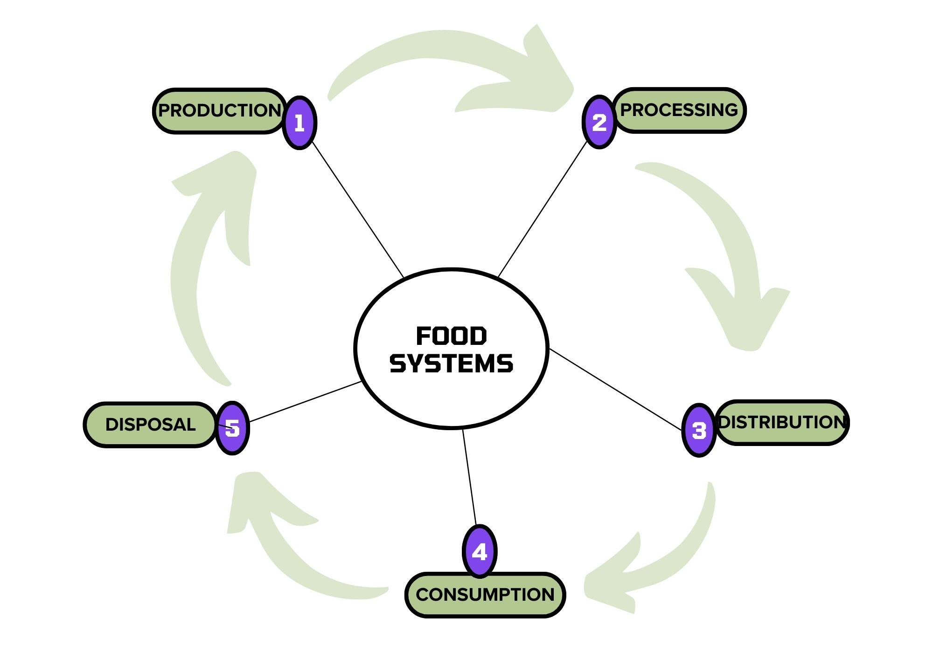

Slide 5
VIDEO: TOIDUSÜSTEEM
Notes:
Introduce the video and encourage participants to watch it for a comprehensive overview.

Slide 6
Toidusüsteemide mõju
Isiklik tervis ja toiduvalikud
Rahvatervis
Keskkond
Toiduvalikute keskkonnamõju
Toiduharjumuste jätkusuutlikkus
Notes:
Health Impact: Poor dietary choices can lead to health issues such as obesity, diabetes, and heart disease. Sustainable diets promote better health and well-being.
Environmental Impact: Food production and consumption are major contributors to greenhouse gas emissions, deforestation, and biodiversity loss. Sustainable practices help mitigate these impacts.
Sustainability: Emphasising the need for habits that support long-term ecological balance, such as reducing meat consumption, avoiding food waste, and choosing organic produce.

Slide 7
Mõelgem oma valikute mõjule…
1-Mis on kohaliku toidu valimise peamine eelis?
A. See on alati odavam.
B. See vähendab toidu transpordiga seotud süsiniku jalajälge.
C. See maitseb paremini kui imporditud toit.
D. See välistab vajaduse toidu pakendamise järele.
Notes:
Multiple choice quiz on file with questions, alternatives and explanation of right answers.
Choice of applying quiz directly on Platform, use PDF file or simply discuss in the presentation.
Q:1 B: Choosing locally sourced food reduces the carbon footprint because it minimises the distance food travels from farm to table, leading to lower transportation emissions. This helps decrease greenhouse gas emissions and supports local economies. Sometimes local food is cheaper and most of the time it tastes better too and if you can avoid the packaging by buying directly from the local market you are also contributing to reduce pollution.

Slide 8
1-Mis on kohaliku toidu valimise peamine eelis?
A. See on alati odavam.
B. See vähendab toidu transpordiga seotud süsiniku jalajälge.
C. See maitseb paremini kui imporditud toit.
D. See välistab vajaduse toidu pakendamise järele.
Notes:
Multiple choice quiz on file with questions, alternatives and explanation of right answers.
Choice of applying quiz directly on Platform, use PDF file or simply discuss in the presentation.
Q:1 B: Choosing locally sourced food reduces the carbon footprint because it minimises the distance food travels from farm to table, leading to lower transportation emissions. This helps decrease greenhouse gas emissions and supports local economies. Sometimes local food is cheaper and most of the time it tastes better too and if you can avoid the packaging by buying directly from the local market you are also contributing to reduce pollution.

Slide 9
2-Kuidas saab liha tarbimise vähendamine aidata kaasa keskkonnasäästlikkusele?
A. See suurendab veekasutust.
B. See vähendab vajadust sünteetiliste väetiste järele.
C. See vähendab kasvuhoonegaaside heitkoguseid.
D. See toob kaasa bioloogilise mitmekesisuse suurema vähenemise.
Notes:
Multiple choice quiz on file with questions, alternatives and explanation of right answers.
Choice of applying quiz directly on Platform, use PDF file or simply discuss in the presentation.
Q2: C: Reducing meat consumption helps lower greenhouse gas emissions, as intensive feedlot animal farming is a significant source of methane and other greenhouse gases. This reduction is crucial for mitigating climate change and its impacts on the environment.

Slide 10
2-Kuidas saab liha tarbimise vähendamine aidata kaasa keskkonnasäästlikkusele?
A. See suurendab veekasutust.
B. See vähendab vajadust sünteetiliste väetiste järele.
C. See vähendab kasvuhoonegaaside heitkoguseid.
D. See toob kaasa bioloogilise mitmekesisuse suurema vähenemise.
Notes:
Multiple choice quiz on file with questions, alternatives and explanation of right answers.
Choice of applying quiz directly on Platform, use PDF file or simply discuss in the presentation.
Q2: C: Reducing meat consumption helps lower greenhouse gas emissions, as intensive feedlot animal farming is a significant source of methane and other greenhouse gases. This reduction is crucial for mitigating climate change and its impacts on the environment.

Slide 11
3-Mis kasu on tervisele, kui süüa vähem liha ja rohkem köögivilju?
A. Suurenenud südamehaiguste risk.
B. Kõrgem kolesteroolitase.
C. Väiksem risk krooniliste haiguste, näiteks diabeedi tekkeks.
D. Kiudainete tarbimise vähenemine.
Notes:
Multiple choice quiz on file with questions, alternatives and explanation of right answers.
Choice of applying quiz directly on Platform, use PDF file or simply discuss in the presentation.
Q3:C: A plant-based diet is associated with a lower risk of chronic diseases such as diabetes, heart disease, and certain cancers due to higher intake of essential nutrients, vitamins, and antioxidants, and lower intake of unhealthy fats.

Slide 12
3-Mis kasu on tervisele, kui süüa vähem liha ja rohkem köögivilju?
A. Suurenenud südamehaiguste risk.
B. Kõrgem kolesteroolitase.
C. Väiksem risk krooniliste haiguste, näiteks diabeedi tekkeks.
D. Kiudainete tarbimise vähenemine.
Notes:
Multiple choice quiz on file with questions, alternatives and explanation of right answers.
Choice of applying quiz directly on Platform, use PDF file or simply discuss in the presentation.
Q3:C: A plant-based diet is associated with a lower risk of chronic diseases such as diabetes, heart disease, and certain cancers due to higher intake of essential nutrients, vitamins, and antioxidants, and lower intake of unhealthy fats.

Slide 13
Toidusüsteemide tähtsus
4-Milline on toidujäätmete keskkonnamõju?
A. Bioloogilise mitmekesisuse suurenemine.
B. Suurenenud mullaviljakus.
C. Prügilates toidu lagunemisel tekkiv metaani heide.
D. Veereostuse vähenemine.
Notes:
Multiple choice quiz on file with questions, alternatives and explanation of right answers.
Choice of applying quiz directly on Platform, use PDF file or simply discuss in the presentation.
Q4:C: When food waste decomposes in landfills, it produces methane, a potent greenhouse gas that significantly contributes to climate change. Reducing food waste can help lower methane emissions and reduce the overall environmental impact.

Slide 14
4-Milline on toidujäätmete keskkonnamõju?
A. Bioloogilise mitmekesisuse suurenemine.
B. Suurenenud mullaviljakus.
C. Prügilates toidu lagunemisel tekkiv metaani heide.
D. Veereostuse vähenemine.
Notes:
Multiple choice quiz on file with questions, alternatives and explanation of right answers.
Choice of applying quiz directly on Platform, use PDF file or simply discuss in the presentation.
Q4:C: When food waste decomposes in landfills, it produces methane, a potent greenhouse gas that significantly contributes to climate change. Reducing food waste can help lower methane emissions and reduce the overall environmental impact.

Slide 15
5-Miks on toiduga kindlustatus kestlike toidusüsteemide oluline aspekt?
A. See tagab, et kõigil kogukondadel on juurdepääs kõrge kalorsusega toitudele.
B. See edendab geneetiliselt muundatud organismide (GMOd) kasutamist.
C. See tagab kõigile inimestele juurdepääsu piisavale, ohutule ja täisväärtuslikule toidule.
D. See soodustab toidu ülemaailmset jaotamist.
Notes:
Multiple choice quiz on file with questions, alternatives and explanation of right answers.
Choice of applying quiz directly on Platform, use PDF file or simply discuss in the presentation.
Q5:C: Food security is crucial for sustainable food systems because it ensures that all people have access to enough safe and nutritious food to maintain a healthy and active life. This includes addressing issues such as hunger, malnutrition, and equitable food distribution.

Slide 16
5- Miks on toiduga kindlustatus kestlike toidusüsteemide oluline aspekt?
A. See tagab, et kõigil kogukondadel on juurdepääs kõrge kalorsusega toitudele.
B. See edendab geneetiliselt muundatud organismide (GMOd) kasutamist.
C. See tagab kõigile inimestele juurdepääsu piisavale, ohutule ja täisväärtuslikule toidule.
D. See soodustab toidu ülemaailmset jaotamist.
Notes:
Multiple choice quiz on file with questions, alternatives and explanation of right answers.
Choice of applying quiz directly on Platform, use PDF file or simply discuss in the presentation.
Q5:C: Food security is crucial for sustainable food systems because it ensures that all people have access to enough safe and nutritious food to maintain a healthy and active life. This includes addressing issues such as hunger, malnutrition, and equitable food distribution.

Slide 17
Väljakutsed, millega me oma toidusüsteemidega silmitsi seisame
Kompleksne veeb: Toidusüsteemid on tootmise, töötlemise, levitamise, tarbimise ja kõrvaldamise keeruline võrk.
Vastastikune sõltuvus: Iga komponent sõltub teistest – muutused ühes mõjutavad kõiki.
Globaalne mõju: kohalikul tasandil tehtud valikutel võib olla ülemaailmne keskkonna-, majanduslik ja sotsiaalne mõju.
Notes:
Discuss each challenge and the complexity and interconnectedness of food systems.
Highlight key challenges faced by food systems today.
**Online activity (Forum) Described in Content
Interconnectedness: Food systems are linked to various sectors such as water, energy, and health. Changes in one area can have cascading effects on others.
Challenges:
Resource Use: Efficient use of land, water, and energy is crucial to sustainable food production.
Waste Management: Reducing food waste through better storage, processing, and consumption practices.
Climate Impact: Addressing the significant contribution of food systems to global greenhouse gas emissions.
Social Equity: Ensuring fair access to food and resources, and supporting farmers and workers in the food industry.

Slide 18
Väljakutsed, millega me oma toidusüsteemidega silmitsi seisame
Ressursimahukas: suur nõudlus vee, energia ja maaressursside järele.
Kliimamuutused: põllumajandus on kasvuhoonegaaside heitkoguste peamine põhjustaja.
Toiduga kindlustatus: tagada, et kõigil oleks juurdepääs piisavale, ohutule ja täisväärtuslikule toidule.
Notes:
Discuss each challenge and the complexity and interconnectedness of food systems.
Highlight key challenges faced by food systems today.
** Online activity (Forum) Described in Content
Interconnectedness: Food systems are linked to various sectors such as water, energy, and health. Changes in one area can have cascading effects on others.
Challenges:
Resource Use: Efficient use of land, water, and energy is crucial to sustainable food production.
Waste Management: Reducing food waste through better storage, processing, and consumption practices.
Climate Impact: Addressing the significant contribution of food systems to global greenhouse gas emissions.
Social Equity: Ensuring fair access to food and resources, and supporting farmers and workers in the food industry.

Slide 19
Väljakutsed, millega me oma toidusüsteemidega silmitsi seisame
Bioloogilise mitmekesisuse vähenemine: Monokultuurne põllumajandus vähendab bioloogilist mitmekesisust, mõjutades ökosüsteemi tervist.
Jäätmed: märkimisväärsed toidujäätmed kõigis etappides – tootmisest tarbimiseni.
Sotsiaalne võrdsus: erinevused toidu kättesaadavuses ja kvaliteedis eri piirkondade ja kogukondade vahel.
Jätkusuutlikkus: kasvava elanikkonna toitmise vajaduse tasakaalustamine vajadusega säilitada planeeti.
Notes:
Discuss each challenge and the complexity and interconnectedness of food systems.
Highlight key challenges faced by food systems today.
If possible use Online activity (Forum) Described in the Presentation Content
Interconnectedness: Food systems are linked to various sectors such as water, energy, and health. Changes in one area can have cascading effects on others.
Challenges:
Resource Use: Efficient use of land, water, and energy is crucial to sustainable food production.
Waste Management: Reducing food waste through better storage, processing, and consumption practices.
Climate Impact: Addressing the significant contribution of food systems to global greenhouse gas emissions.
Social Equity: Ensuring fair access to food and resources, and supporting farmers and workers in the food industry.

Slide 20
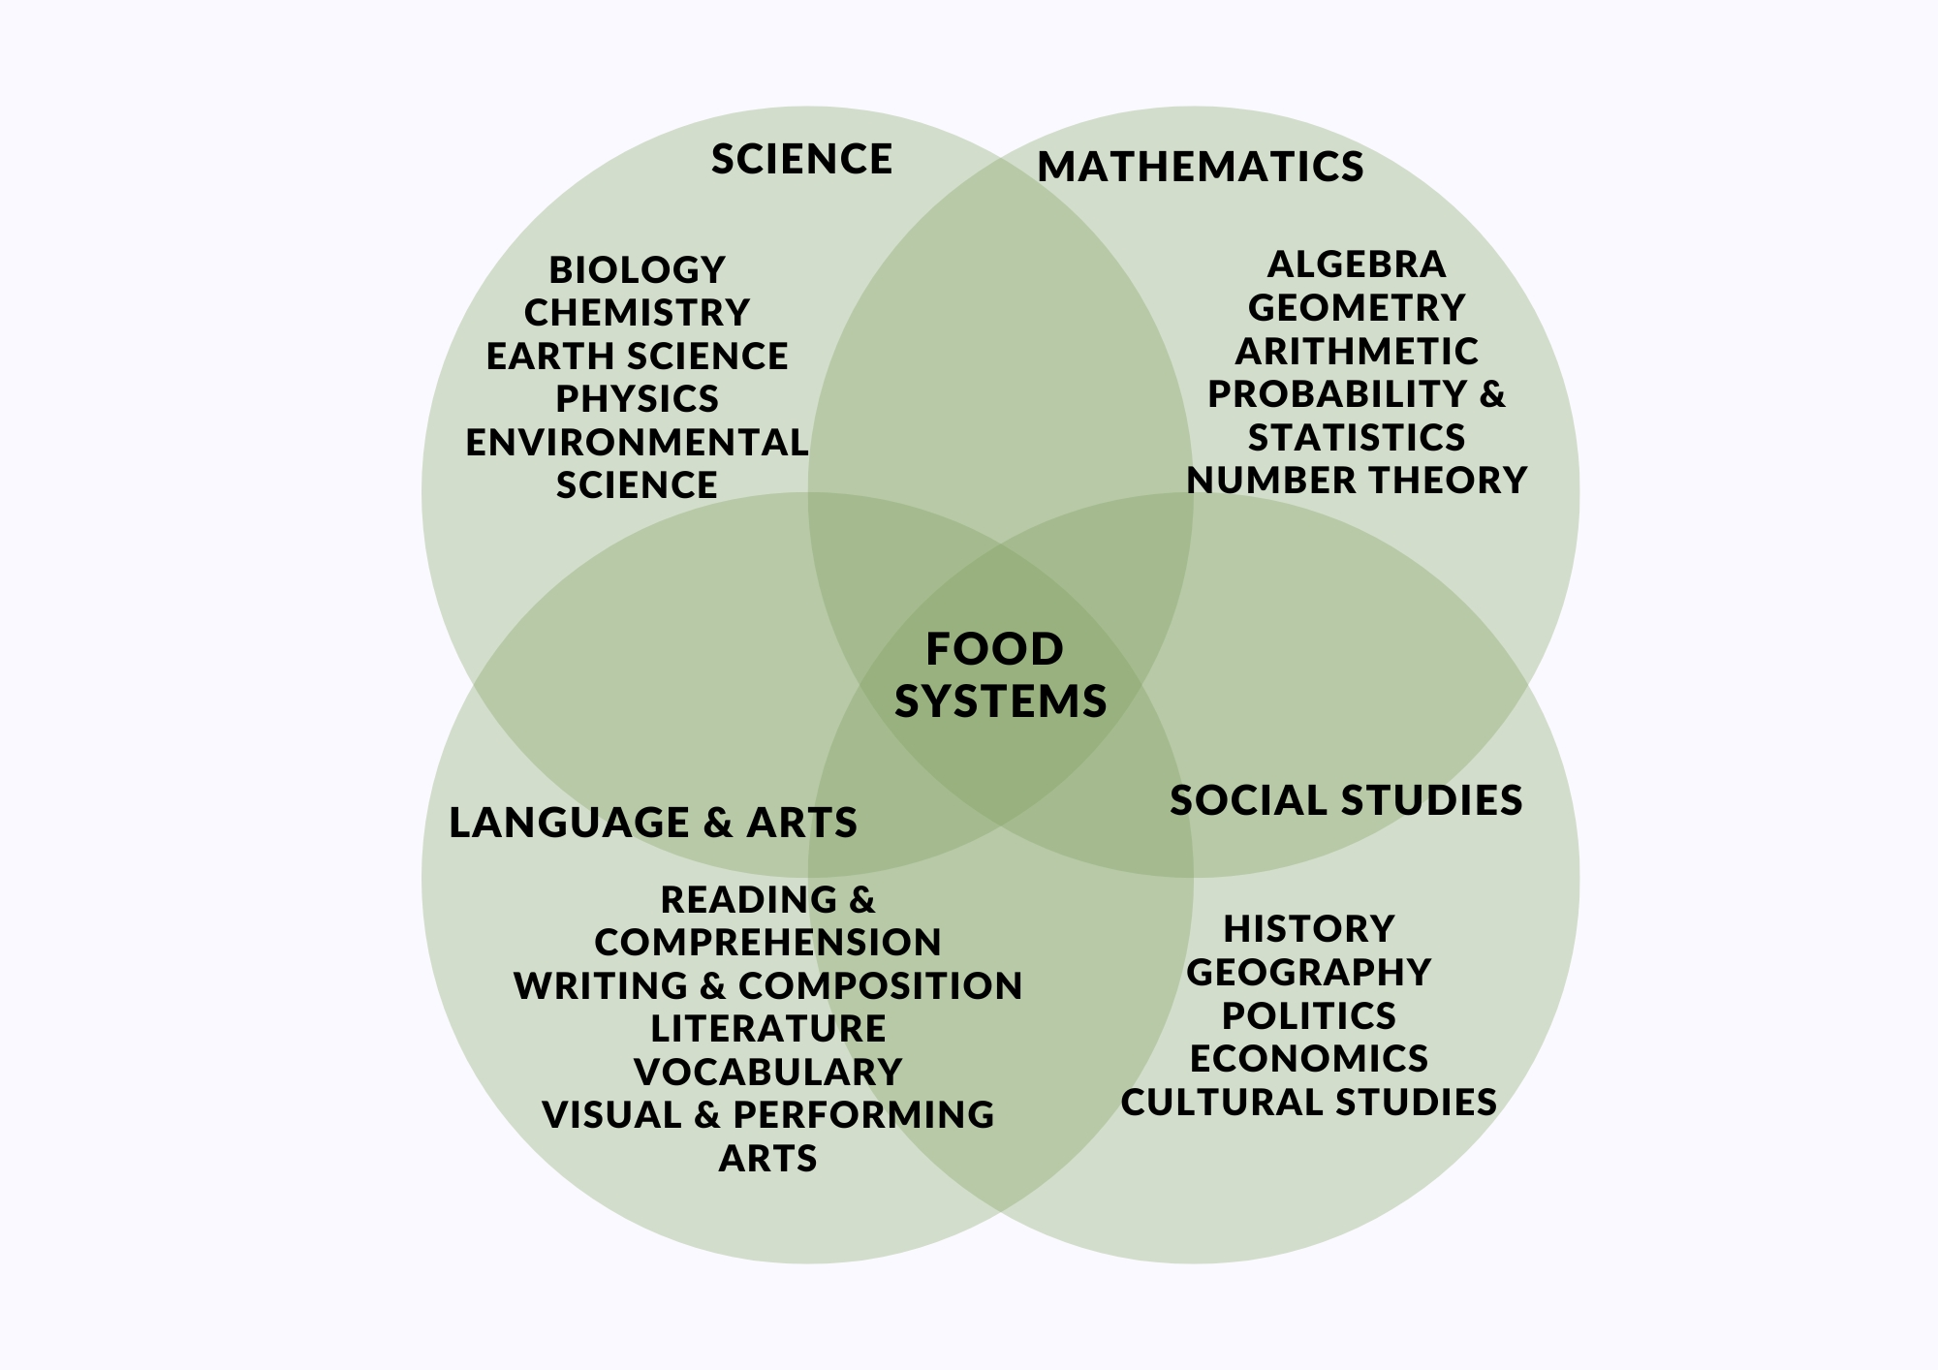
TOIDUSÜSTEEMIDE ÕPETAMINE
VÕITE ÕPETADA TOIDUSÜSTEEMIDE KOHTA
MIS TAHES DISTSIPLIINIS.
TEEMASID JA VÕIMALUSI ON PALJU
TOIDUSÜSTEEMIDE LISAMINE KLASSIPLAANIDESSE
Notes:
Multiple choice quiz on file with questions, alternatives and explanation of right answers.
Choice of applying quiz directly on Platform, use PDF file or simply discuss in the presentation.
Q5:C: Food security is crucial for sustainable food systems because it ensures that all people have access to enough safe and nutritious food to maintain a healthy and active life. This includes addressing issues such as hunger, malnutrition, and equitable food distribution.

Slide 21
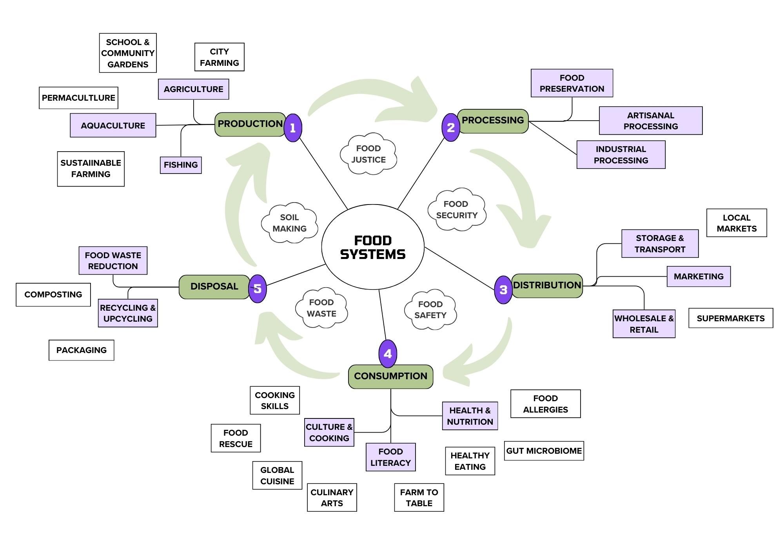
PALJU TEEMASID, MILLE VAHEL SAAB VALIDA
Notes:
Multiple choice quiz on file with questions, alternatives and explanation of right answers.
Choice of applying quiz directly on Platform, use PDF file or simply discuss in the presentation.
Q5:C: Food security is crucial for sustainable food systems because it ensures that all people have access to enough safe and nutritious food to maintain a healthy and active life. This includes addressing issues such as hunger, malnutrition, and equitable food distribution.

Slide 22
Alustades tootmisest. Miks me vajame jätkusuutlikku toidutootmist?
Põllumajandusettevõtted kui kultiveeritud ökosüsteemid
Integreeritud disain: energia-, vee- ja viljakushoidlate jaoks, kus on haritud bioloogiline mitmekesisus ja kiirendatud järglus meie põllumajandusmeetodites.
Notes:
Discuss various methods of sustainable food production.
Highlight the importance of biodiversity and organic farming in sustainable agriculture.
Sustainable Agricultural Practices: Introduce the concept of Permaculture as an integral design method for sustainable food production that include techniques such as organic farming, crop rotation, agroforestry, integrated pest management, soil regeneration and integral water management.
Biodiversity: Emphasise how maintaining a variety of plants and animals in agriculture helps improve ecosystem resilience and productivity.
Organic Farming: Highlight the benefits of organic farming, such as reduced chemical use and improved soil health.

Slide 23
VIDEO: SÄÄSTEV PÕLLUMAJANDUS
Notes:
Introduce the animated video on sustainable farming practices and encourage participants to watch it.

Slide 24
Kas räägime jätkusuutlikest toitumisharjumustest?
Taimede domineeriv toitumine (liha või mitte?)
Toidu kohalik hankimine (turg X supermarketid)
Toidujäätmete vähendamine (toit kodus?)
Notes:
Plant-predominant Diets: can reduce the environmental impact of food production and improve health outcomes. Plan your meals to take advantage of seasonal local foods.
Local Sourcing: benefits such as supporting local economies and reducing transportation emissions. Ask your suppliers about the origin of the food and let them know your preference for local.
Food Waste Reduction Habits: such as meal planning, proper food storage, and composting. Make your own broth from clean leftovers. Learn to make full use of all vegetables.
Discuss the benefits of sustainable diets and healthy food habits.
Emphasise the importance of reducing food waste.
**ToolKit Activity ( I LEARN)
Quiz: Sustainable Diets and Food Habits
Quiz: True/False questions on sustainable diets.
Presenter’s Notes:
Introduce the quiz and encourage participants to test their understanding of sustainable diets.

Slide 25
Jätkusuutlikud toitumisharjumused – kas õige või vale?
1- Taimset dieeti peetakse jätkusuutlikumaks kui kõrge loomsete saaduste sisaldusega dieeti.
Notes:
Quiz: True/False questions on sustainable diets.
Introduce the quiz and encourage participants to test their understanding of sustainable diets.
True
Explanation: A plant-based diet generally has a lower environmental impact, requiring fewer resources such as water and land, and producing fewer greenhouse gases compared to a diet high in animal products.

Slide 26
Jätkusuutlikud toitumisharjumused – kas õige või vale?
2- Kohalikult hangitud toidu valimine tähendab alati väiksemat keskkonnamõju.
Notes:
Quiz: True/False questions on sustainable diets.
Introduce the quiz and encourage participants to test their understanding of sustainable diets.
False
Explanation: While locally sourced foods can reduce transportation emissions, the overall environmental impact also depends on the methods of production. For instance, locally grown foods that rely heavily on fossil fuels or chemical inputs may still have a high environmental footprint.

Slide 27
Jätkusuutlikud toitumisharjumused – kas õige või vale?
3- Toidu raiskamise vähendamine on jätkusuutliku toitumise põhikomponent.
Notes:
Quiz: True/False questions on sustainable diets.
Introduce the quiz and encourage participants to test their understanding of sustainable diets.
True
Explanation: Reducing food waste helps conserve resources used in food production, decreases methane emissions from landfills, and ensures that more food is available to feed the global population.

Slide 28
Jätkusuutlikud toitumisharjumused – kas õige või vale?
4- Mahepõllumajandus tagab alati parema mulla tervist.
Notes:
Quiz: True/False questions on sustainable diets.
Introduce the quiz and encourage participants to test their understanding of sustainable diets.
True
Explanation: Organic farming avoids synthetic chemicals and emphasises natural processes, which generally leads to improved soil health through better soil structure, fertility, and biodiversity.

Slide 29
Jätkusuutlikud toitumisharjumused – kas õige või vale?
5- Erinevate toitude söömine pole jätkusuutlikkuse jaoks oluline.
Notes:
Quiz: True/False questions on sustainable diets.
Introduce the quiz and encourage participants to test their understanding of sustainable diets.
False
Explanation: Eating a diverse range of foods promotes agricultural biodiversity, which is crucial for ecosystem health and resilience. It also reduces the risk of over-reliance on a single crop, which can be vulnerable to pests and diseases.

Slide 30
Jätkusuutlikud toitumisharjumused – kas õige või vale?
6- Töödeldud toidud on alati vähem jätkusuutlikud kui mitte töödeldud toidud.
Notes:
Quiz: True/False questions on sustainable diets.
Introduce the quiz and encourage participants to test their understanding of sustainable diets.
False
Explanation: The sustainability of processed foods depends on various factors including the methods of production, packaging, and transportation. Some minimally processed foods can have lower environmental impacts compared to certain whole foods that require extensive resources to produce and transport.

Slide 31
Toidukeskkonnad
See on füüsiline, sotsiaalne, majanduslik ja kultuuriline keskkond, mis mõjutab inimeste toiduvalikuid ja toitumiskäitumist.
Kättesaadavus: Tervislike toiduvalikute olemasolu kogukonnas.
Taskukohasus: tervisliku toidu maksumus võrreldes sissetulekute tasemega.
Ohutus: Toidu ohutus ja hügieen.
Kvaliteet: Pakutava toidu toiteväärtus ja värskus.
Check
Beeforest
https://eu-cap-network.ec.europa.eu/news/inspirational-idea-sustainable-bee-forest_en
Notes:
Explain the concept of food environments and their impact on food choices.
Discuss the factors that influence food environments.
Suggest reading of case study Bee forests

Slide 32
Kujutledes kestlikke toidusüsteeme
Tukeviku kirjaoskus: võime ette kujutada ja luua erinevaid tulevikustsenaariume, mis aitab planeerimisel ja otsuste tegemisel.
https://illuminem.com/category/sustainable-lifestyle
Notes:
Introduce the concept of futures literacy and its importance in food education.
Scenario Analysis: A method used to explore and prepare for different future possibilities by considering various factors and their potential impacts.
There is a detailed activity described in the content file. This can be a tool as part of the toolkit.
**TOOLKIT ACTIVITY (I Design): “Imagining Sustainable Food Systems”
Activity: Futures literacy exercise using a scenario analysis.
Provide guidance on how to complete the exercise and facilitate discussion.
Engage participants in an exercise to imagine sustainable food futures using scenario analysis.
Activity Guidance: Explain how participants can use scenario analysis to envision sustainable food systems in their communities or schools.

Slide 33
Kestlike toidusüsteemide kujundamine
Projektipõhine õpe: õpilased õpivad, osaledes aktiivselt reaalsetes ja sisukates projektides.
Kooliaiad: Eelised hõlmavad praktilist õppimist, toidutootmise mõistmist ja tervislike toitumisharjumuste edendamist.
Kohaliku toidu hankimise projektid: Julgustage õpilasi uurima ja hankima kohalikku toitu koolitoidu või ürituste jaoks.
Jäätmete vähendamise algatused: projektid, mis keskenduvad toidujäätmete vähendamisele, korduskasutamisele ja ringlussevõtule koolides.
Koolitoidu nädal: kaasake kogu kool toidusüsteemide projekti
Notes:
Suggest project ideas for students to design sustainable food systems.
Examples: school gardens, local food sourcing projects, waste reduction initiatives.
Encourage participants to think about project-based learning in their classrooms.
Suggest practical project ideas for students.

Slide 34
Kliimat ja kestlikke toidusüsteeme edendav tegevus
Kriitiline mõtlemine: küsi ja analüüsi oma toiduvalikute mõju keskkonnale ja ühiskonnale.
Motiveeriv tegevus: õpilaste juhitud algatused, millel on positiivne mõju nende kogukondadele.
Notes:
Changing Perspectives and Behaviours
Encourage teachers to foster critical thinking about food choices.
Discuss how to motivate students to take action in their communities.
Discuss the importance of changing perspectives and behaviours for sustainable food systems.
Encourage participants to inspire their students to take action.

Slide 35
Õppekavaga seotud praktilised tegevused
Klassiruumi tegevused: kokandustunnid, toidujäätmete auditid, kohalike talude külastused jne.
Rühmaarutelud: hõlbustada arutelusid sellistel teemadel nagu toidusüsteemide mõju meie tervisele ja keskkonnale.
Praktilised projektid: projektid, mis hõlmavad toidu kasvatamist, toiduvalmistamist, pakendite ringlussevõttu või teadlikkuse suurendamise kampaaniate loomist jätkusuutlike toitumisharjumuste kohta.
Notes:
Provide examples of practical and engaging classroom activities.
Encourage participants to think about how they can implement these activities in their classrooms.
Guide participants through the interactive session on planning activities.
**Refer to toolkit of I ACT activities

Slide 36
Juhtumiuuring: CLIKIS-Network – kliimasõbralikud kooliköögid - Eesti
Projekt andis kaheksale Eesti lasteaiale ja koolile võimaluse hinnata oma köögitehnikat, menüüd, toiduvalmistamise viise ja jäätmekäitlust.
Näide: Tartu Kivilinna Kool on võtnud kasutusele taldrikule jäetud toidujäätmete kaalumise, mis annab kasulikku infot õpilastele, kooli juhtkonnale ja toitlustajale. Kohvik peab igapäevast toidujäätmete arvestust, mis näitab söövate õpilaste arvu ja järelejäänud toidu kogust liitrites
Notes:
Present Case and discuss its key aspects.
Describe the goals and strengths of the project
Explain the solutions implemented
Highlight the outcomes and benefits of these solutions.
Encourage participants to reflect on the case and share their thoughts in the discussion forum.
*Case study in content file

Slide 37
Juhtumiuuring: Berliini väljakutse
Probleem: Berliin seisis silmitsi väljakutsetega, mis olid seotud toiduga kindlustatuse, värskete toodete kättesaadavuse ja toidujäätmete käitlemisega.
Lahendusi:
Kogukonnaaiad: Pakkuda kohalikele elanikele juurdepääsu värsketele saadustele ja haljasaladele.
Ühistulised supermarketid: võimaldavad tarbijatel omada suuremat kontrolli ostetava toidu üle ja toetada kohalikke tootjaid.
Toidujäätmete vähendamise rakendused: ühendatud toiduülejäägid abivajajatega, vähendades toidujäätmeid.
Tulemused: parem toiduga kindlustatus, kogukonna suurem kaasatus ja toidu raiskamise vähendamine.
Notes:
Present the Berlin Case and discuss its key aspects.
Describe the problem faced in Berlin regarding food systems.
Explain the solutions implemented, such as community gardens, cooperative supermarkets, and food waste reduction apps.
Highlight the outcomes and benefits of these solutions.
Encourage participants to reflect on the case and share their thoughts in the discussion forum.
*Case study in content file

Slide 38
Juhtumiuuring: Laste suvelaager Eesti talus
Ranna Rantšo suvelaager pakub lastele võimalust saada värske vaatenurk loodusele, sealhulgas toidu kasvatamise protsessile. Laagri ajal elavad lapsed keset loodust ja tegelevad lihtsate, traditsiooniliste maakohtadega.
Lapsed saavad väärtuslikke teadmisi ja kogemusi toidualase kirjaoskuse kohta, täpsemalt toidu kasvu protsessi, erinevate taimede tervisele kasulike omaduste kohta, minimaalsete toidujäätmetega retseptide loomise kohta jne. Põllumajandusloomade eest hoolitsemine soodustab ka empaatiat ja austust loomade vastu.
Notes:
Present Case and discuss its key aspects.
Describe the goals and strengths of the project
Explain the solutions implemented
Highlight the outcomes and benefits of these solutions.
Encourage participants to reflect on the case and share their thoughts in the discussion forum.
*Case study in content file

Slide 39
Tulevaste toidusüsteemide kavandamine ja kujundamine
Tuleviku kirjaoskuse meetodid
Stsenaariumi planeerimine:
Tagasiside
Visiooniharjutused
Notes:
Introduce the futures literacy methods and their application in food systems education.
Explain the characteristics and benefits of using these methods.
Provide a step-by-step description of how to use the futures literacy method in classroom settings.
Discuss how these methods can be applied to other subjects.
Guide participants through a futures literacy task for designing a sustainable food system.
Tool Kit Activities - Additional Information:
Futures Literacy Methods: Include scenario planning, backcasting, and visioning exercises.
Justification: These methods help students think critically about future possibilities and develop strategies for sustainable development.
Activities Procedure:
Scenario Planning: Identify key drivers of change and develop different scenarios for future food systems.
Backcasting: Start with a desired future outcome and work backward to identify the steps needed to achieve it.
Visioning: Create a detailed and inspiring vision of a sustainable future and discuss how it can be realised.
Task: Ask participants to envision a sustainable food system in their community and outline the steps to achieve it.

Slide 40
Toidusüsteemide juhtpaneeli veebileht
https://www.foodsystemsdashboard.org/
Notes:
If time allows an exploration of the food systems dashboard can demonstrate how food systems around the world are being monitored. Website allows for country by country statistics.
Otherwise this can be an activity for teachers to research at home.
Discuss the Food Systems Dashboard and how it can be used to analyse food systems.
Introduce the Food Systems Dashboard as a practical example.
Provide the link to the Dashboard and encourage participants to review it.

Slide 41
VIITED
Raamatud ja väljaanded
Legan, L. (2020). Planet Schooling: How to Create a Permaculture Living Laboratory in Your Back Yard. CreateSpace Independent Publishing Platform.
European Commission. (2020). Farm to Fork Strategy: For a Fair, Healthy and Environmentally-Friendly Food System. Retrieved from https://ec.europa.eu/food/horizontal-topics/farm-fork-strategy_en
Food and Agriculture Organization of the United Nations (FAO). (2018). Agroecology: Scaling up Agroecology to Achieve the Sustainable Development Goals. Retrieved from http://www.fao.org/3/I9049EN/i9049en.pdf
European Environment Agency (EEA). (2019). The European Environment – State and Outlook 2020: Knowledge for Transition to a Sustainable Europe. Retrieved from https://www.eea.europa.eu/publications/soer-2020
International Panel of Experts on Sustainable Food Systems (IPES-Food). (2016). From Uniformity to Diversity: A Paradigm Shift from Industrial Agriculture to Diversified Agroecological Systems. Retrieved from http://www.ipes-food.org/_img/upload/files/UniformityToDiversity_FULL.pdf
European Union. (2019). EU Agricultural Outlook for Markets and Income 2019-2030. Retrieved from https://ec.europa.eu/info/sites/info/files/food-farming-fisheries/farming/documents/agricultural-outlook-2019-report_en.pdf
WWF. (2019). Living Planet Report 2019: Aiming Higher. Retrieved from https://wwf.panda.org/knowledge_hub/all_publications/living_planet_report_2019/
Notes:
Provide a comprehensive list of resources for further reading.
Encourage participants to explore these resources for ongoing professional development.
Highlight the importance of continuous learning in the field of food systems.
Introduce the interactive link to the curated reading list and additional resources.

Slide 42
VIITED
Veebilehed
European Commission – Farm to Fork Strategy: https://ec.europa.eu/food/horizontal-topics/farm-fork-strategy_en
Food and Agriculture Organization (FAO) – Sustainable Food and Agriculture: http://www.fao.org/sustainability/en/
European Environment Agency (EEA): https://www.eea.europa.eu/
International Panel of Experts on Sustainable Food Systems (IPES-Food): http://www.ipes-food.org/
Sustainable Food Trust: https://sustainablefoodtrust.org/
EAT Forum: https://eatforum.org/
Agroecology and Sustainable Food Systems Journal: https://www.tandfonline.com/toc/wjsa20/current
Food Systems Dashboard: https://foodsystemsdashboard.org/

Slide 43
VIITED
Aruanded ja dokumendid
European Commission. (2020). A Farm to Fork Strategy for a Fair, Healthy and Environmentally-Friendly Food System. Retrieved from https://ec.europa.eu/food/sites/food/files/safety/docs/f2f_action-plan_2020_strategy-info_en.pdf
FAO. (2018). The Future of Food and Agriculture: Alternative Pathways to 2050. Retrieved from http://www.fao.org/3/I8429EN/i8429en.pdf
EEA. (2020). Food in a Green Light: A Systems Approach to Sustainable Food. Retrieved from https://www.eea.europa.eu/publications/food-in-a-green-light
IPES-Food. (2019). Towards a Common Food Policy for the European Union: The Policy Reform and Realignment That Is Required to Build Sustainable Food Systems in Europe. Retrieved from http://www.ipes-food.org/_img/upload/files/CFP_FullReport.pdf
European Commission. (2018). EU Food Losses and Waste. Retrieved from https://ec.europa.eu/food/sites/food/files/safety/docs/fw_eu-actions_food-waste-com_2018_en.pdf

Slide 44
VIITED
Artiklid ja ajakirjad
Garnett, T. (2014). What is a Sustainable Healthy Diet?. Food Climate Research Network. Retrieved from https://www.fcrn.org.uk/sites/default/files/fcrn_what_is_a_sustainable_healthy_diet_final.pdf
Tilman, D., & Clark, M. (2014). Global Diets Link Environmental Sustainability and Human Health. Nature, 515(7528), 518-522. Retrieved from https://www.nature.com/articles/nature13959
Gliessman, S. R. (2018). Agroecology: The Ecology of Sustainable Food Systems. CRC Press.

Slide 45
ELi haridusallikad
European Commission – Education and Training: https://ec.europa.eu/education/
European Schoolnet: http://www.eun.org/
Eco-Schools Programme: https://www.ecoschools.global/
European Environment Information and Observation Network (Eionet): https://www.eionet.europa.eu/
Food for Life Partnership: https://www.foodforlife.org.uk/

Slide 46
Täiendavad lugemised
Farming for the Future: Sustainable Agriculture and Food Systems (2020). European Parliament. Retrieved from https://www.europarl.europa.eu/RegData/etudes/BRIE/2020/649359/EPRS_BRI(2020)649359_EN.pdf
Transition to Agroecology: For a Food System Transformation in Europe (2019). Report by IDDRI and Agroecology Europe. Retrieved from https://www.agroecology-europe.org/wp-content/uploads/2019/04/Agroecology-IDDRI-Report.pdf
Rethinking Food and Agriculture: New Ways Forward (2020). Springer Nature. Retrieved from https://www.springer.com/gp/book/9783030393122

Slide 47
Ruum on avatud küsimustele
Notes:
Facilitate a Q&A session to address participants' questions.
Encourage sharing of ideas and experiences among teachers.
Interactive Forum: Ongoing Q&A and support forum.
Encourage an open discussion and sharing of ideas.
Introduce the ongoing Q&A and support forum (Toolkit) for continuous engagement.
Interactive Forum: Set up a forum where participants can post questions and share their experiences. This forum can also be used for ongoing support and networking.This can be connected to Activities and Class Plans website.
Encouraging Engagement: Invite participants to ask questions and share their thoughts on the topics discussed. Use open-ended questions to stimulate discussion.

Slide 48
Ole muutuv! Tervislikuma homse nimel vali jätkusuutlikud toitumisharjumused juba täna. Kaitseme oma planeeti üks söögikord korraga!
Notes:
Summarise the key points covered in the module.
Emphasise the importance of integrating food systems education into the curriculum.
Introduce the motivational video and encourage participants to watch it.
Additional Presenter Information:
Summary: Recap the key points such as the importance of sustainable food habits, the complexity of food systems, and the role of futures literacy.
Call to Action: Encourage teachers to incorporate food systems education into their lessons and inspire their students to think critically about sustainability.
**Motivational Video: Use the video to leave participants with a strong and positive message about the impact they can make.

Slide 49
Täname!
Kontakt
Associazione Kora
Joe Short
Notes:
Gratitude and Contact Information
Thank the teachers for their participation.
Provide your contact information for further questions and collaboration.
Interactive Link: Feedback form and contact details.
Thank the participants for their engagement and participation.
Provide your contact details for further questions and collaboration.
Encourage participants to fill out the feedback form.
Additional Presenter Information:
Feedback Form: Set up an online form where participants can provide feedback on the module. Use this feedback to make improvements.
Contact Information: Provide your email address and any other relevant contact details for follow-up questions and collaboration opportunities.

Slide 50
Sõnavara
Agroökoloogia: terviklik lähenemisviis põllumajandusele, mis rõhutab põllumajandussüsteemide ökoloogilist majandamist, integreerides tavasid, mis toetavad bioloogilist mitmekesisust, jätkusuutlikkust ja ökosüsteemide tervist.
Agrometsandus: maakasutuse juhtimissüsteem, mille puhul puid või põõsaid kasvatatakse põllukultuuride või karjamaade ümber või vahel. See tava suurendab bioloogilist mitmekesisust ning tootlikkust, vastupanuvõimet ja kestlikkust.
Akvakultuur: veeorganismide, näiteks kalade, karpide ja taimede kasvatamine kontrollitavas keskkonnas, tavaliselt toiduks.
Bioloogiline mitmekesisus: elu mitmekesisus maailmas või konkreetses elupaigas või ökosüsteemis. Põllumajanduses aitab bioloogiline mitmekesisus säilitada ökosüsteemi stabiilsust, suurendab mullaviljakust ning parandab vastupanuvõimet kahjuritele ja haigustele.

Slide 51
Kogukonnaaed: üks tükk maad, mida aiatab ühiselt rühm inimesi. Kogukonnaaiad pakuvad värskeid tooteid, parandavad linnakeskkonda ja soodustavad sotsiaalset suhtlemist.
Kompostimine: orgaaniliste jäätmete, näiteks toidujääkide ja aiajäätmete ringlussevõtu protsess väärtuslikuks mullaparanduseks, mida nimetatakse kompostiks. See protsess parandab mulla seisundit ja vähendab prügilajäätmeid.
Külvikord: tava kasvatada eri liiki põllukultuure samal alal järjestikku aastaaegadel. See aitab säilitada mulla tervist, vähendada kahjurite ja haiguste tsükleid ning suurendada saagikust.
Jaotamine: toidu transportimine tootmiskohast tarbimiskohta. Tõhus turustamine tagab, et toit jõuab tarbijateni tõhusalt ning jääb värskeks ja söömiseks ohutuks.
Ökosüsteemi teenused: kasu, mida inimesed saavad ökosüsteemidest, sealhulgas teenuste osutamine (nagu toit ja vesi), teenuste reguleerimine (nt üleujutuste ohjamine), kultuuriteenused (nt meelelahutuslikud hüved)
Eetiline põllumajandus: põllumajandustavad, mis seavad esikohale loomade heaolu, keskkonnasäästlikkuse ja töötajate õiglase kohtlemise. Eetilise põllumajanduse eesmärk on toota toitu viisil, mis on moraalselt õige ja sotsiaalselt vastutustundlik.

Slide 52
Toidukõrbemine: linna- või maapiirkonnad, kus juurdepääs taskukohasele ja täisväärtuslikule toidule on piiratud. Toidukõrbete elanikud toetuvad sageli esmatarbekaupadele ja kiirtoidule, mis toob kaasa halva toitumise.
Toidukeskkond: füüsiline, majanduslik, poliitiline ja sotsiaal-kultuuriline kontekst, milles inimesed toiduvalikuid teevad. Toidukeskkond mõjutab seda, millised toidud on kättesaadavad, taskukohased ja soovitavad.
Toiduga kindlustamatus: seisund, kus inimestel puudub regulaarne juurdepääs piisavale hulgale ohutule ja toitvale toidule normaalseks kasvuks ja arenguks ning aktiivseks ja tervislikuks eluks.
Toidusüsteem: ühendatud võrgustik, mis hõlmab kõiki elanikkonna toitmise aspekte, sealhulgas toidu kasvatamist, koristamist, töötlemist, pakendamist, transportimist, turustamist, tarbimist ja kõrvaldamist.
Tuleviku kirjaoskus: võime ette kujutada ja hinnata võimalikke tulevikke. See võimaldab üksikisikutel ja kogukondadel ette kujutada ja kavandada jätkusuutlikke ja soovitavaid tulevikustsenaariume.
Kasvuhoonegaaside heitkogused: gaasid nagu süsinikdioksiid, metaan ja dilämmastikoksiid, mis hoiavad atmosfääris soojust kinni, aidates kaasa globaalsele soojenemisele ja kliimamuutustele. Põllumajandus on nende heitkoguste oluline allikas.
Integreeritud taimekaitse: keskkonnatundlik lähenemisviis kahjuritõrjele, mis kasutab bioloogiliste, kultuuriliste, füüsikaliste ja keemiliste meetodite kombinatsiooni, et minimeerida mõju inimeste tervisele, kasulikele ja mittesihtorganismidele ning keskkonnale.

Slide 53
Terviklik ressursside haldamine: terviklik lähenemisviis kõigi ressursside – maa, vee, energia ja materjalide – integreeritud haldamisele, et luua jätkusuutlikud ja tõhusad süsteemid.
Kohalik toit: toit, mida toodetakse, töödeldakse ja turustatakse konkreetses geograafilises piirkonnas. Kohalikud toidusüsteemid toetavad piirkondlikku majandust, vähendavad transpordi heitkoguseid ja pakuvad värskemat toodangut.
Mahepõllumajandus: põllumajandusmeetod, mis kasutab looduslikke protsesse ja sisendeid, vältides sünteetilisi kemikaale ja geneetiliselt muundatud organisme (GMOd). Mahepõllumajandus edendab mulla tervist, bioloogilist mitmekesisust ja ökoloogilist tasakaalu.
Permakultuur: jätkusuutliku eluviisi ja põllumajanduse disainisüsteem, mis jäljendab looduslikke ökosüsteeme. Permakultuuri põhimõtted hõlmavad maa eest hoolitsemist, inimeste eest hoolitsemist ja ressursside õiglast jagamist.
Regeneratiivne põllumajandus: toidu- ja põllumajandussüsteemide säilitamise ja taastamise lähenemisviis, mis keskendub pealispinnase taastamisele, bioloogilise mitmekesisuse suurendamisele, veeringluse parandamisele ja
Organic Farming: A method of farming that uses natural processes and inputs, avoiding synthetic chemicals and genetically modified organisms (GMOs). Organic farming promotes soil health, biodiversity, and ecological balance.
Permaculture: A design system for sustainable living and agriculture that mimics natural ecosystems. Permaculture principles include care for the earth, care for people, and fair share of resources.
Regenerative Agriculture: A conservation and rehabilitation approach to food and farming systems that focuses on regenerating topsoil, increasing biodiversity, improving water cycles, and ökosüsteemi teenuste tõhustamine.
Säästev põllumajandus: põllumajandustavad, mis vastavad praegustele toiduvajadustele, seadmata ohtu tulevaste põlvkondade võimet oma vajadusi rahuldada. See rõhutab keskkonnatervist, majanduslikku kasumlikkust ning sotsiaalset ja majanduslikku võrdsust.

Slide 54
Jätkusuutlik toitumine: dieet, millel on väike keskkonnamõju, mis aitab kaasa toiduga kindlustatusele ja toitumisalasele kindlustatusele ning toetab praeguste ja tulevaste põlvkondade tervislikku elu. See on kultuuriliselt vastuvõetav, majanduslikult õiglane ja toiteväärtuselt piisav.
Jäätmekäitlus: jäätmematerjalide kogumine, transport, töötlemine, ringlussevõtt ja kõrvaldamine. Tõhus jäätmekäitlus vähendab keskkonnamõju ja soodustab ressursside taaskasutamist.

Slide 55
Õpetaja materjalid

Slide 56
Tunnikava
Berlin

Slide 57
Kujutlemine ja kujundamine

