Slide 1
Module 3. Soil management
Authors:
Hildur Dagbjört Arnardóttir
Institution:
Einurð & Gróandi

Slide 2
General Information

Slide 3
Substantive content:
Glossary
Understanding healthy soil; a highly integrated system
Teaching materials
Methods to rehabilitate degraded soil
Case studie
Sepp Holzer: Lifelong innovative soil building in steep terrain
Additional materials
Imagining & Designing
Litterature list

Slide 4
Objectives of the training module:
Understanding the different component of healthy soil and how it works
learning about different ways to get soil back to health and fertility
seeing examples of good practices
Teaching methods:
lectures, case studies, practical exercises, self-study of additional literature
Duration: 3 hours

Slide 5
Glossary

Slide 6
Soil management
which means:
Saving soil & keeping it healthy + functional
- WARNING -
Healthy soil is crucial for us and all ecosystems on land to continue living on this planet
Notes:
Soils act as sources and sinks for greenhouse gases
That means that when everything is going well carbon and other greenhouse gases are continuously extracted from the atmosphere and stored in the soil, the more soils builds up over longer time, the more is stored.
These days we are having reverse effect - we are losing soil fast and the greenhouse gasses that had been collected and stored over long time are being released out into the atmosphere.

Slide 7
First we need to know what healthy soil is …
Soil is a highly integrated living system!
- WARNING -
Healthy soil is crucial for us and all ecosystems on land to continue living on this planet

Slide 8
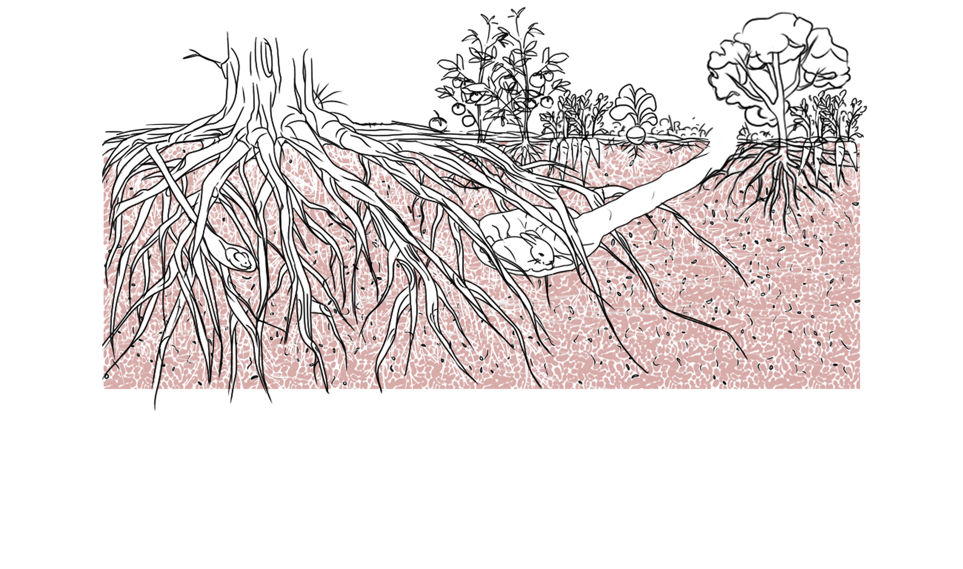
Soil is a highly integrated living system!
Let’s start by investigating the different components >>

Slide 9
Mineral particles & rocks
Functions:
Soil structure & bearing
Contains minerals needed for living beings
Feeds soil microbes

Slide 10
Organic material
Functions:
Food for soil life, released slowly when it’s breaking down
Builds soil structure by gluing mineral particles together into aggregates.
Holds moisture

Slide 11
Air & Water tunnels
Functions:
Transport air and water to all parts of the soil, allowing roots and living beings to breathe and drink.
Nutrients solve in the water and become available to plants
drain away excess water

Slide 12
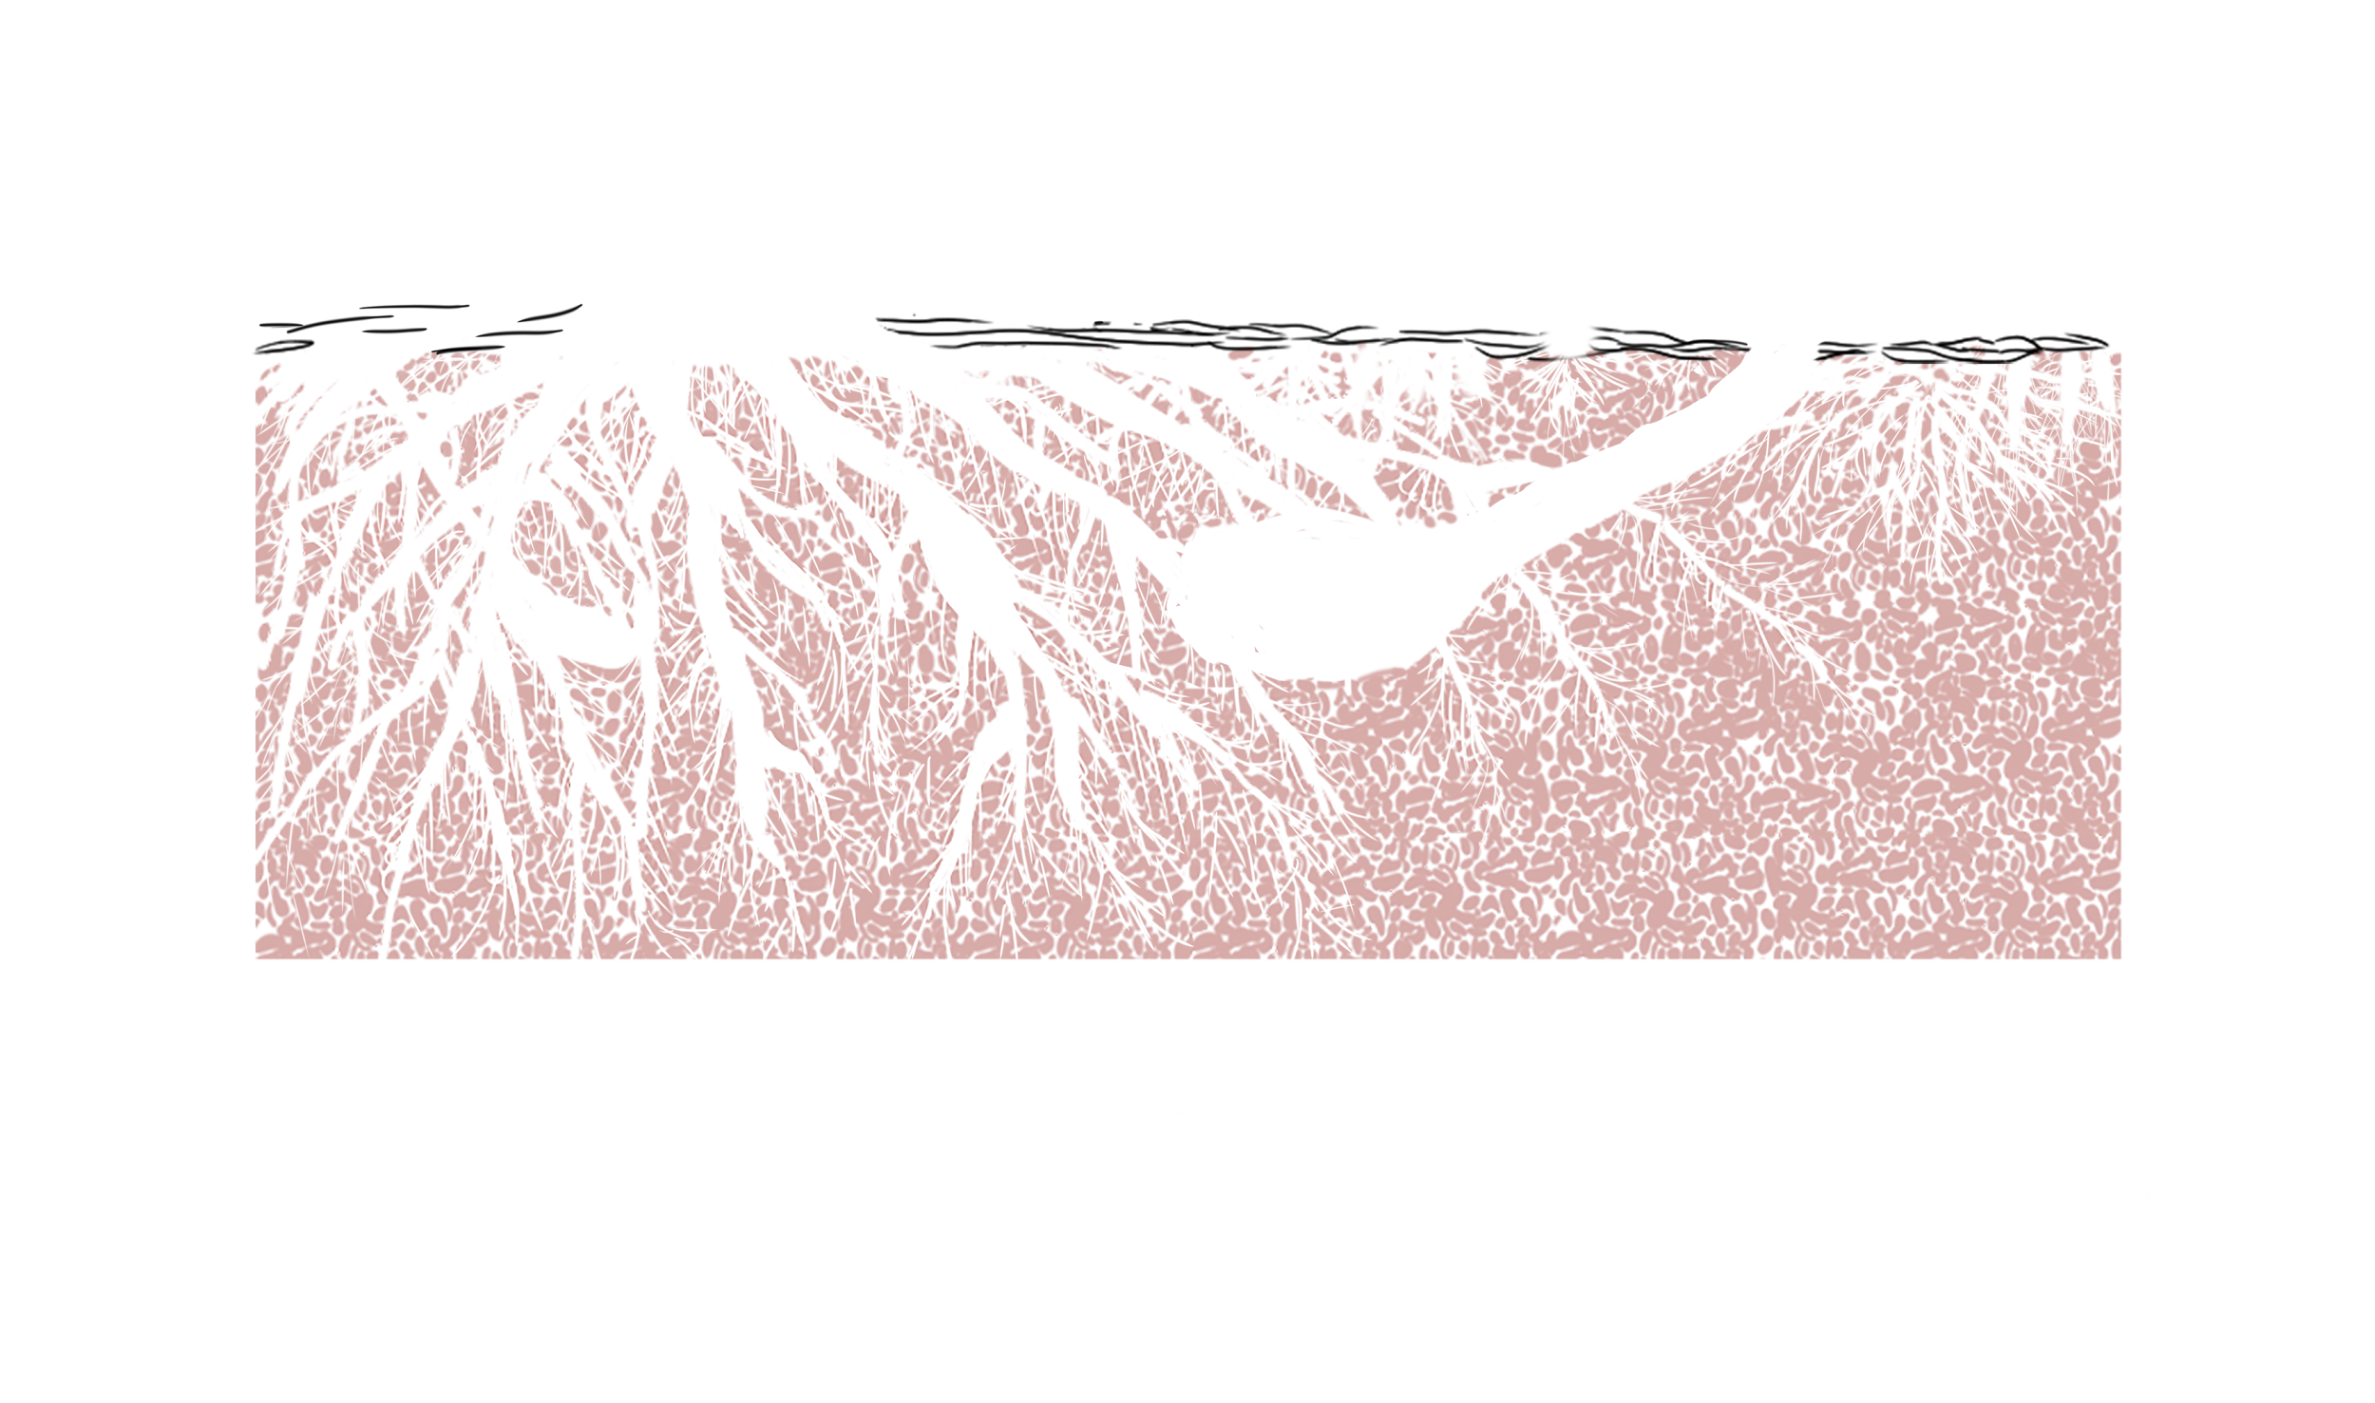
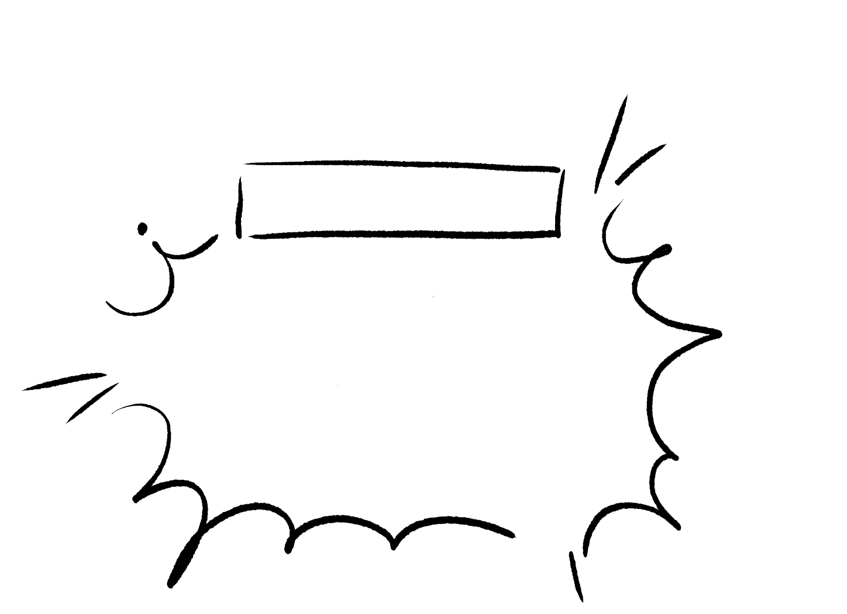
Humus layer
without humus layer
Functions:
Keep soil from eroding away
Sunscreen for the microorganisms (they will die in sun)
Keep moisture in the soil
Breaks down (with the help of soil life) and adds fertility to the soil
Red alert! The soil ecosystem will activate it’s fastest soil saving heroes to sprout immediately & cover the soil fast and efficiently. Some call them “weeds”

Slide 13
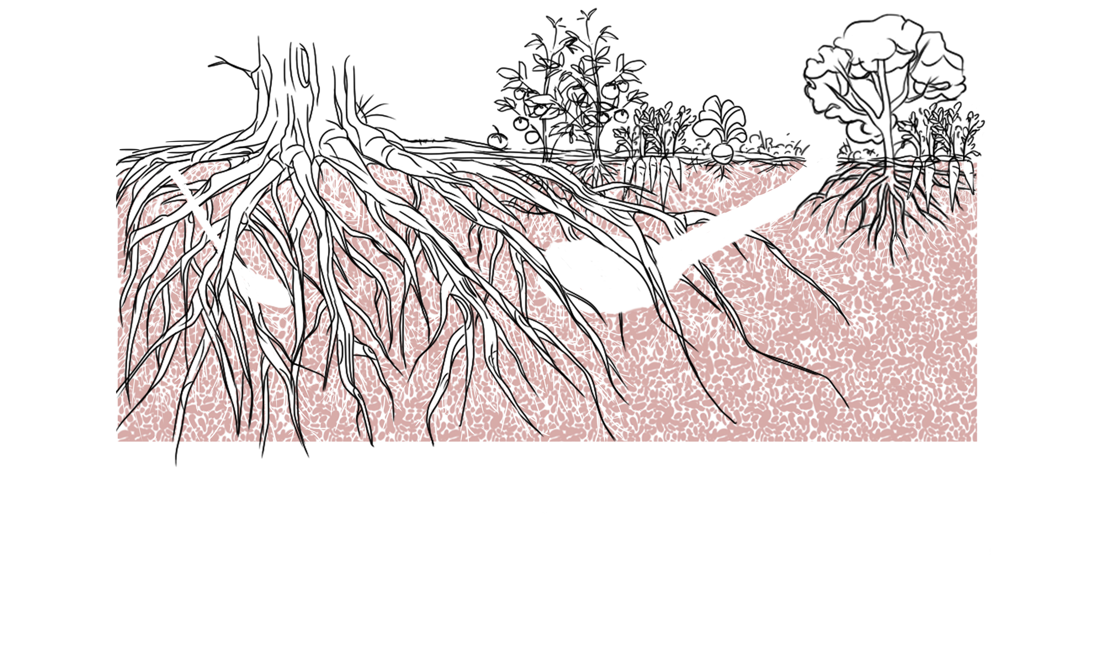
Roots
Functions:
Keep soil from eroding away
Make soil structure by constructing tunnels
Add organic matter & nutrition to the soil when they die / are trimmed / grazed

Slide 14
Bigger animals
Functions:
Mixing soil and moving soil upwards to the surface, making nutrients available to the soil life and roots in the top layer
Increase moisture
Carbon storage increase & nutrients contents in general
Soil bacteria & fungi network density increases

Slide 15
Mycilium (Fungi)
Functions:
Break down organic matter
Break carbon & protein into simple sugars - make it accessible to others
Tight co-operation with plant roots, exchange of “goods”
Communication network between plants
Distribute nutrition & sugars between plants - helping those that are in need

Slide 16
Small & tiny beings
Functions:
Make the soil functional !
Investigate them further
by looking closer! >>

Slide 17
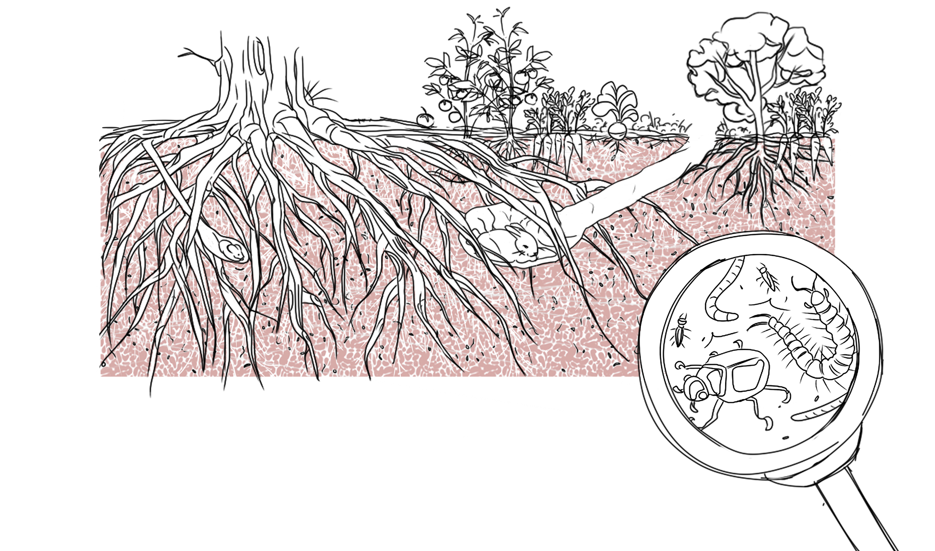
Insects & invertebrates
Functions:
Break down organic matter
Mix the soil & distribute nutrition
Dig tunnels - make airways and structure in soil

Slide 18
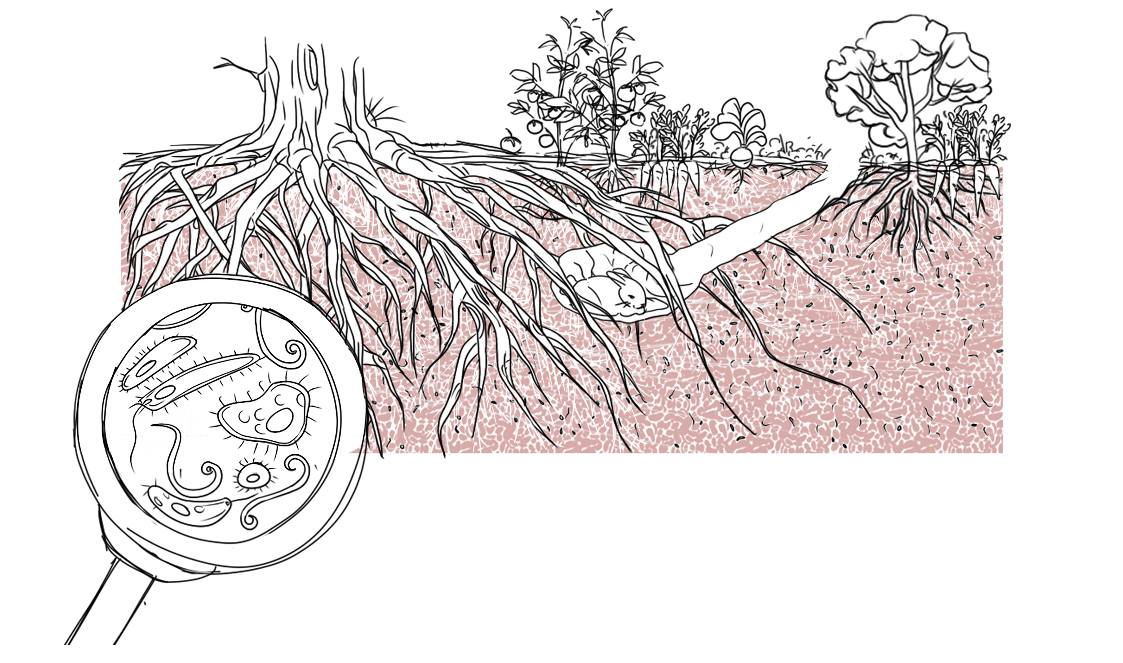
Micro- & meso organisms
Functions:
Make nitrogen available for plants
Break down organic material
Break down rock!

Slide 19
Teaching materials

Slide 20
How to save soil that is in trouble?
RED ALERT!
Bare soil (you can see the soil without digging)
Artificial fertilizer
Biocides (chemicals to kill insects or “weeds”)
Dry & cracking soil
Compacted soil
Erosion
Little or no soil life (worms, insects…)
Streams & rivers around lacking life
Plants grow poorly
Soil hero:
“Let’s go and save that soil !”

Slide 21
Soil hero
Add more organic material
Anything that was alive and doesn’t have any poison in it
For example:
▸ manure ▸ compost ▸ plant parts ▸ wool ▸ straw ▸ grass clippings
▸ branches ▸ leaves ▸ wood shavings ▸ wood chips ▸ sawdust
When?
If plants grow slowly / the soil is dry or compacted /when there’s little soil life / when quitting artificial fertilizer.

Slide 22
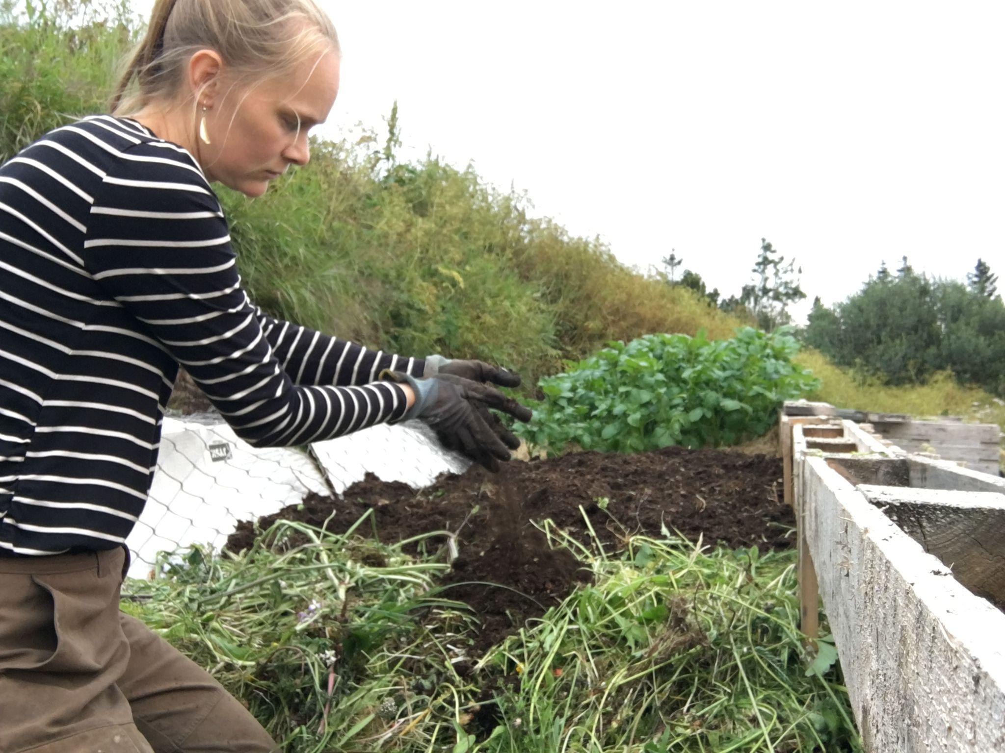

Slide 23
Soil hero
MULCH = add organic material on top
Anything that was alive and doesn’t have any poison in it.
For example:
▸ Hay ▸ wool ▸ straw ▸ grass clippings ▸leaves ▸ wood shavings▸ sawdust
When?
Always! Soil in nature always has a layer of organic material on top - crucial for water regulation, shading out sunlight for the soil life to thrive etc.

Slide 24
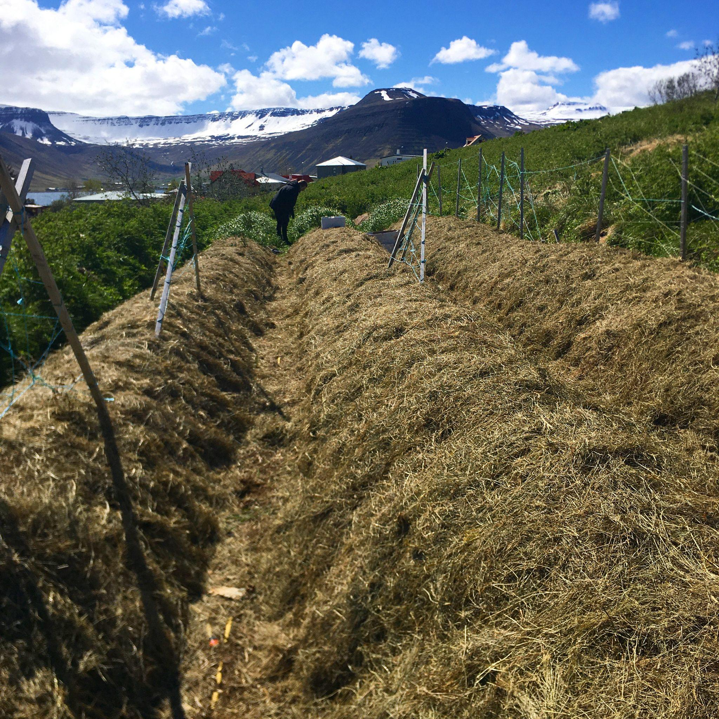

Slide 25
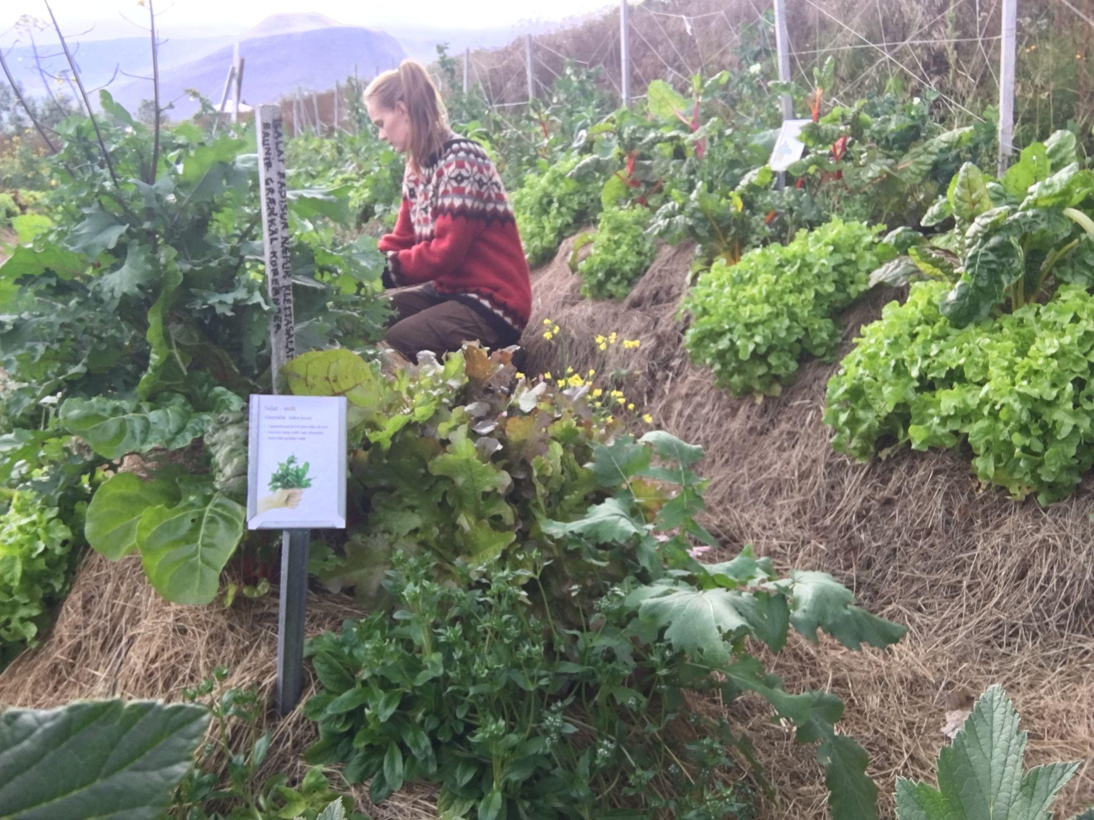

Slide 26
Soil hero
Landshaping
Adjusting landforms so that they’ll function better. Land chiropractics.
Water retention techniques also tend to prevent erosion by slowing down the water and build up fertility in the soil.
When?
Flat land ▸ Hugelkultur
Slope ▸ Terraces, swales or terraces with swales
Farm scale ▸ Yeoman’s Keyline Water Harvesting, series of smaller dams

Slide 27
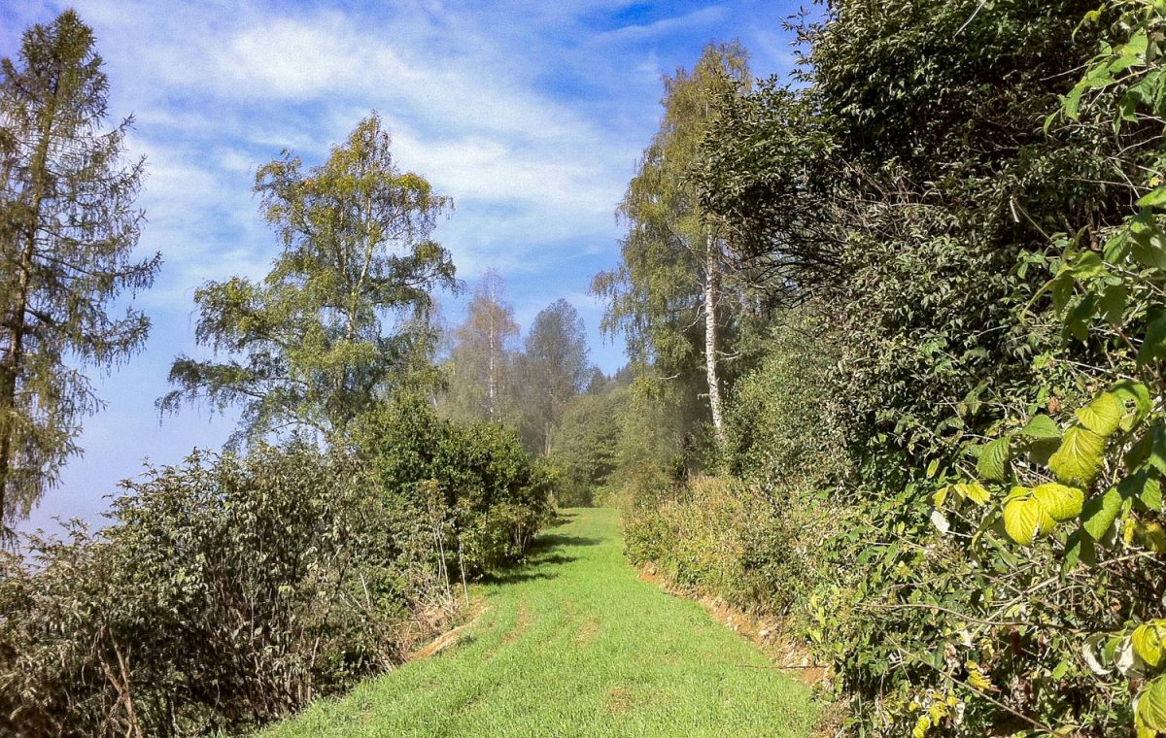
https://krameterhof.at/en/

Slide 28
Swales

Slide 29
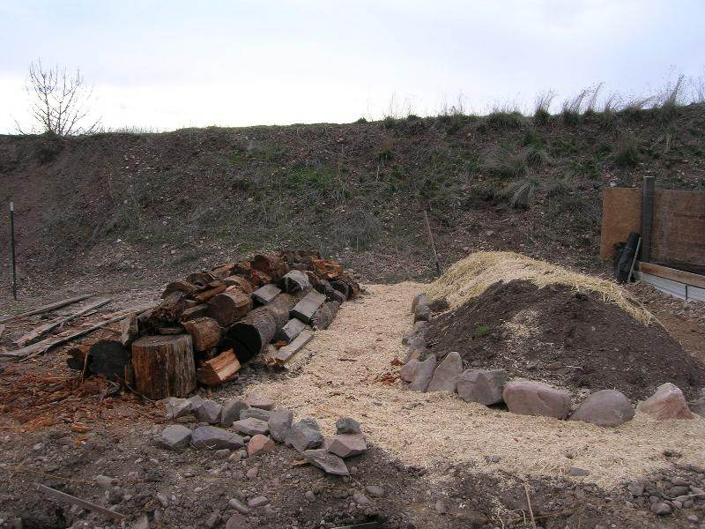
Hugelkultur
Caleb Larson
hugelkultur forum at permies

Slide 30
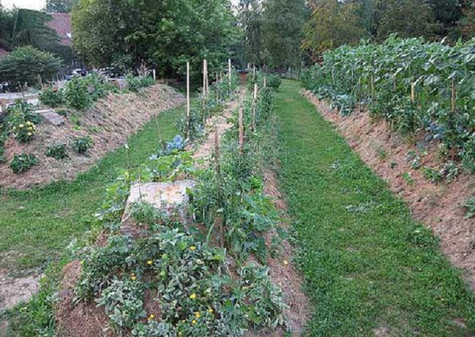
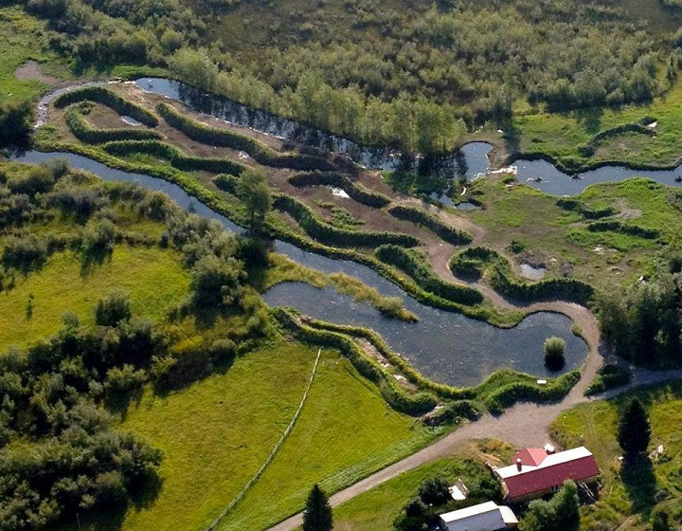
Hugelkultur
https://seppholzer.at/en/

Slide 31
Soil hero
Soil binding
Soil is a scarce resource and much of it is eroding away.
Keeping soil covered at all times
Landshaping to slow down the water (terraces, swales, keyline water harvesting)
Planting plants that hold on to the soil with their roots
When?
Everywhere ▸ keep soil covered with mulch or living mulch
In slopes ▸ landshaping, cover soil, all slopes have to have permanent plants
By waterways ▸ plant perennials, bushes and trees (+ technical adjustments)

Slide 32
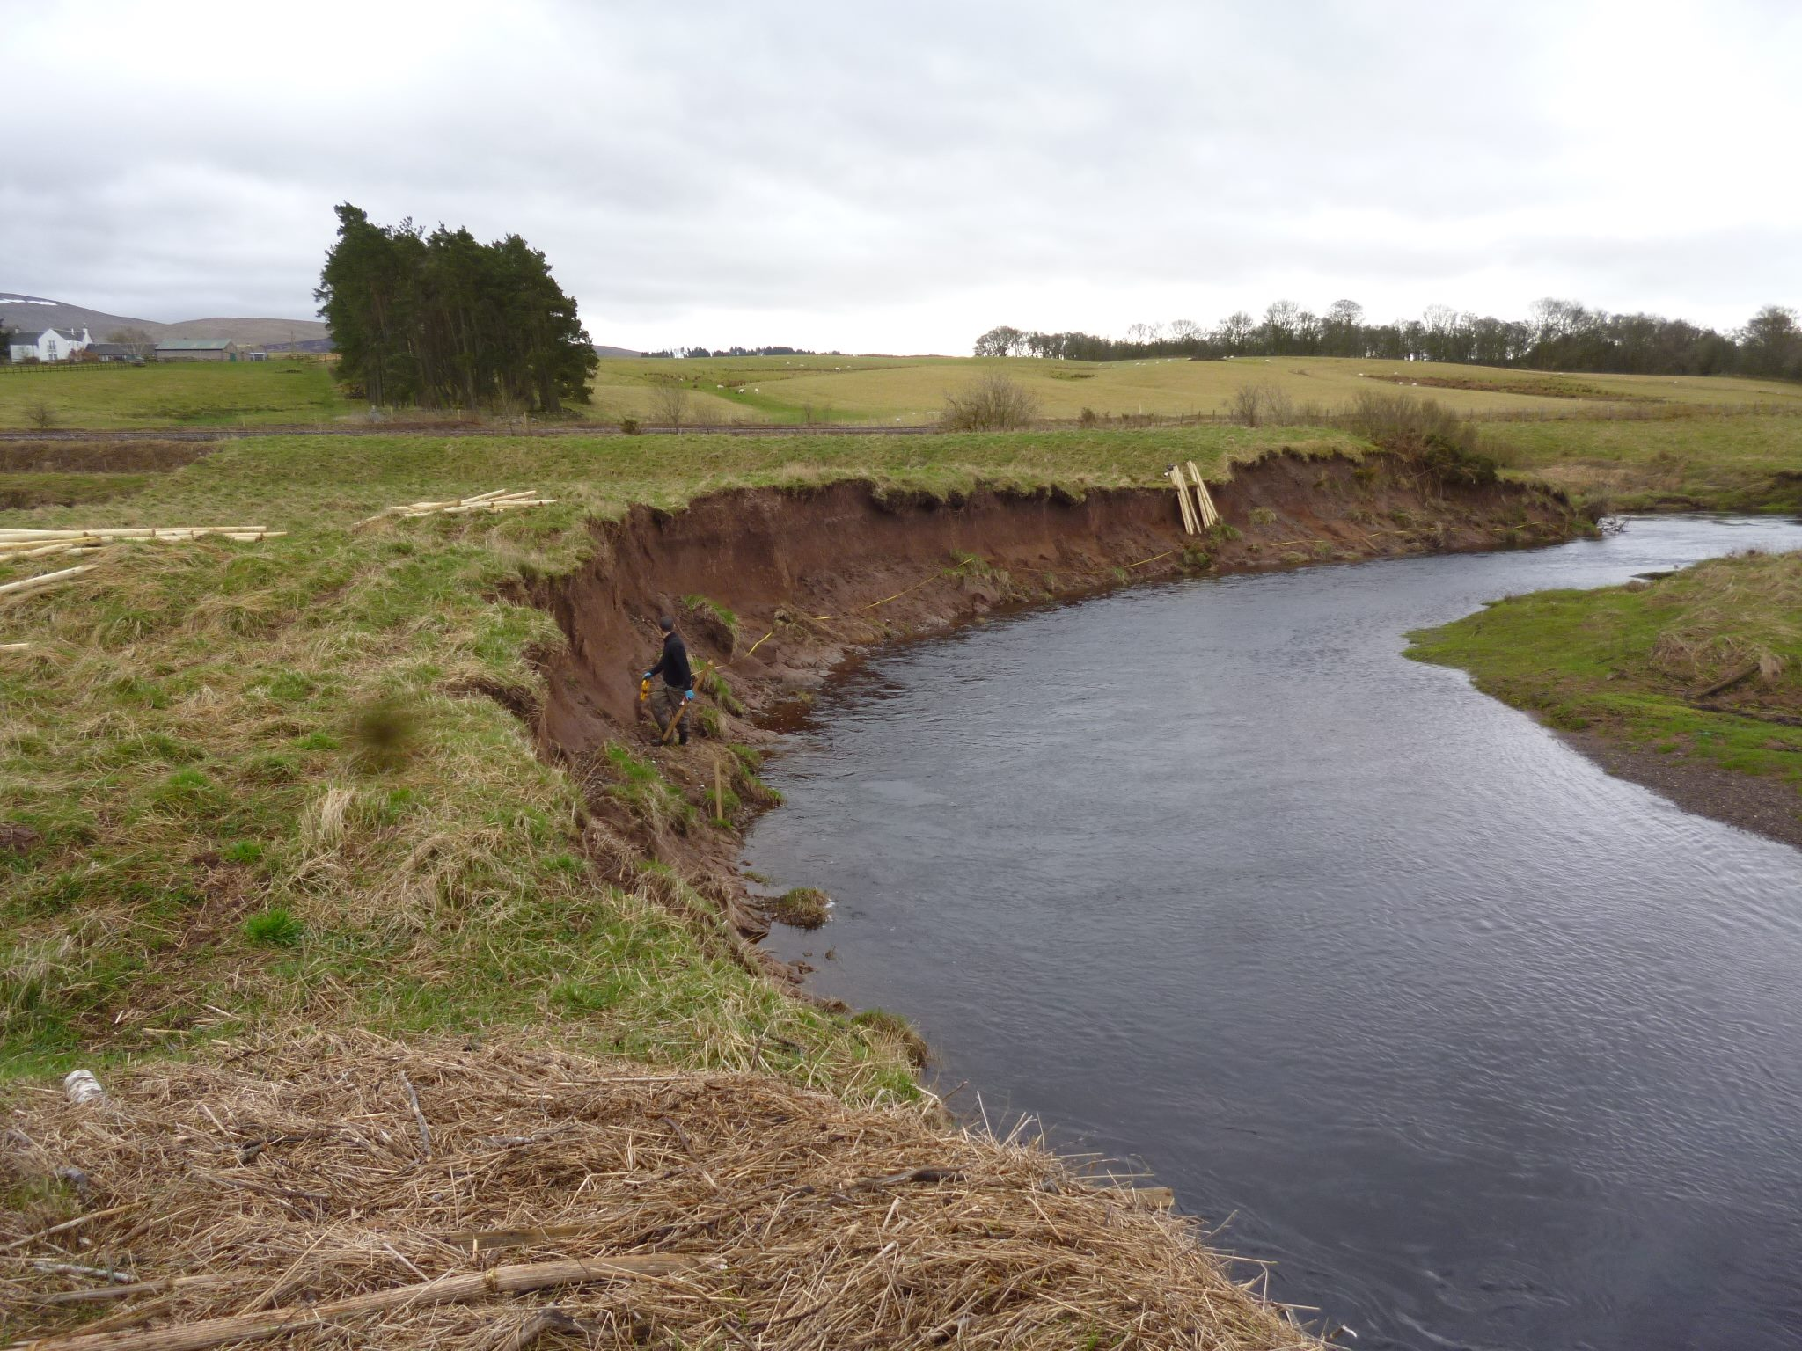
Nether Cambushinnie Bank Protection | Forth Rivers Trust

Slide 33
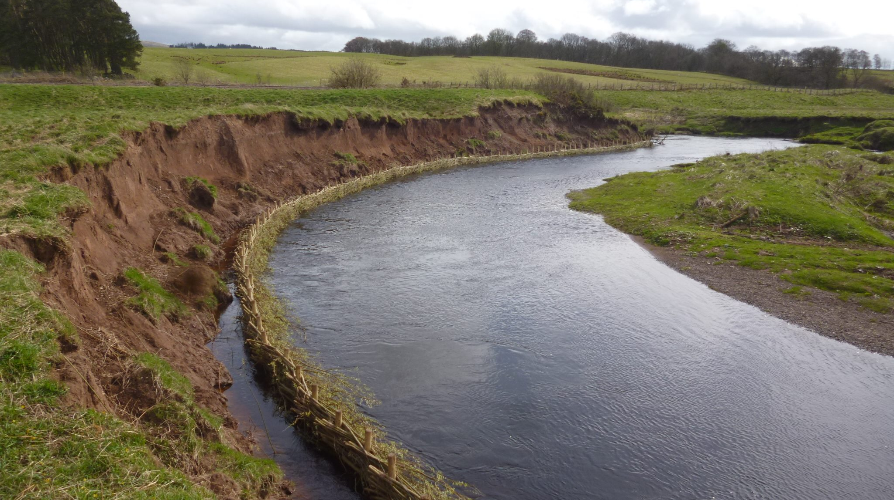
Nether Cambushinnie Bank Protection | Forth Rivers Trust

Slide 34
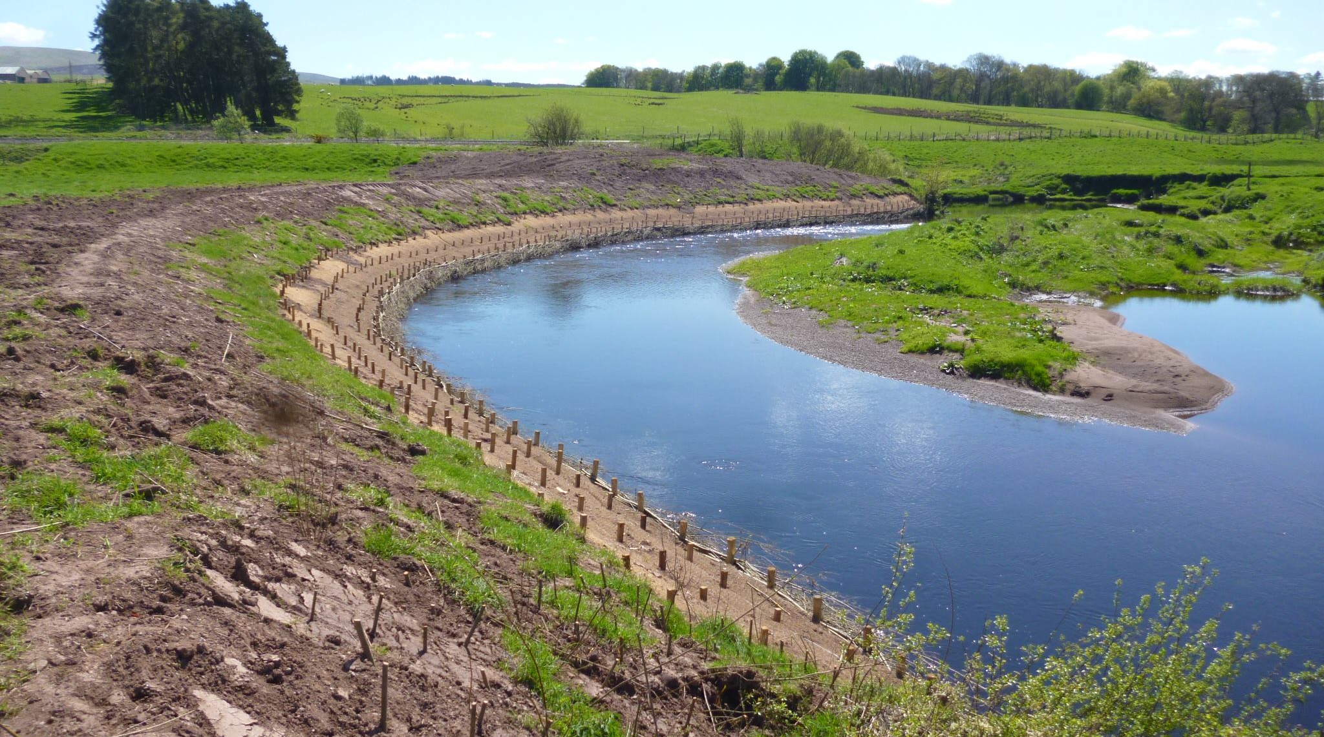
Nether Cambushinnie Bank Protection | Forth Rivers Trust

Slide 35
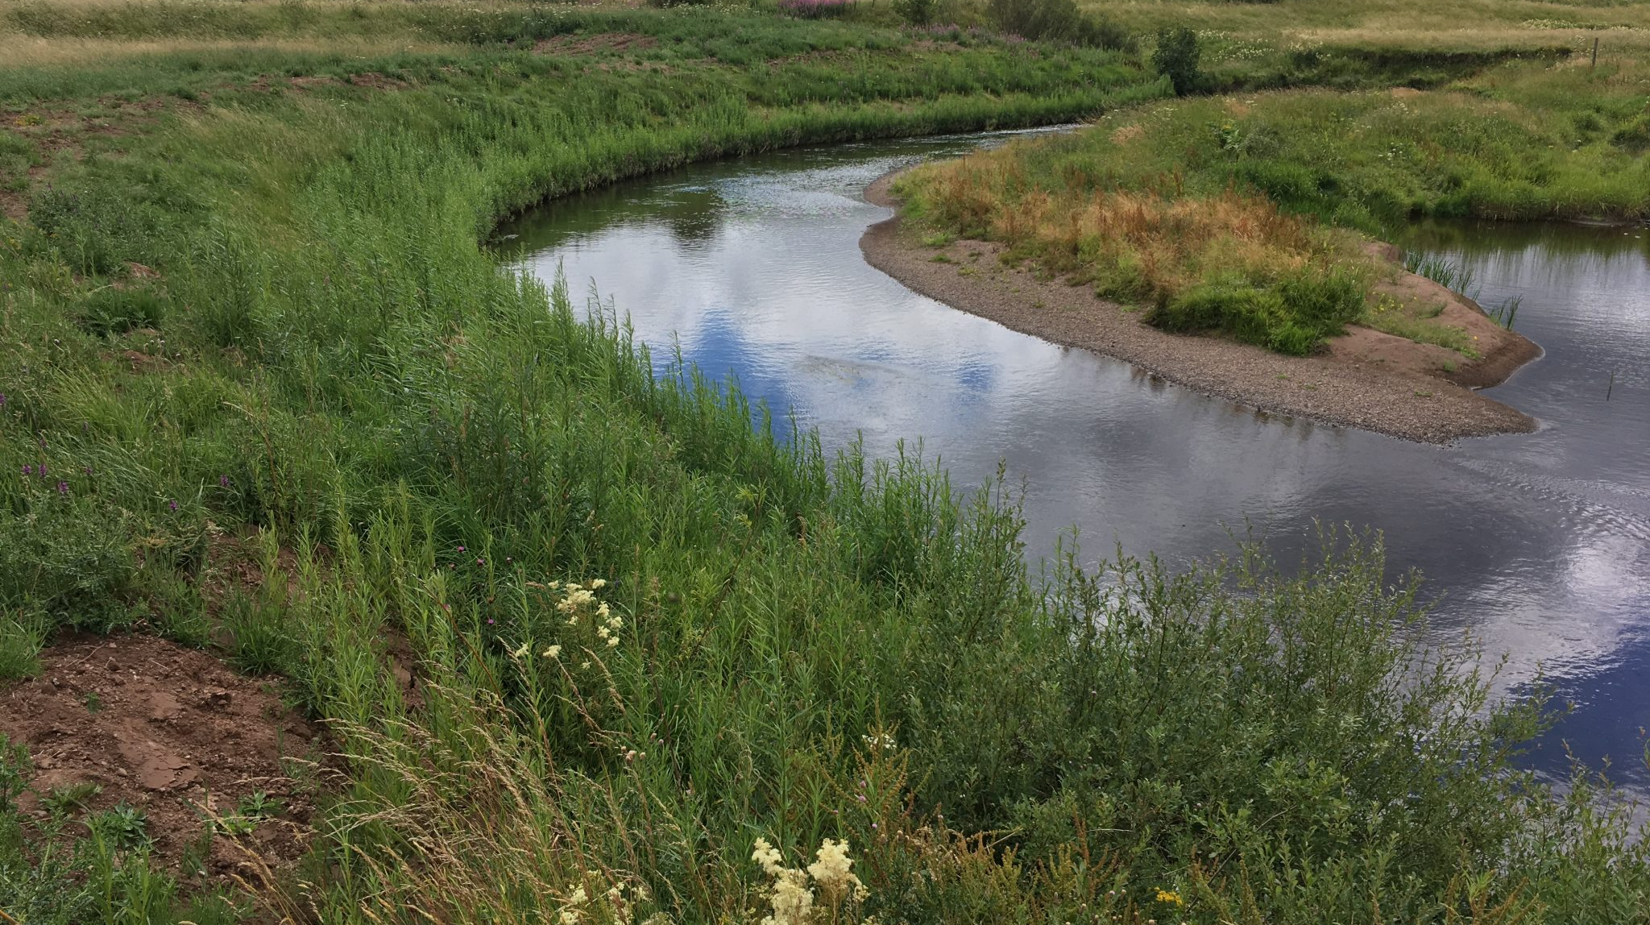
Nether Cambushinnie Bank Protection | Forth Rivers Trust

Slide 36
Soil hero
Fermented! Reintroduce fungi & micro organisms
Brewing a liquid full of microorganisms to bring that soil back to life!
Plant matter, compost and/ or animal manure fermented in water
Worm castings are considered especially rich in the good microorganisms.
Irrigate the area with the brew
This needs to be combined with adding organic matter to the soil, so that the microorganisms have a place to live.
When?
If plants grow poorly / little or no soil life / artificial fertilizer has been used

Slide 37
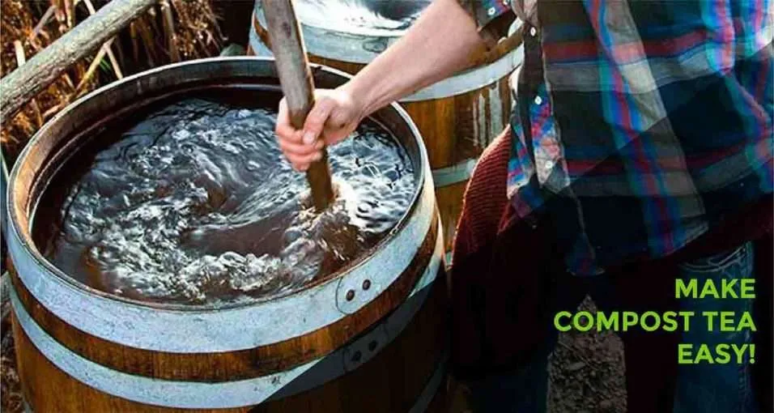
Unlocking Garden Success: Biodynamic Compost Tea and Dynamization Practice World Permaculture Association

Slide 38
Soil hero
Green Manure, Cover Crops, Legumes
Seeding beneficial plants that will cover the soil, make soil structure and/or increase available nutrition
Green manure will usually be cut and left on the surface, in a period where the soil is “resting” from agriculture
Cover crops can grow under other crops that will be harvested
Legumes are popular for both green manure & cover crops - bind nitrogen
When?
Wind erosion, big area with poor soil, compacted soil

Slide 39
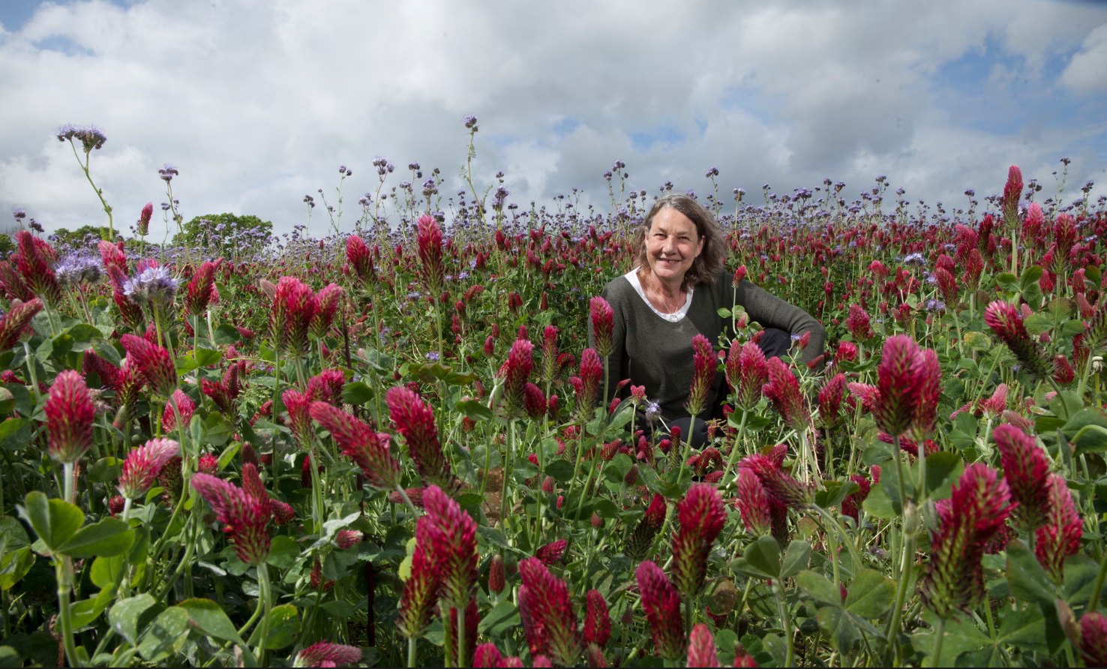
Green manure
Regenerative farmer Marina O'Connell
Photo: Karen Robinson/The Observer

Slide 40
Soil hero
Intensive care & rest
Some years of work to rehabilitate the soil and then run tests, before agricultural use.
deep rooted green manuring & adding lots of organic material
inoculating the soil with fungi, bacteria and other microorganisms again
combined with water retention landshaping or keyline ploughing
planting trees
When?
After extensive harm in the form of intensive monoculture agriculture with chemicals and even biocides (pesticides, fungicides, herbicides) that poison the soil life.

Slide 41
Additional materials and sources of information

Slide 42
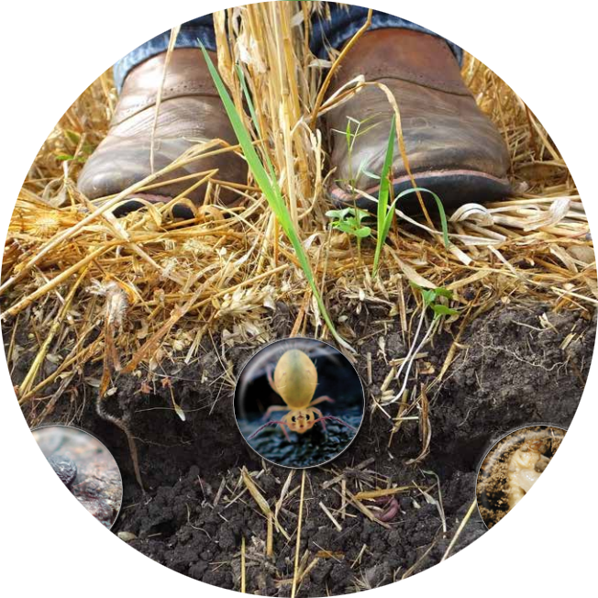
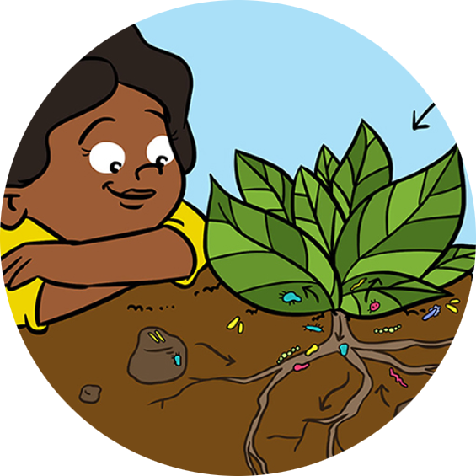
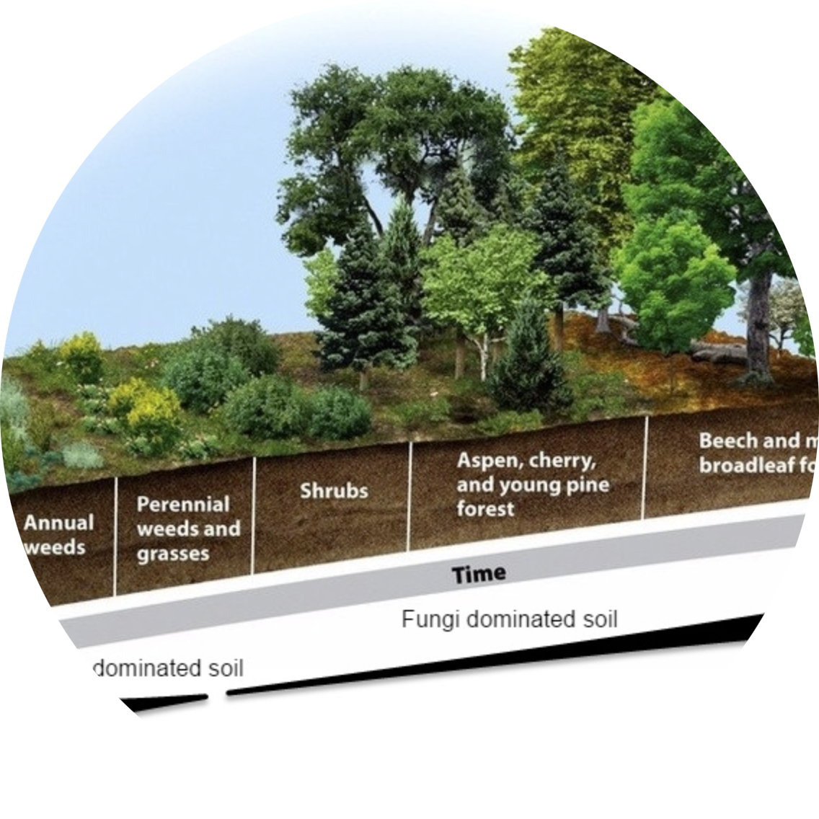
Farming with Soil Life: A Handbook for Supporting Soil Invertebrates and Soil Health on Farms
Who Feeds The Plants? Microbes! · Frontiers for Young Minds
Soil Building – How to Make Deep Rich Soils by Imitating Nature - Permaculture Apprentice
Kiss The Ground - videos
Find the film too!

Slide 43
Case study

Slide 44
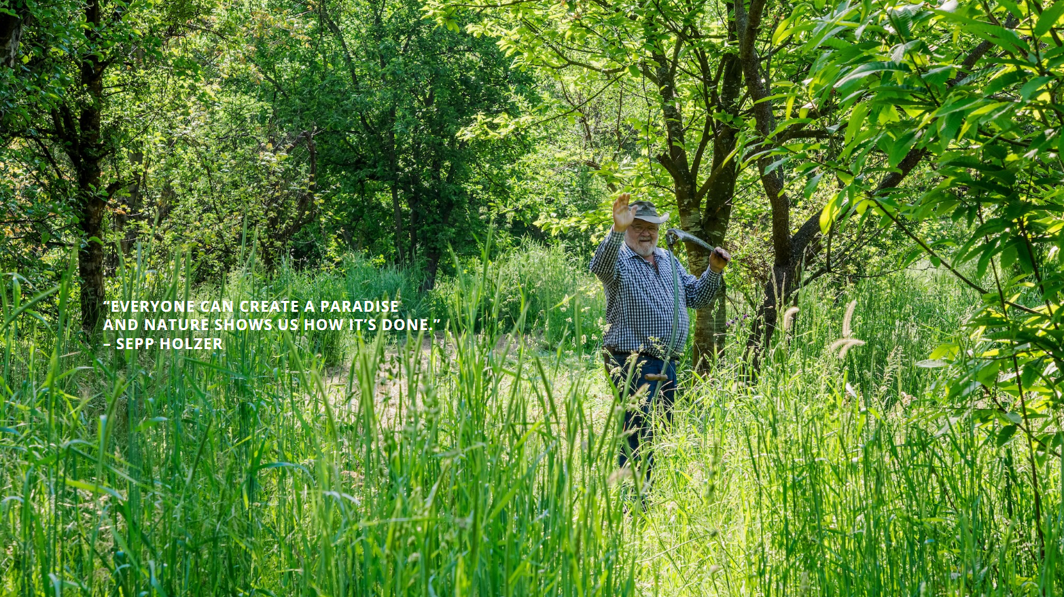
Sepp Holzer
Born & raised in Krameterhof
Fascinated by nature
https://seppholzer.at/en/

Slide 45
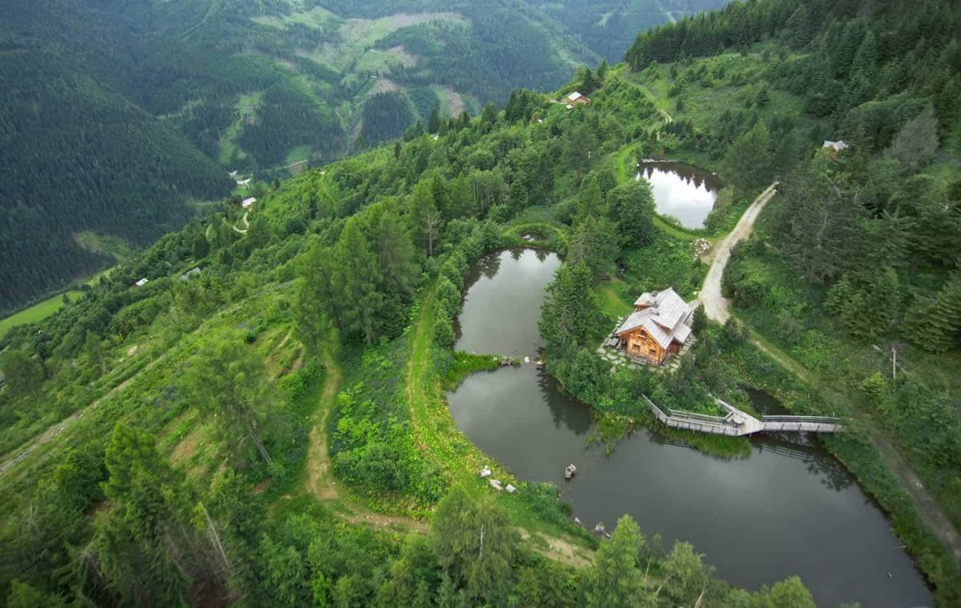
Krameterhof in Austria
https://krameterhof.at/en/

Slide 46
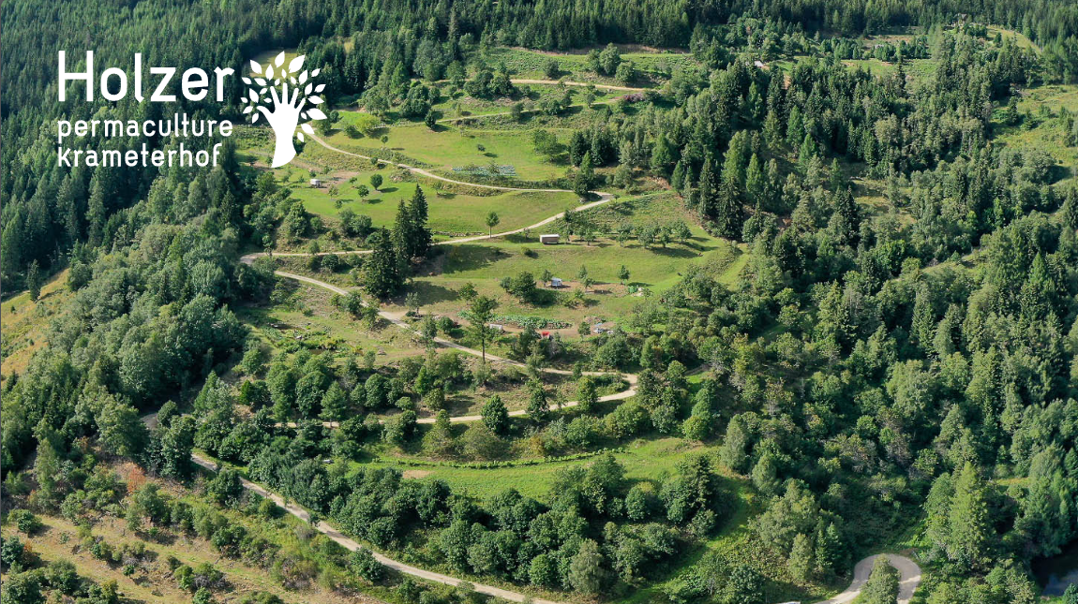

Slide 47
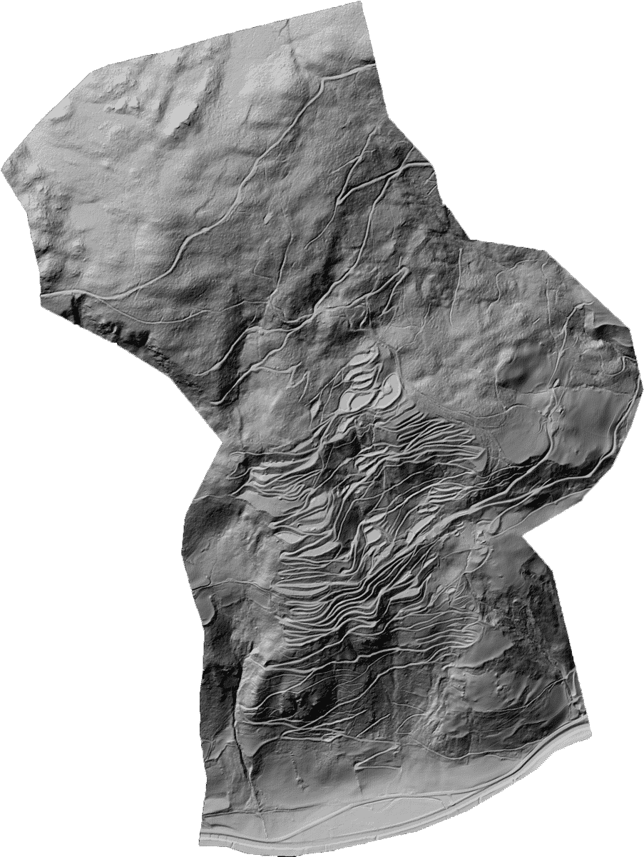
https://krameterhof.at/en/

Slide 48
https://krameterhof.at/en/

Slide 49
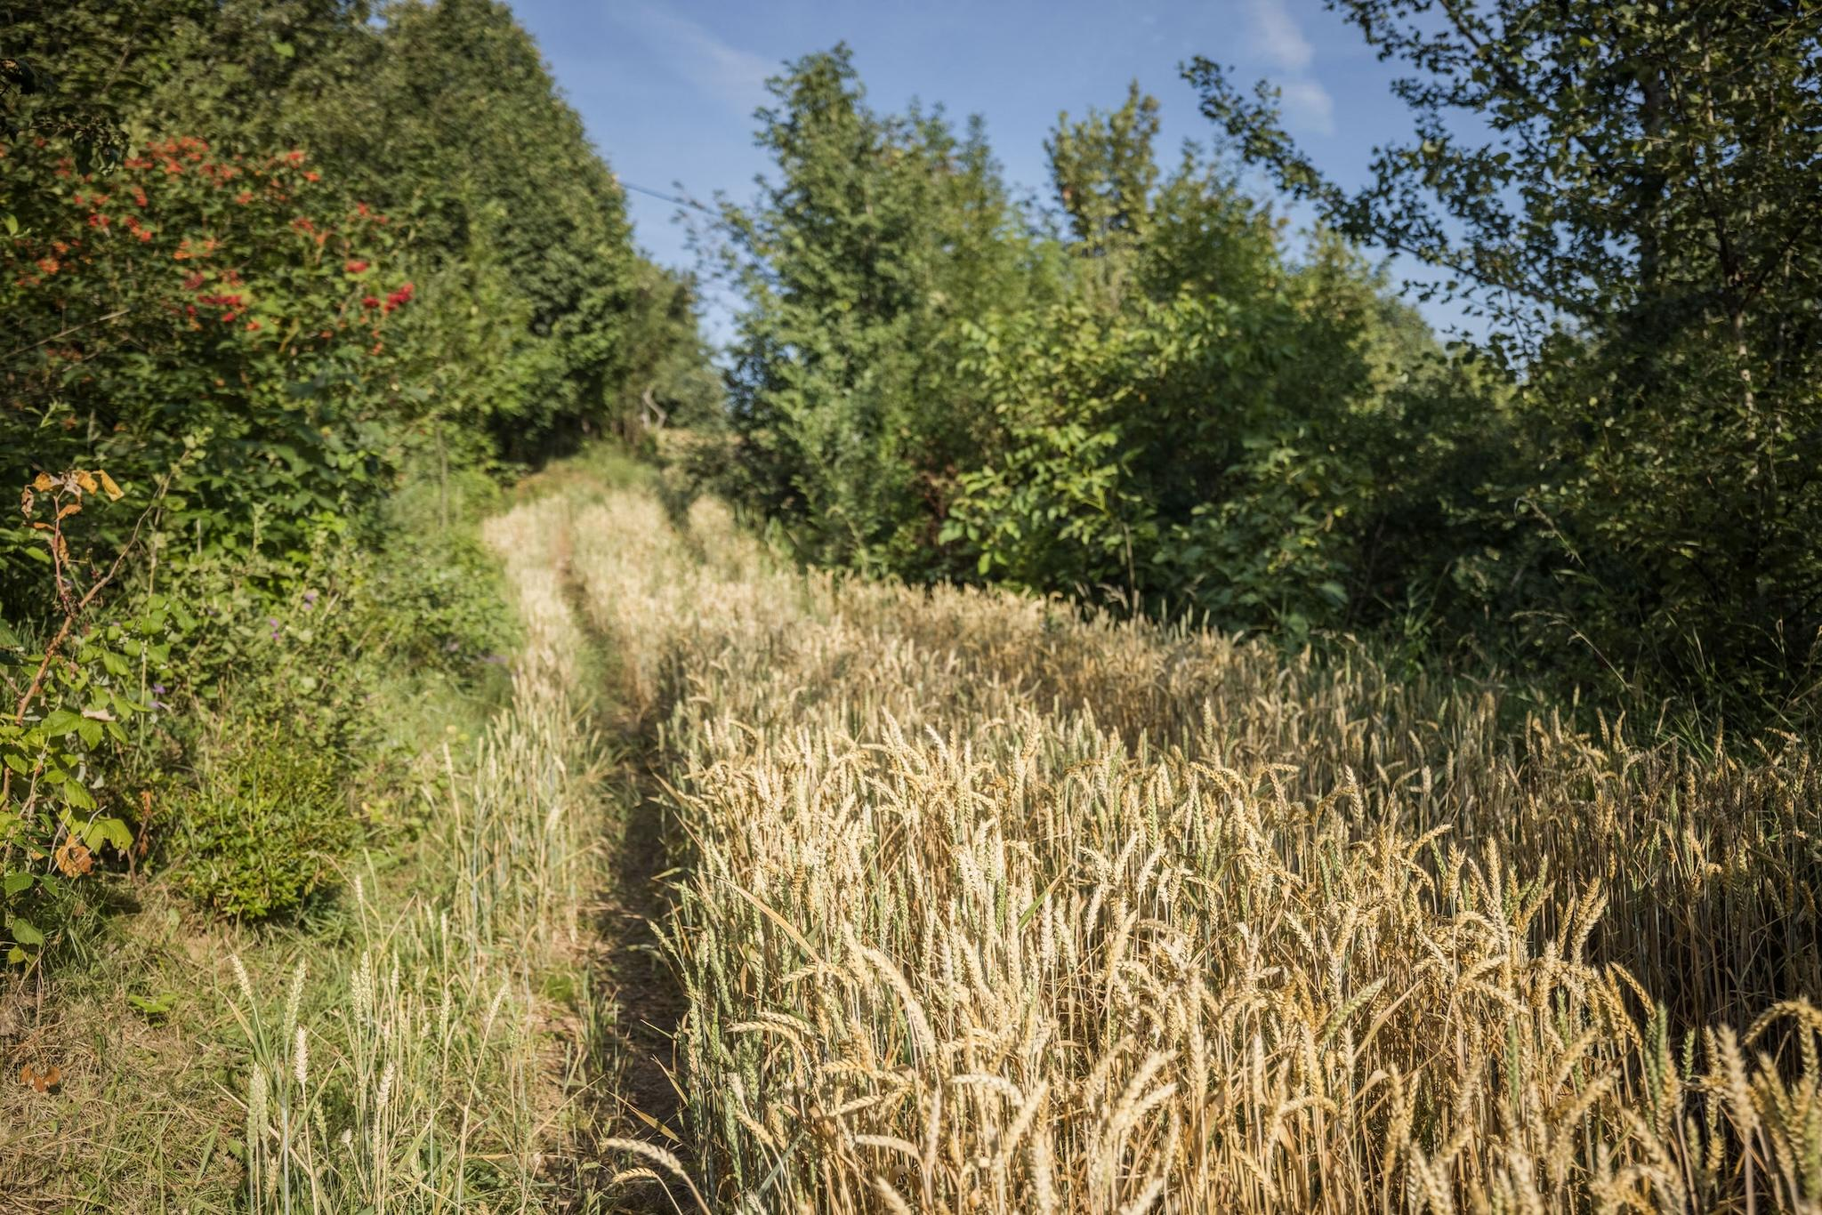
https://seppholzer.at/en/

Slide 50
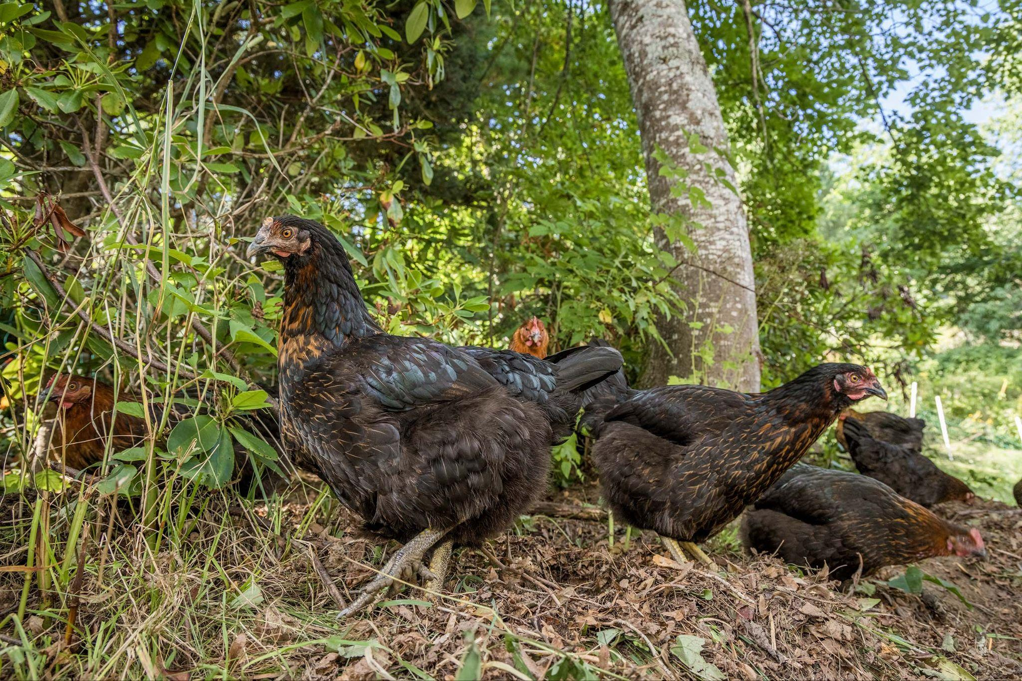
https://seppholzer.at/en/

Slide 51
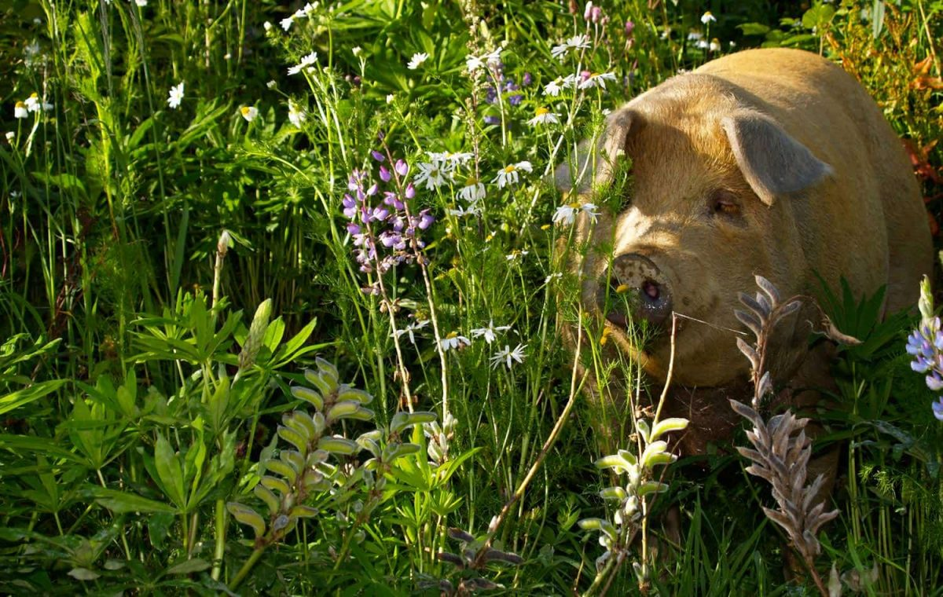
https://krameterhof.at/en/

Slide 52
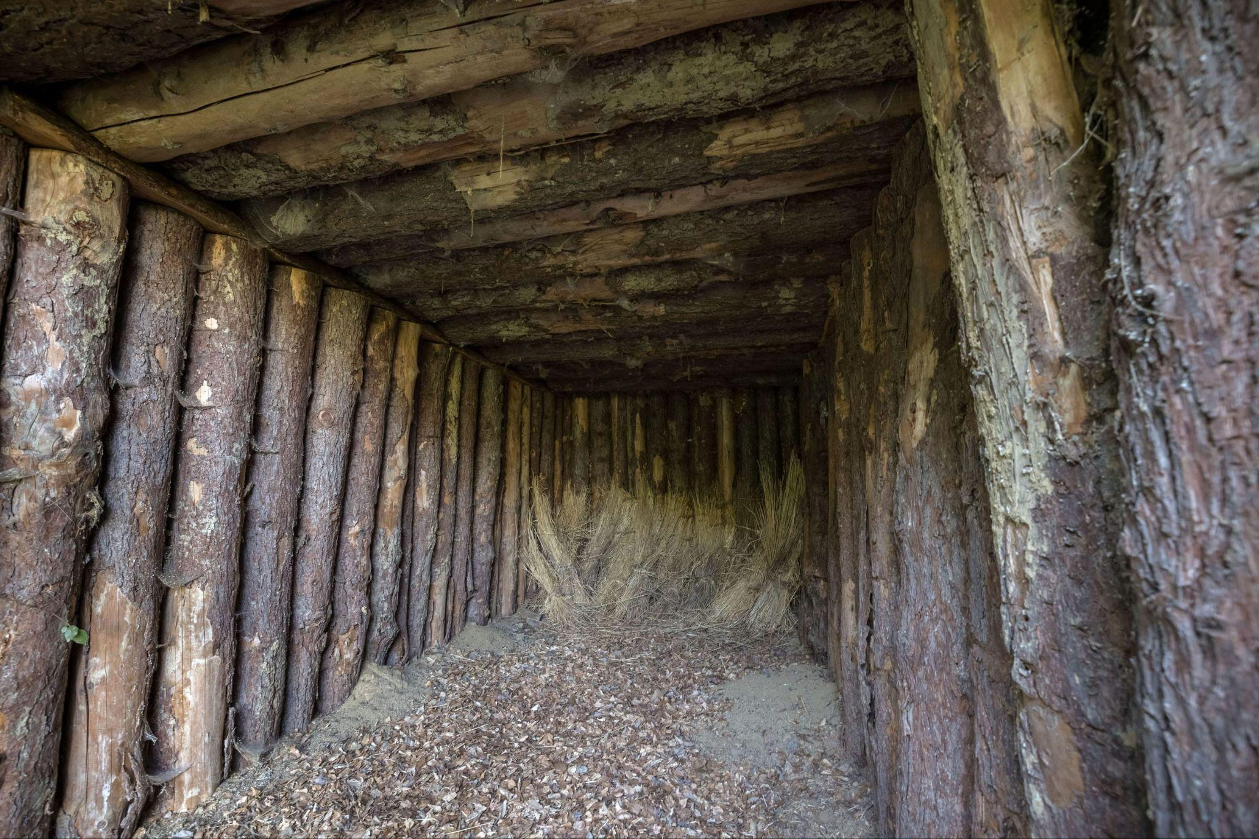
https://seppholzer.at/en/

Slide 53
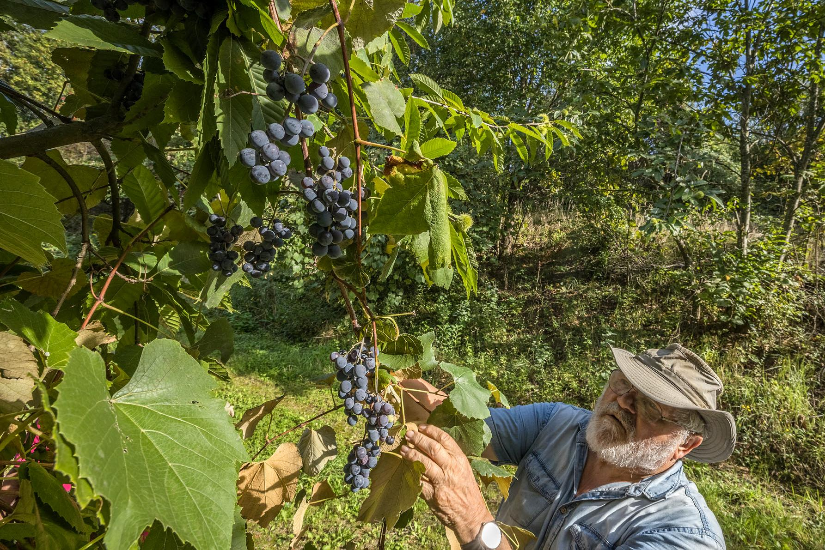
https://seppholzer.at/en/

Slide 54
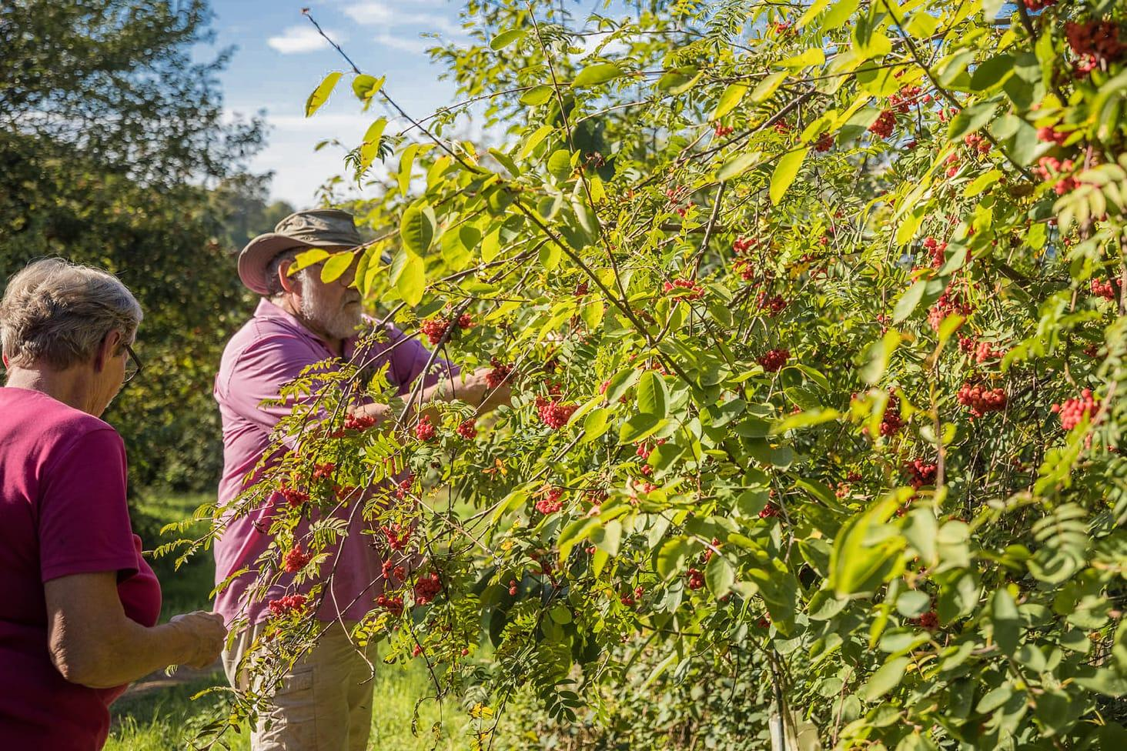
https://seppholzer.at/en/

Slide 55
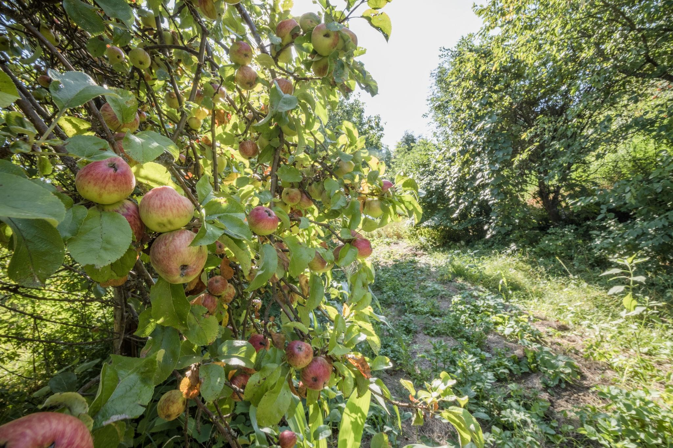
https://seppholzer.at/en/

Slide 56
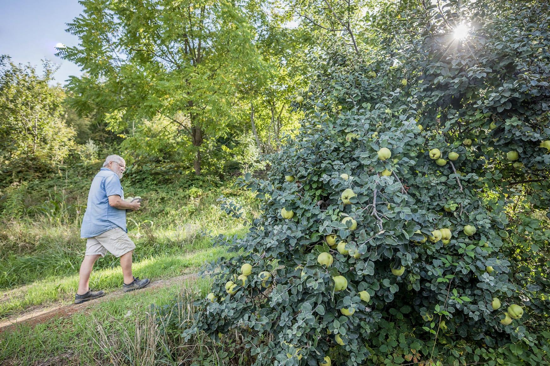
https://seppholzer.at/en/

Slide 57
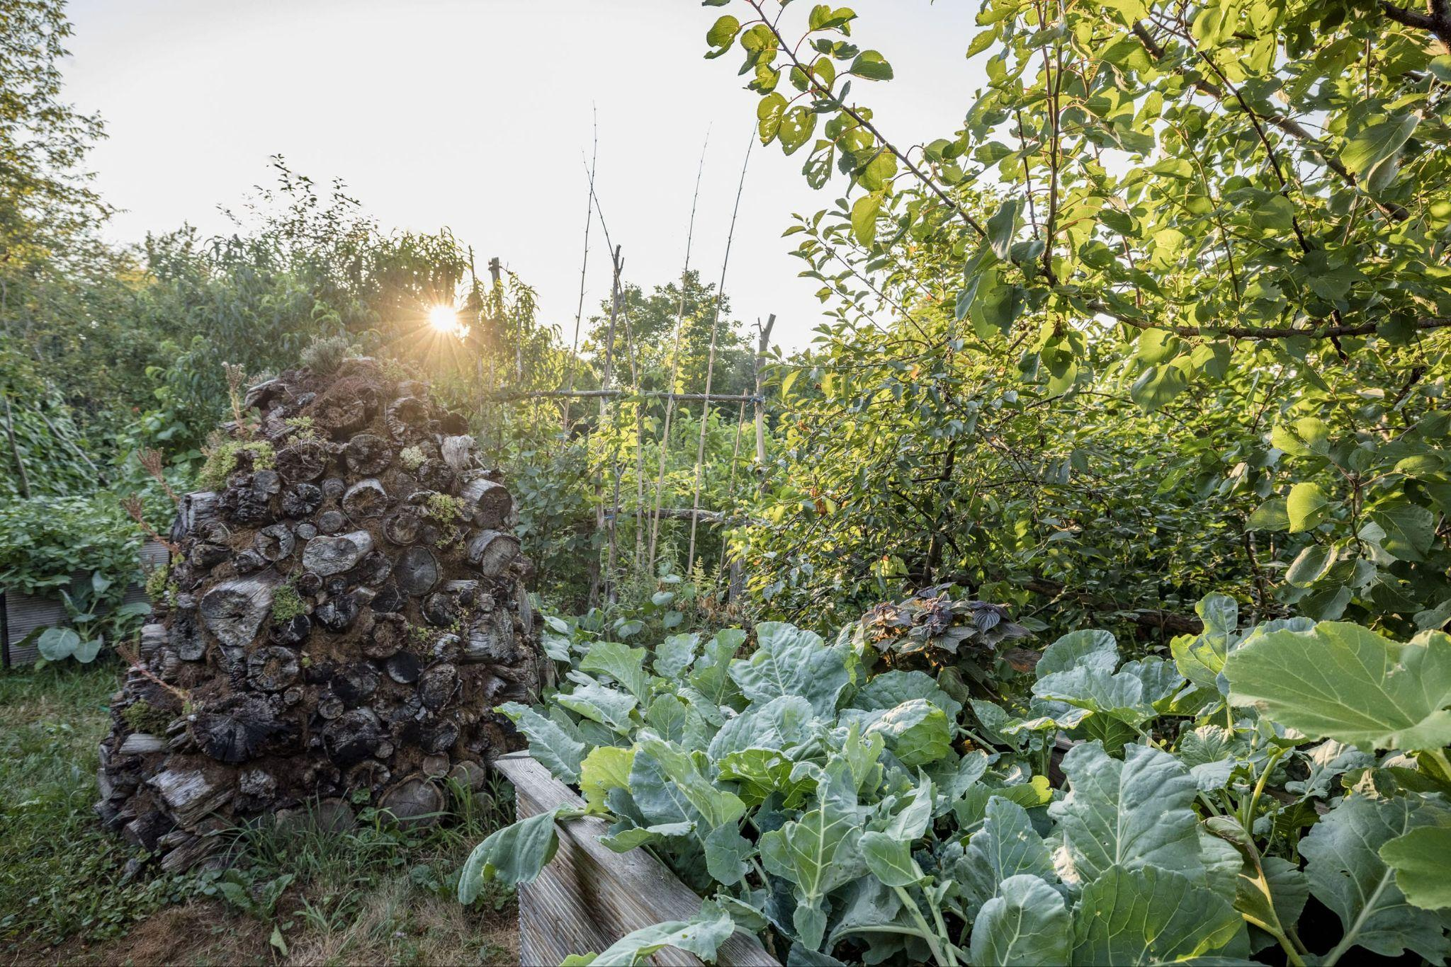
https://seppholzer.at/en/

Slide 58
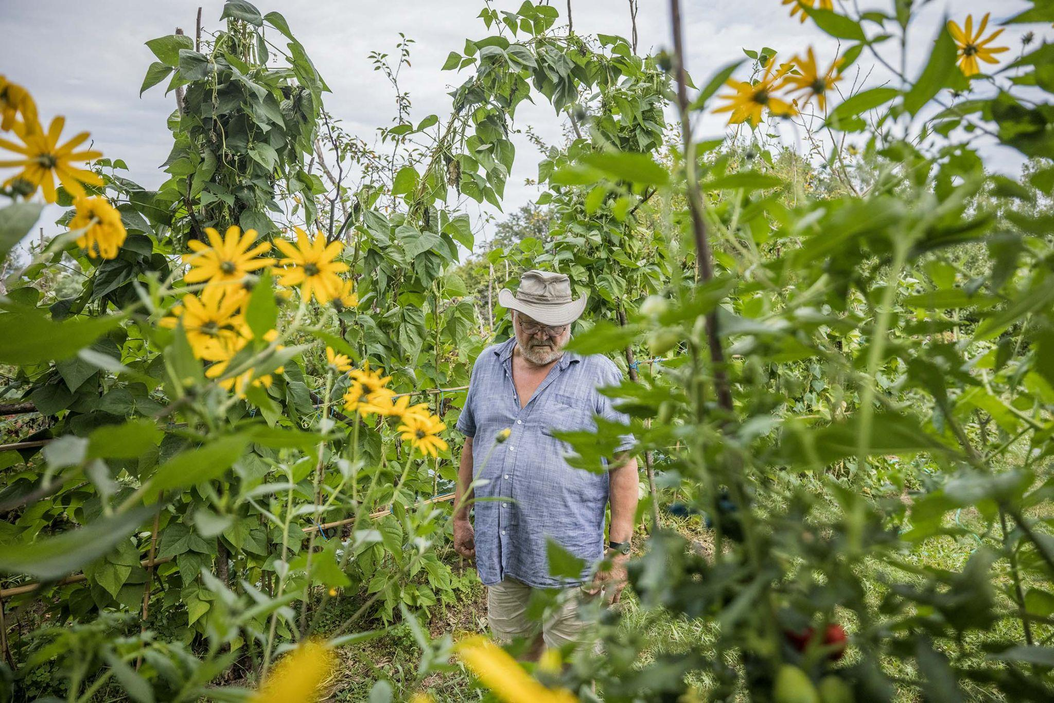
https://seppholzer.at/en/

Slide 59
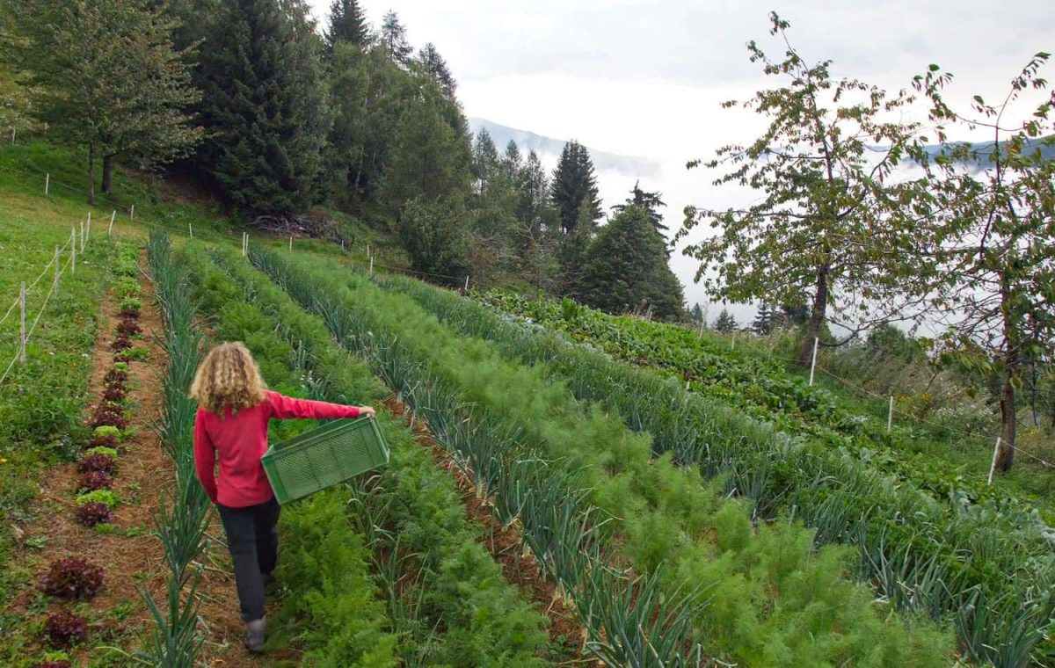
https://krameterhof.at/en/

Slide 60
Imagining and designing

Slide 61
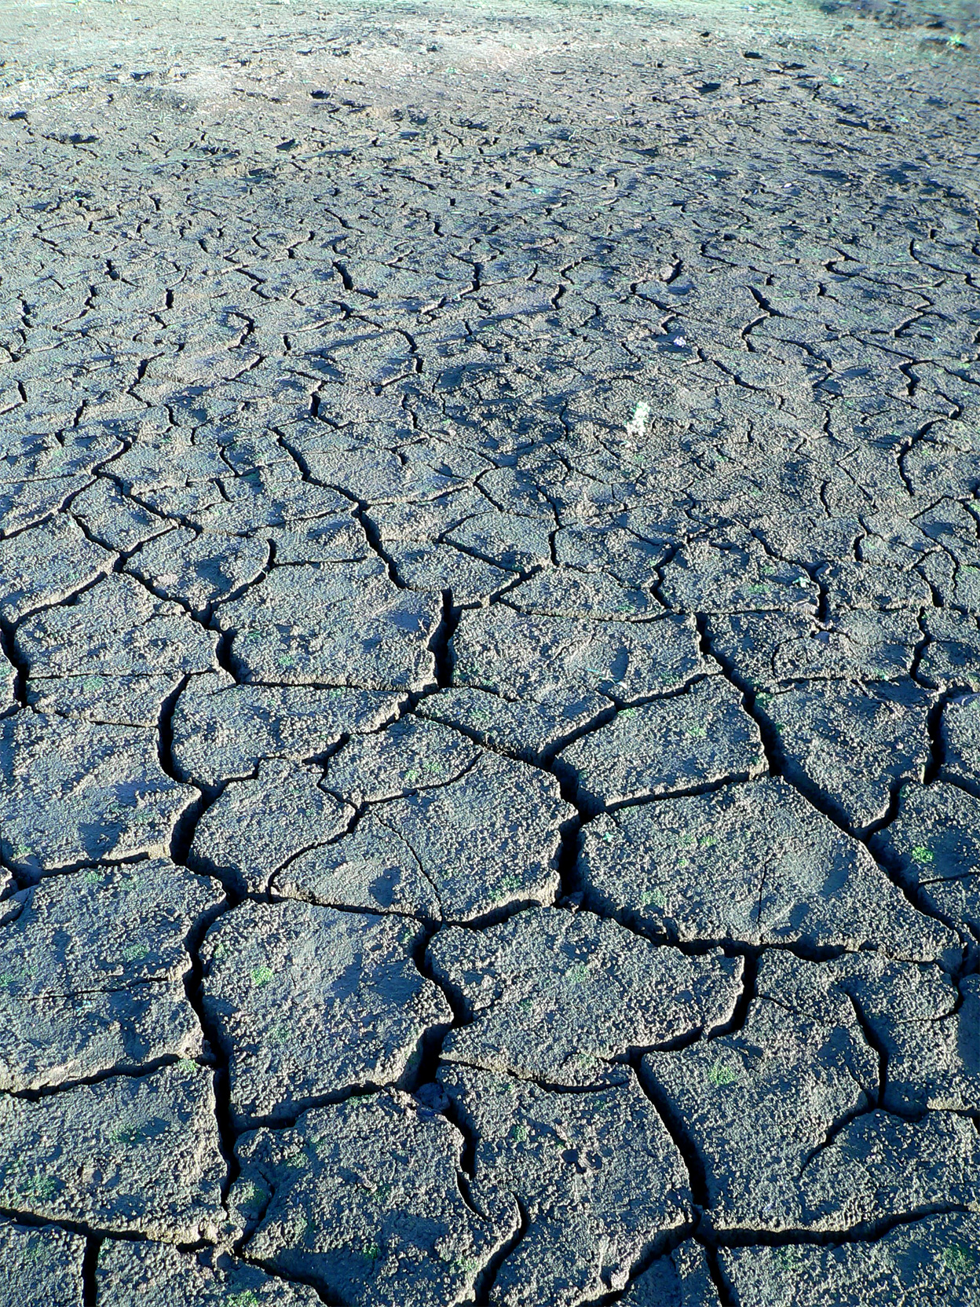
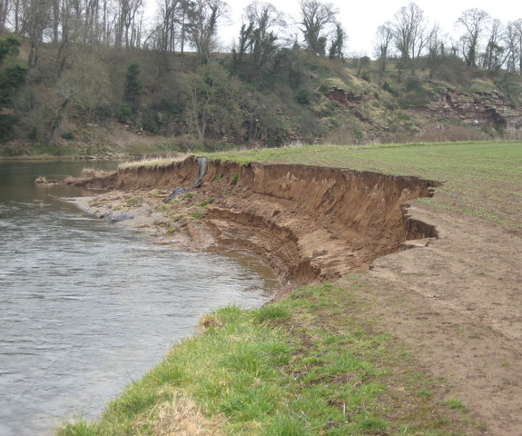
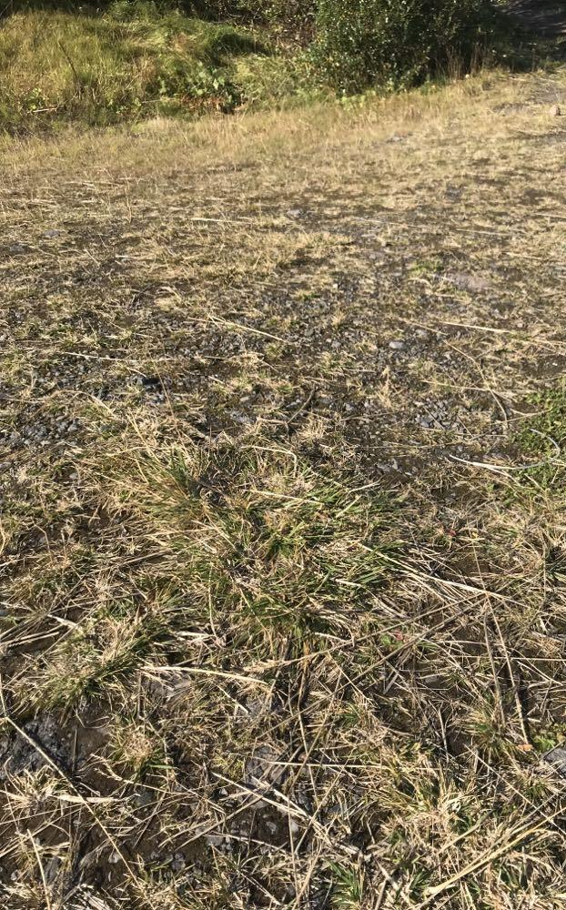
Make an action plan
for how to save the soil in these three locations
Photo by vikush on Freeimages.com
Photo Frank Smith www.geograph.org.uk

Slide 62
Dry & cracking soil
No life visible
How can you bring this soil back to life?
Few plants that are small and struggling
Almost no organic material, small stones visible on the surface
How can this soil be fertile again?
Active erosion from the river
Soil crumbles down into the river, nothing keeping it stuck
How can you get this soil healthy and keep it from eroding away?

Slide 63
Literature

Slide 64
Earth User’s guide to Permaculture by Rosemary Morrow
Farming with Soil Life: A Handbook for Supporting Soil Invertebrates and Soil Health on Farms
Burrowing-mammal-induced enhanced soil multifunctionality is associated with higher microbial network complexity in alpine meadows - ScienceDirect
The role of burrowing animals in the transport of mineral substances in the soil - ScienceDirect
https://www.apricotcentre.co.uk/

